Slide 1
Seamless SR
Shraddha Hegde
June 2021

Slide 2
Legal Statement
This statement of direction sets forth Juniper Networks’ current intention and is subject to change at any time without notice.
No purchases are contingent upon Juniper Networks delivering any feature or functionality depicted in this presentation.

Slide 3
AGENDA
Distributed Architecture
Seamless SR
BGP-CT
Automatic Filtering
Protection
Service Mapping
Label resources
Slicing
SRv6
Co-existence

Slide 4
DISTRIBUTED ARCHITECTURE
Intra domain TE Controller
Independent Domains
Loosely coupled
Highly scalable (order of 100k)
Widely deployed Seamless MPLS architecture
EBGP-LU
IBGP-LU
EBGP-LU
IBGP-LU
IBGP-LU
Core
PE1
ABR5
ABR1
ABR3
ABR7
PE5
Metro1
Metro 3
PE2
ABR6
ABR2
ABR4
ABR8
PE6
End to End Services: EVPN, IPVPN, IP
4

Slide 5
SEAMLESS SR
draft-hegde-spring-mpls-seamless-sr
E2E Intent Based paths
Automatic filtering of BGP prefixes
E2E protection including border nodes
Service mapping
Network Slicing
EBGP-CT
IBGP-CT
EBGP-CT
IBGP-CT
Core
Metro1
PE1
PE5
Metro 3
PE2
PE6
IGP-SR/flex-algo
SR-TE-MPLS (v4/v6)
IGP-SR/flex-algo
End to End Colored transport satisfying SLAs
RED Transport Class
BLUE Transport Class
GREEN Transport Class
5

Slide 6
BGP-CT
draft-kaliraj-idr-bgp-classful-transport-planes
New BGP Family
Uses RD to distinguish multiple paths
Uses Router Target community to indicate the Transport Class/color
Independent of VPN/ no VPN configuration needed
Prefix : PE5
RD: 5.5.5.5
RT: red
Label: L5
Nexthop; ABR1
Prefix : PE5
RD: 5.5.5.5
RT: red
Label: L4
Nexthop; ABR3
Prefix : PE5
RD: 5.5.5.5
RT: red
Label: L3
Nexthop; ABR5
Prefix : PE5
RD: 5.5.5.5
RT: red
Label: L2
Nexthop; ABR7
Prefix : PE5
RD: 5.5.5.5
RT: red
Label: L1
Nexthop; PE5
Core
PE5
VPN prefix: v1
RD: X
RT: Y
Ext color comm: Red
Label: Lv1
PE1
ABR1
ABR3
ABR5
ABR7
Metro1
Metro 3
PE2
ABR2
ABR4
ABR6
ABR8
PE6
SR-TE-MPLS (v4/v6)
SR-TE Label
Flex-algo label
SR-TE Label
Flex-algo label
L5
L4
L3
L2
L1
Lv1
Lv1
Lv1
Lv1
Lv1
Lv1
Data packet
Data packet
Data packet
Data packet
Data packet
Data packet
6

Slide 7
Automatic filtering
RR2
RR1
RR3
Service Prefix: 10.1.1.1
Pnh: 5.5.5.5
Color:Blue
BGP-CT: 5.5.5.5
RT:Blue
Based on service prefix PNH
Pull the BGP-CT route for PNH
Ability to aggregate the RTC route
RTC: 5.5.5.5
Color:Blue
Service Prefix: 10.1.1.1
Pnh: 5.5.5.5
Color: Blue
Core
ABR3
Metro 3
PE1
Metro1
ABR1
PE5
PE2
ABR2
ABR4
PE6
7
7
7
7

Slide 8
Resiliency
ABR1:
50.50.50.50
Label L3
Pnh: 30.30.30.30
RT: 100:1
ABR3:
50.50.50.50
Label L2
Pnh: 40.40.40.40
RT: 100:1
PE5:
50.50.50.50
Label L1
Pnh: 50.50.50.50
RT: 100:1
Node and link failure of internal nodes
Border node failure
Egress node failure
Anycast loopback 30.30.30.30
Metro 3
Metro1
Anycast loopback 40.40.40.40
PE1
ABR1
Core
ABR3
PE5
Anycast loopback 50.50.50.50
PE2
ABR2
ABR4
PE6
ABR3:
50.50.50.50
Label L3
Pnh: 30.30.30.30
RT: 100:1
ABR4:
50.50.50.50
Label L2
Pnh: 40.40.40.40
RT: 100:1
PE6:
50.50.50.50
Label L1
Pnh:50.50.50.50
RT: 100:1
8
8
8
8

Slide 9
Service mapping
Service mapping
Color based
Cos based
Filter Based Forwarding
Fallback options
By default resolve on specific color
If no specific color, fallback to best effort
Ability to fallback to another color
Ability to drop traffic on non-availability of intent paths
Core
PE1
ABR1
ABR3
ABR5
ABR7
PE5
Metro1
Metro 3
ABR2
ABR4
ABR6
ABR8
PE2
E2E service EVPN/L3VPN
PE6
Dscp class 1
Src:add, port src port, dst port 100
Ext color com red
Ext color com blue
Dscp class 2
Color based mapping
CBF mapping
FBF mapping
Ext color com green
Dscp class 3
fallback
default
9

Slide 10
USECASES: E2E LOW LATENCY ROUTING
Intra-domain low latency routing
TWAMP based dynamic latency measurements
Accumulated latency metric carried in AIGP attribute
Acc latency:
35+5 =40
Accu latency:
15 +20 =35
Accu Latency:
10 +5 =15
Latency metric :10
Acc Latency:
40 +2=42
IBGP
IBGP
Core
PE1
ABR1
ABR3
ABR5
ABR7
PE5
Metro1
Metro 3
ABR2
ABR4
ABR6
ABR8
PE6
PE2
Acc latency:
32+2 =34
Acc Latency:
12 +20 =32
Acc Latency:
10 +2 =12
Latency metric :10
Acc Latency:
34 +1=35
10

Slide 11
MPLS Label Resource
Nexthop unchanged from nodes under label resource constraint
ABRs may be configured to advertise BGP-LU/BGP-CT labels for local domain and core nodes
For remote domains nexthop unchanged
Dynamic and distributed way to build lable stacks
Nh-unchanged
BGP-CT:
Prefix:PE5
RT: Red
Pnh: ABR5
Label: L2
BGP-CT:
Prefix:PE5
RT: Red
Pnh: ABR5
Label: L2
BGP-CT:
Prefix:PE5
RT: Red
Pnh: PE5
Label: L1
PE1
ABR3
Core
ABR5
PE5
Metro1
Metro 3
Recursive route resolution on PE1:
BGP-CT for PE5 resolves on another BGP-CT advertised by ABR5
ABR4
PE2
ABR6
PE6
Intra-domain
LABR5
L2
VPN label
Data packet
11

Slide 12
SRv6 : Summarization and Leaking
aggregate {
defaults {
... aggregate-options ...
}
route destination-prefix {
policy policy-name;
... aggregate-options ...
}
}
Extremely simple to implement and deploy
Low end access devices need to store a very few number of routes
End-to-end best effort paths
Can be used for
E2E flex-algo paths
Cannot be used for
E2E TE paths
Traffic can blackhole if the remote border or PE device goes down
Prefix independent convergence feature cannot be used
Domain 1
Domain 2
Domain 3
A0:32::/48
A0:30::/48
A0::/16
PE2
PE3
C2
C3
PE1
C1
C4
PE0
PE4
C0
C5

Slide 13
SRv6 : E2E option C connectivity with BGP
prefix: A:PE5:END.DT4:1
Nexthop :ABR5 loopback
SID: A:ABR5:END:1(usd)
prefix: A:PE5:END.DT4:1
Nexthop :ABR3 loopback
SID: A:ABR3:END:1(usd)
prefix:
A:PE5:END.DT4:1
Nexthop PE5 loopback
Color com: red
SID: A:PE5:END:
Separate 128 bit End SID for each transport class.
Advertise these 128 bit addresses in
BGP AFI 2 SAFI 1
Service prefixes use corresponding END.DT4 SID
IBGP
IBGP
Core
PE1
PE5
Metro1
Metro 3
ABR3
ABR5
PE2
ABR4
ABR6
PE6
SRv6
SRv6
SRv6
13

Slide 14
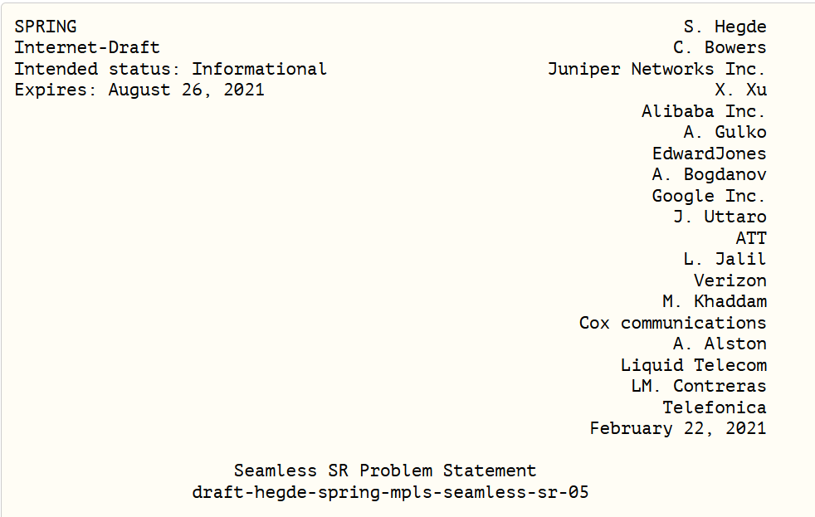
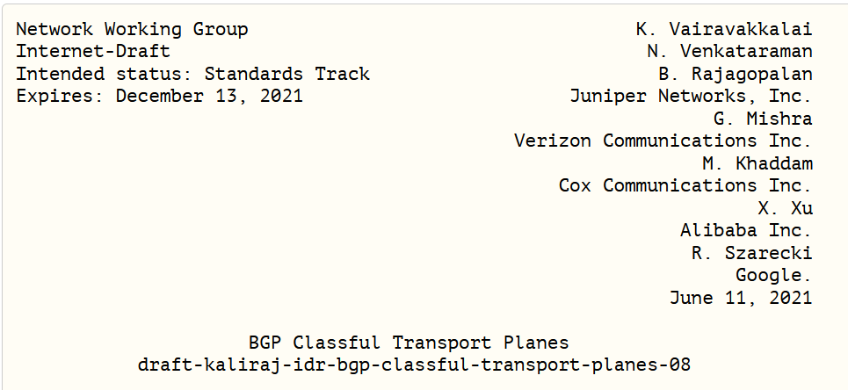
IETF update
Seamless SR draft in SPRING WG posted more than an year ago
BGP-CT draft in IDR posted more than an year ago
Lot of interest from service provides, cloud and enterprise customers

Slide 15
CO-EXISTENCE of centralized and distributed archItecures
FLEXS
5G network functions with stringent requirements
Paths with latency bounds
Seamless SR
L3VPN/L2VPN services running Access to Access
Paths going to other networks
Connectivity to3rd party Cache/ Public cloud
Transit through co-operating domains
Flex-algo 128
FLEXS Tunnels
Flex-algo 129
BGP-CT Tunnels
BGP-CT Tunnels
3rd party cache
CDC
LDC
RDC
Public cloud
LDC
RDC
Access
Aggregation
Core

Slide 16
FLEXS & SEAMLESS SR
Intra domain TE Controller
IBGP-CT
IBGP-CT
Core and aggregation with ISIS L2 and L1
SR-TE/RSVP in the core for granular TE
ISIS L1 domains in the aggregation with IGP-SR/Flex-algo
Metros with multi-instance IGP with IGP-SR/flex-algo
Express Segments provide E2E SLA paths in the core domain
BGP-CT to provide E2E connectivity
IBGP-CT
FLEXS Tunnel
Access
Access
Core
ISIS 3
ISIS 2
Agg
ISIS L2
ISIS L1
PE1
ISIS L1
Agg
PE5
Metro1
Metro 3
PE2
PE6
IGP-SR/flex-algo(v4/V6)
IGP-SR/flex-algo(v4/V6)
SR-TE (v4/V6)/RSVP
IGP-SR/flex-algo(v4/V6)
IGP-SR/ flex-algo (v4/V6)

Slide 17
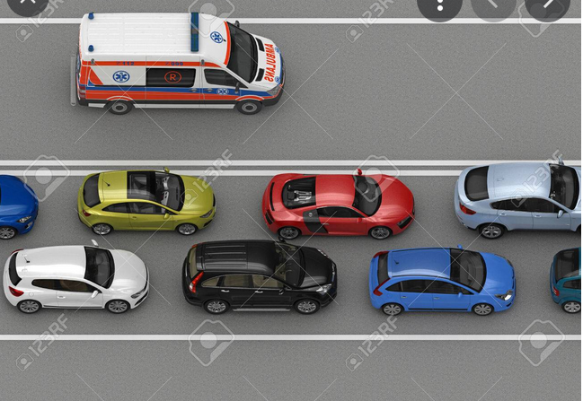
NETWORK SLICING
How do 5G network requirements translate to transport network SLAs?
What enhancements are needed for an IP transport network to meet new 5G requirements?
What new differentiation in service offerings can network providers offer on top of their existing network infrastructure?

Slide 18
Network Slicing
Transport independent network slicing solution
Dedicated/shared queueing
Traffic control profiles
Minimum latency/jitter
Slice indicators
Slice steering policies
Ingress shapers/policers
Per-hop behaviour
Controller/Orchestrator
GW
GW
GW
A
GW
A
Access
PE
Pre-Agg
PE
Agg
PE
Metro
PE
Core
Multi-Domain(AS/Area/Level) End-to-End Network

Slide 19
Resource information
Contact info
shraddha@juniper.net
IETF draft links
https://datatracker.ietf.org/doc/draft-hegde-spring-mpls-seamless-sr/
https://datatracker.ietf.org/doc/html/draft-hegde-spring-seamless-sr-architecture-00
https://datatracker.ietf.org/doc/draft-kaliraj-idr-bgp-classful-transport-planes/
Migrating to Segment Routing Day-one book
https://www.juniper.net/documentation/en_US/day-one-books/DO_MigrateSR.pdf
Blogs
https://blogs.juniper.net/en-us/industry-solutions-and-trends/seamless-segment-routing-sr-networks
https://blogs.juniper.net/en-us/industry-solutions-and-trends/seamless-segment-routing-sr-use-cases

Slide 20
THANK YOU

