Slide 1
Juniper Apstra 4.2.1 EVE-NG Virtual Lab Demo Video series companion guide Video 8: Day-1 DCI Addendum – Direct Peering
Colin Doyle, Sr. CE AMER
See the complete video walkthrough on YouTube at: https://www.youtube.com/@5minutejunos
Ask questions at the Juniper Elevate Community using the hashtag #5minutejunos
Adapted from v4.0.0 documentation originally compiled by: - Raymond Lam, SSE APAC - Tony Chan, SSE APAC

Slide 2
Agenda
Prepping your Lab
Day-0 Fabric Onboarding
Virtual Device Profile Verification
Virtual Device Profile Cloning
Onboarding Virtual Nodes
Create ASN Pool and IP Pools
Create Logical Devices and Interface Maps
Create Rack Types
Create Templates
Create Blueprints
Day-1 Service Provisioning
Create Routing Zones
Create Virtual Networks
Assign Virtual Network to Switchports
Add Server Links
Data Center Interconnect
DCI Addendum: Direct Peering
Core/WAN Connectivity
Internet Connectivity
Day-2 Operational Scenarios
Incorrect Cable Patch (RCA, LLDP Link Discovery, Time Voyager)
Config Deviation Checking
Apply custom config through Configlet
View Telemetry Data
Hardware Replacement
Future Documentation
Firewall Service Chaining
Cluster with Service Block
Type-5 Route (fabric integrated) with MNHA
VLAN Stitching
vEvo Fabric

Slide 3
Day-1 Service Provisioning
Create Routing Zones
Create Virtual Networks
Assign Virtual Network to Switchports
Add Testing Hosts
Data Center Interconnect (OTT)
DCI Addendum – Direct Peering
Core Connectivity
Internet Connectivity

Slide 4
DCI Addendum: Direct Peering – Underlay
While working with a customer to build a physical lab, I was asked about direct DCI between fabrics. Like our lab, the customer has two fabrics. Unlike our lab, rather than having OTT DCI with intermediate layer-3 routers, their border leafs were directly connected. In a production scenario, you might see this design when two fabrics are physically adjacent to each other in the same data center, or if the DCI link between geographically separated fabrics is a Layer-2 service.
The workflow to do this is different than the OTT workflow and is worth reviewing. In our lab, we’ll create a single link between spines in DC-A and DC-B, something we can do since we don’t need any VXLAN gateway functionality for this to work (NOTE: this works on leafs as well). Once the the underlay is built, the overlay configuration will use the same workflow defined in the previous section to share type-2/3 routes between fabrics.
A-border1
A-border2
B-border1
B-border2
A-spine1
A-spine2
ge-0/0/5
B-spine1
B-spine2
ge-0/0/5
A-leaf1
A-leaf2
B-leaf1
B-leaf2

Slide 5
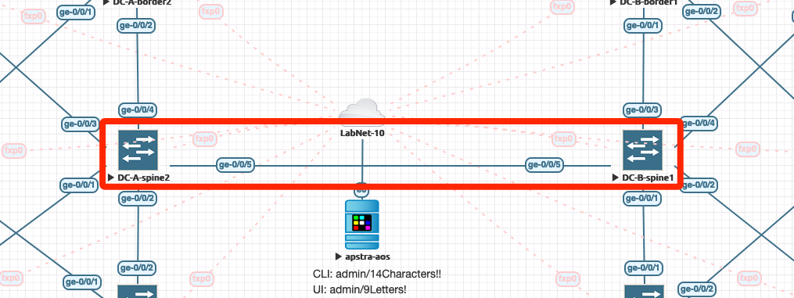
DCI Addendum: Direct Peering – Underlay
Start by creating a link between:
DC-A-spine2: ge-0/0/5
DC-B-spine1: ge-0/0/5

Slide 6
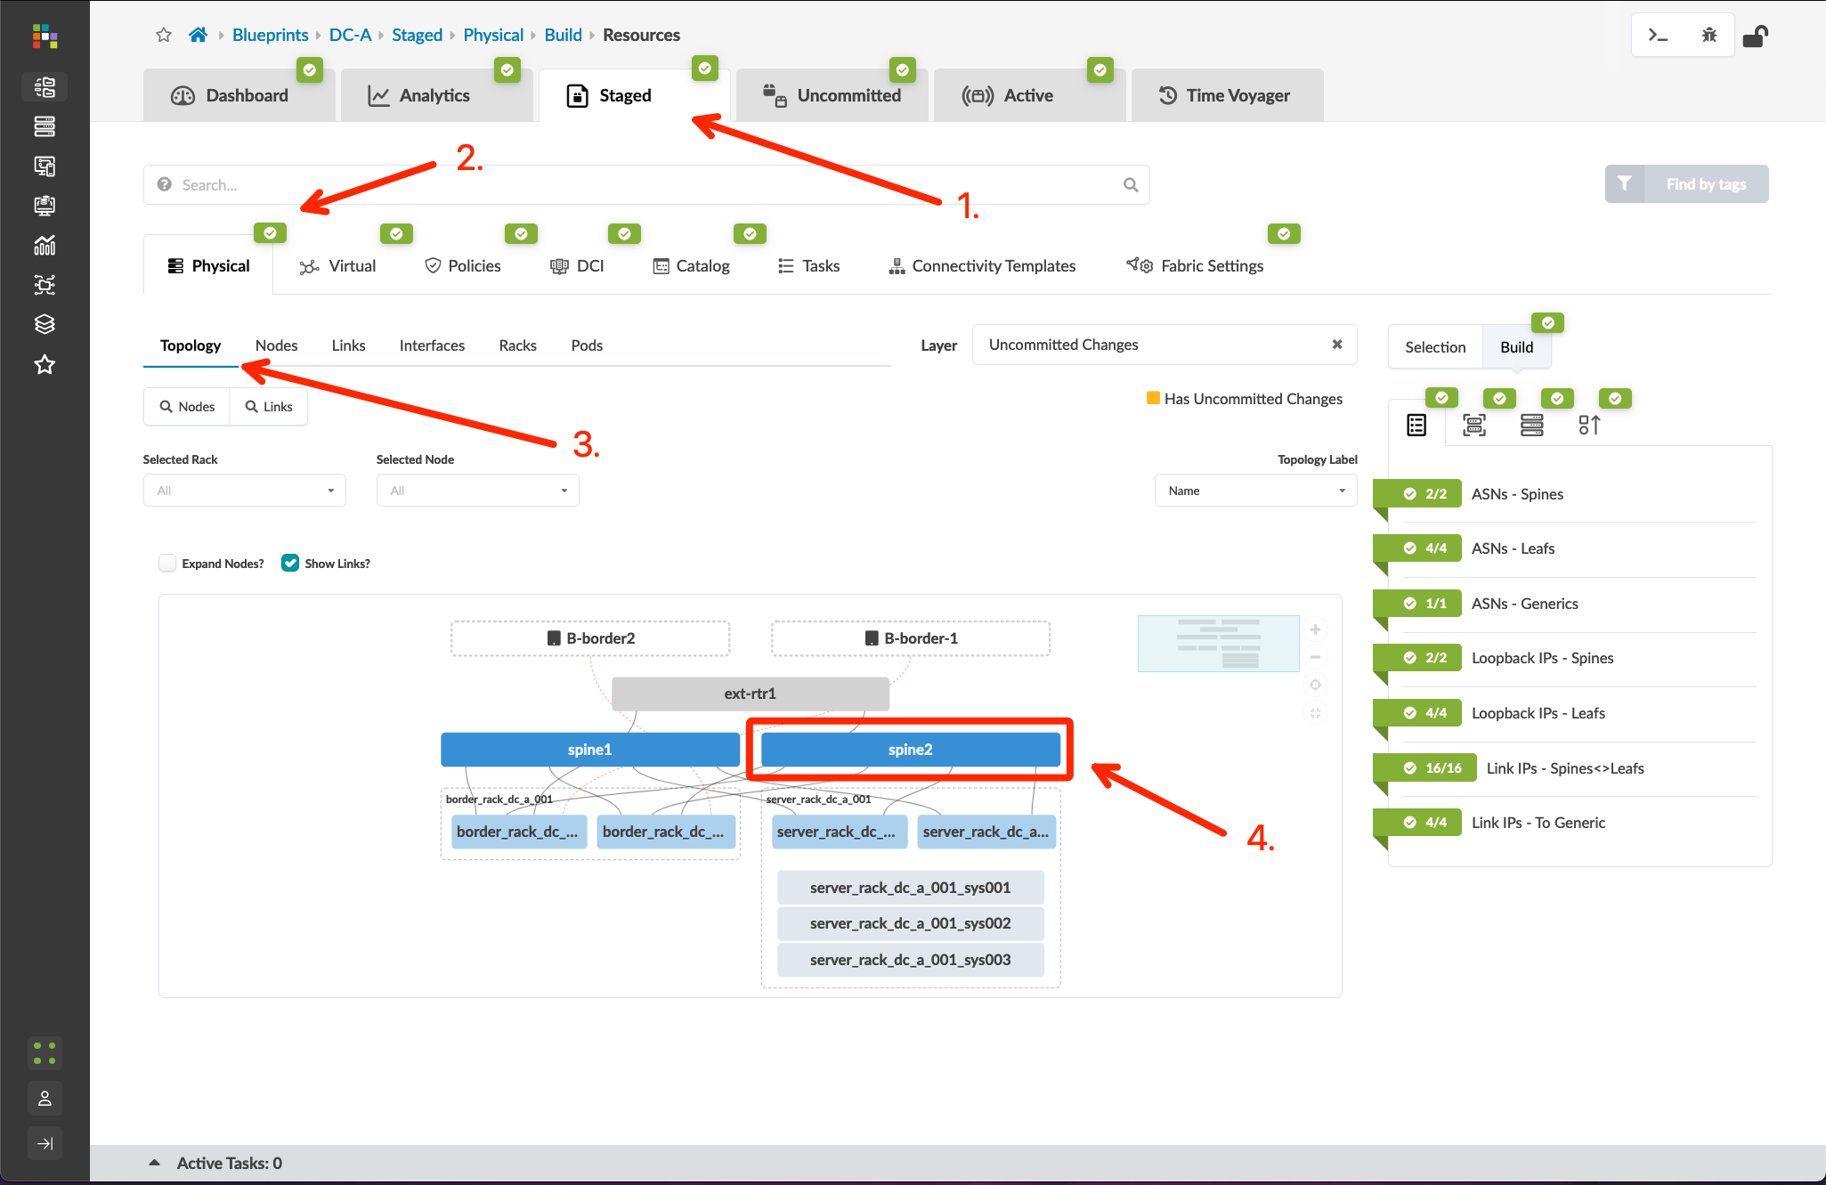
DCI Addendum: Direct Peering – Underlay
Go to Blueprints > DC-A > Staged > Physical > Topology, and click “spine2”
Click the checkbox for the border rack node and select “Add external generic system”
Create a new external generic system called DC-B-Spine1, select “None” for the device representation, and click Next
Select port 5 on spine2, click the port icon followed by the “Add Link” button, then click “Create”
Click “DC-B-Spine1”, open the properties page to edit the ASN, and set it to 65200. You can verify this by navigating to Blueprints > DC-B > Staged > Physical > Nodes and viewing the ASN assignment for spine1

Slide 7
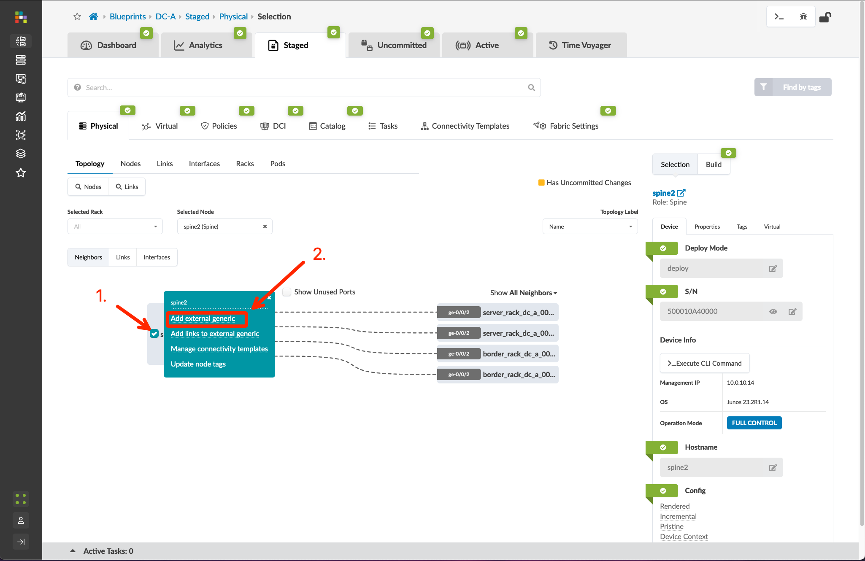
DCI Addendum: Direct Peering – Underlay
Go to Blueprints > DC-A > Staged > Physical > Topology, and click “spine2”
Click the checkbox for the border rack node and select “Add external generic system”
Create a new external generic system called DC-B-Spine1, select “None” for the device representation, and click Next
Select port 5 on spine2, click the port icon followed by the “Add Link” button, then click “Create”
Click “DC-B-Spine1”, open the properties page to edit the ASN, and set it to 65200. You can verify this by navigating to Blueprints > DC-B > Staged > Physical > Nodes and viewing the ASN assignment for spine1

Slide 8
DCI Addendum: Direct Peering – Underlay
Go to Blueprints > DC-A > Staged > Physical > Topology, and click “spine2”
Click the checkbox for the border rack node and select “Add external generic system”
Create a new external generic system called DC-B-Spine1, select “None” for the device representation, and click “Next”
Select port 5 on spine2, click the port icon followed by the “Add Link” button, then click “Create”
Click “DC-B-Spine1”, open the properties page to edit the ASN, and set it to 65200. You can verify this by navigating to Blueprints > DC-B > Staged > Physical > Nodes and viewing the ASN assignment for spine1

Slide 9
DCI Addendum: Direct Peering – Underlay
Go to Blueprints > DC-A > Staged > Physical > Topology, and click “spine2”
Click the checkbox for the border rack node and select “Add external generic system”
Create a new external generic system called DC-B-Spine1, select “None” for the device representation, and click Next
Select port 5 on spine2, click the port icon followed by the “Add Link” button, then click “Create”
Click “DC-B-Spine1”, open the properties page to edit the ASN, and set it to 65200. You can verify this by navigating to Blueprints > DC-B > Staged > Physical > Nodes and viewing the ASN assignment for spine1

Slide 10
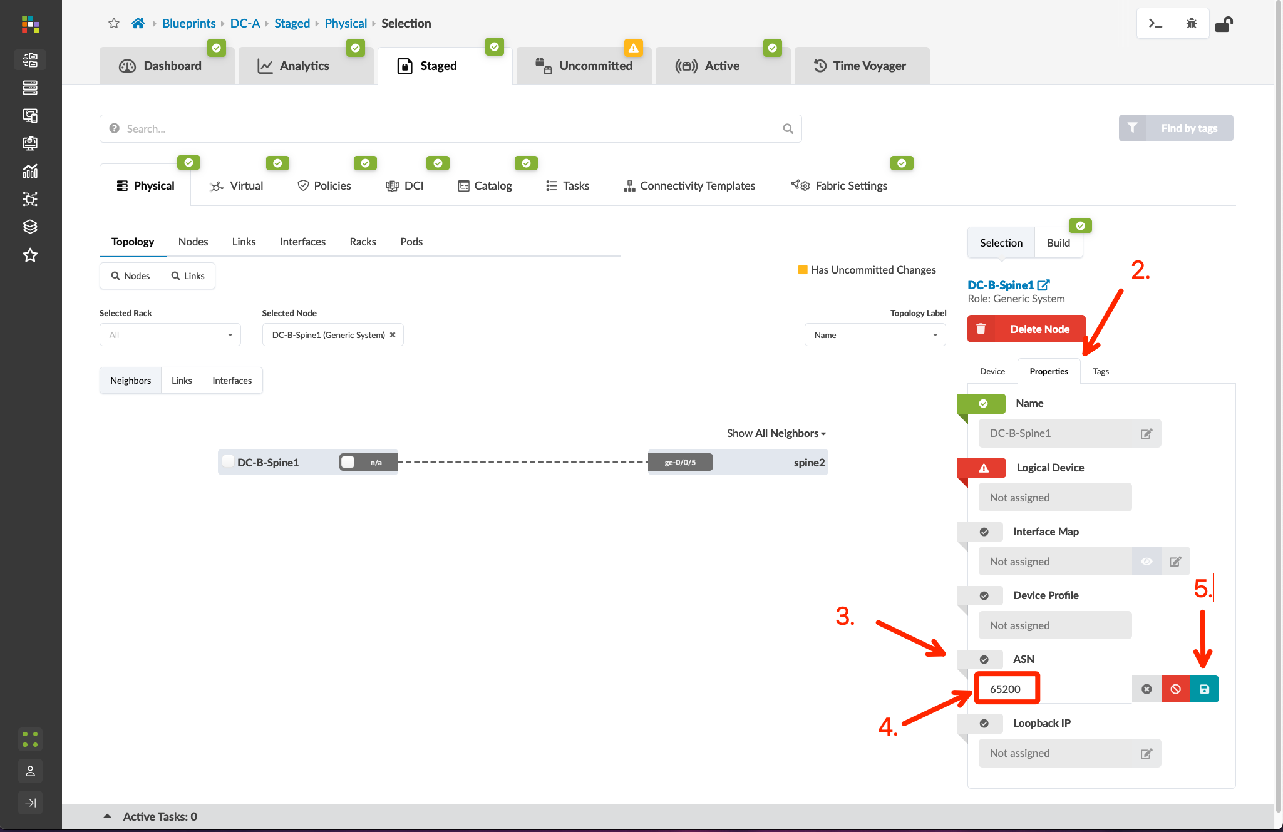
DCI Addendum: Direct Peering – Underlay
Go to Blueprints > DC-A > Staged > Physical > Topology, and click “spine2”
Click the checkbox for the border rack node and select “Add external generic system”
Create a new external generic system called DC-B-Spine1, select “None” for the device representation, and click Next
Select port 5 on spine2, click the port icon followed by the “Add Link” button, then click “Create”
Click “DC-B-Spine1”, open the properties page to edit the ASN, and set it to 65200. You can verify this by navigating to Blueprints > DC-B > Staged > Physical > Nodes and viewing the ASN assignment for spine1

Slide 11
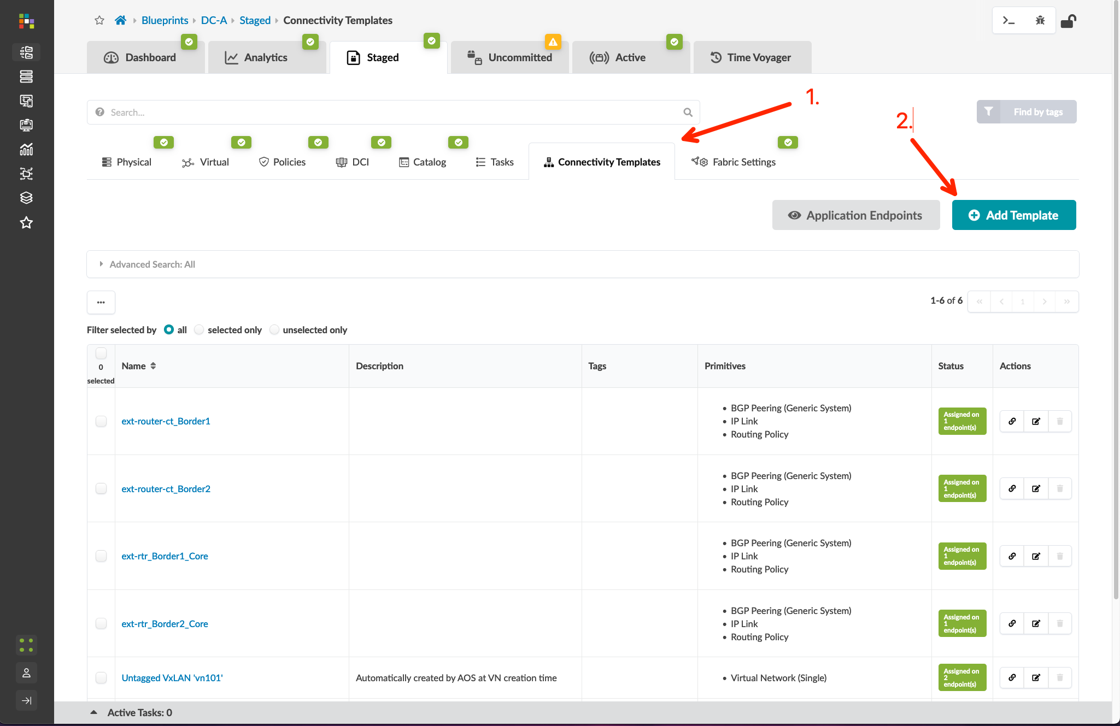
DCI Addendum: Direct Peering – Underlay
Go to Blueprints > DC-A > Staged > Connectivity Templates and create a new template called DCI-Direct
Follow the screenshots to create the connectivity template
Assign the connectivity template to the ge-0/0/5 interface of both border leaf switches
After assigning the connectivity template, we need to manually assign a static /31 transit network
Blueprints > DC-A > Staged > Virtual > Routing Zones and click the “default” VRF Name
Scroll to the bottom of the page, check the box for the spine2 ge-0/0/5 interface, and click the “edit” button
Assign the following IP’s
Interface 1: 192.168.3.0/31
Interface 2: 192.168.3.1/31
NOTE: The transit net IP’s you define must not reside within an IP resource pool that is assigned to an existing blueprint!
Commit the changes to the DC-A Blueprint

Slide 12
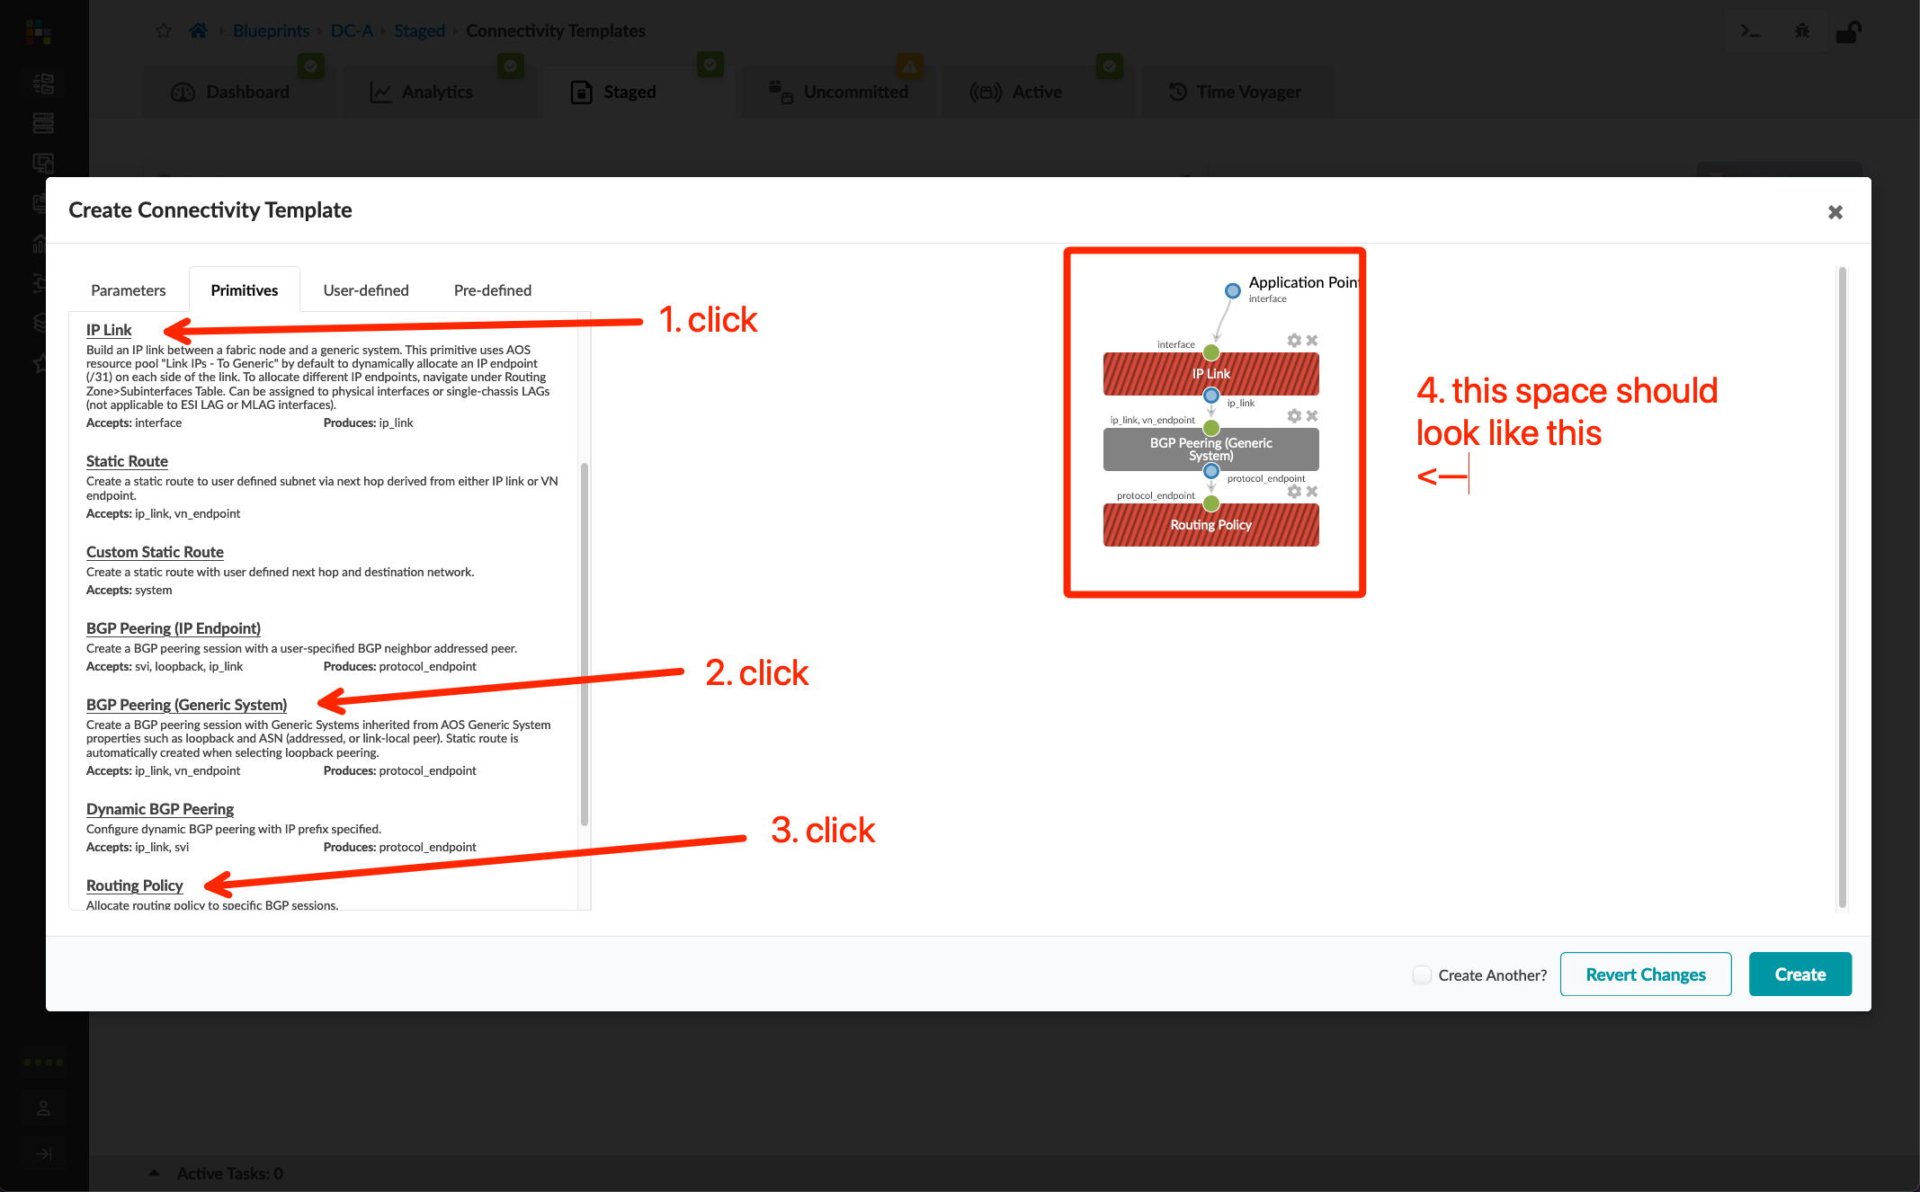
DCI Addendum: Direct Peering – Underlay
Go to Blueprints > DC-A > Staged > Connectivity Templates and create a new template called DCI-Direct
Follow the screenshots to create the connectivity template
Assign the connectivity template to the ge-0/0/5 interface of both border leaf switches
After assigning the connectivity template, we need to manually assign a static /31 transit network
Blueprints > DC-A > Staged > Virtual > Routing Zones and click the “default” VRF Name
Scroll to the bottom of the page, check the box for the spine2 ge-0/0/5 interface, and click the “edit” button
Assign the following IP’s
Interface 1: 192.168.3.0/31
Interface 2: 192.168.3.1/31
NOTE: The transit net IP’s you define must not reside within an IP resource pool that is assigned to an existing blueprint!
Commit the changes to the DC-A Blueprint.

Slide 13
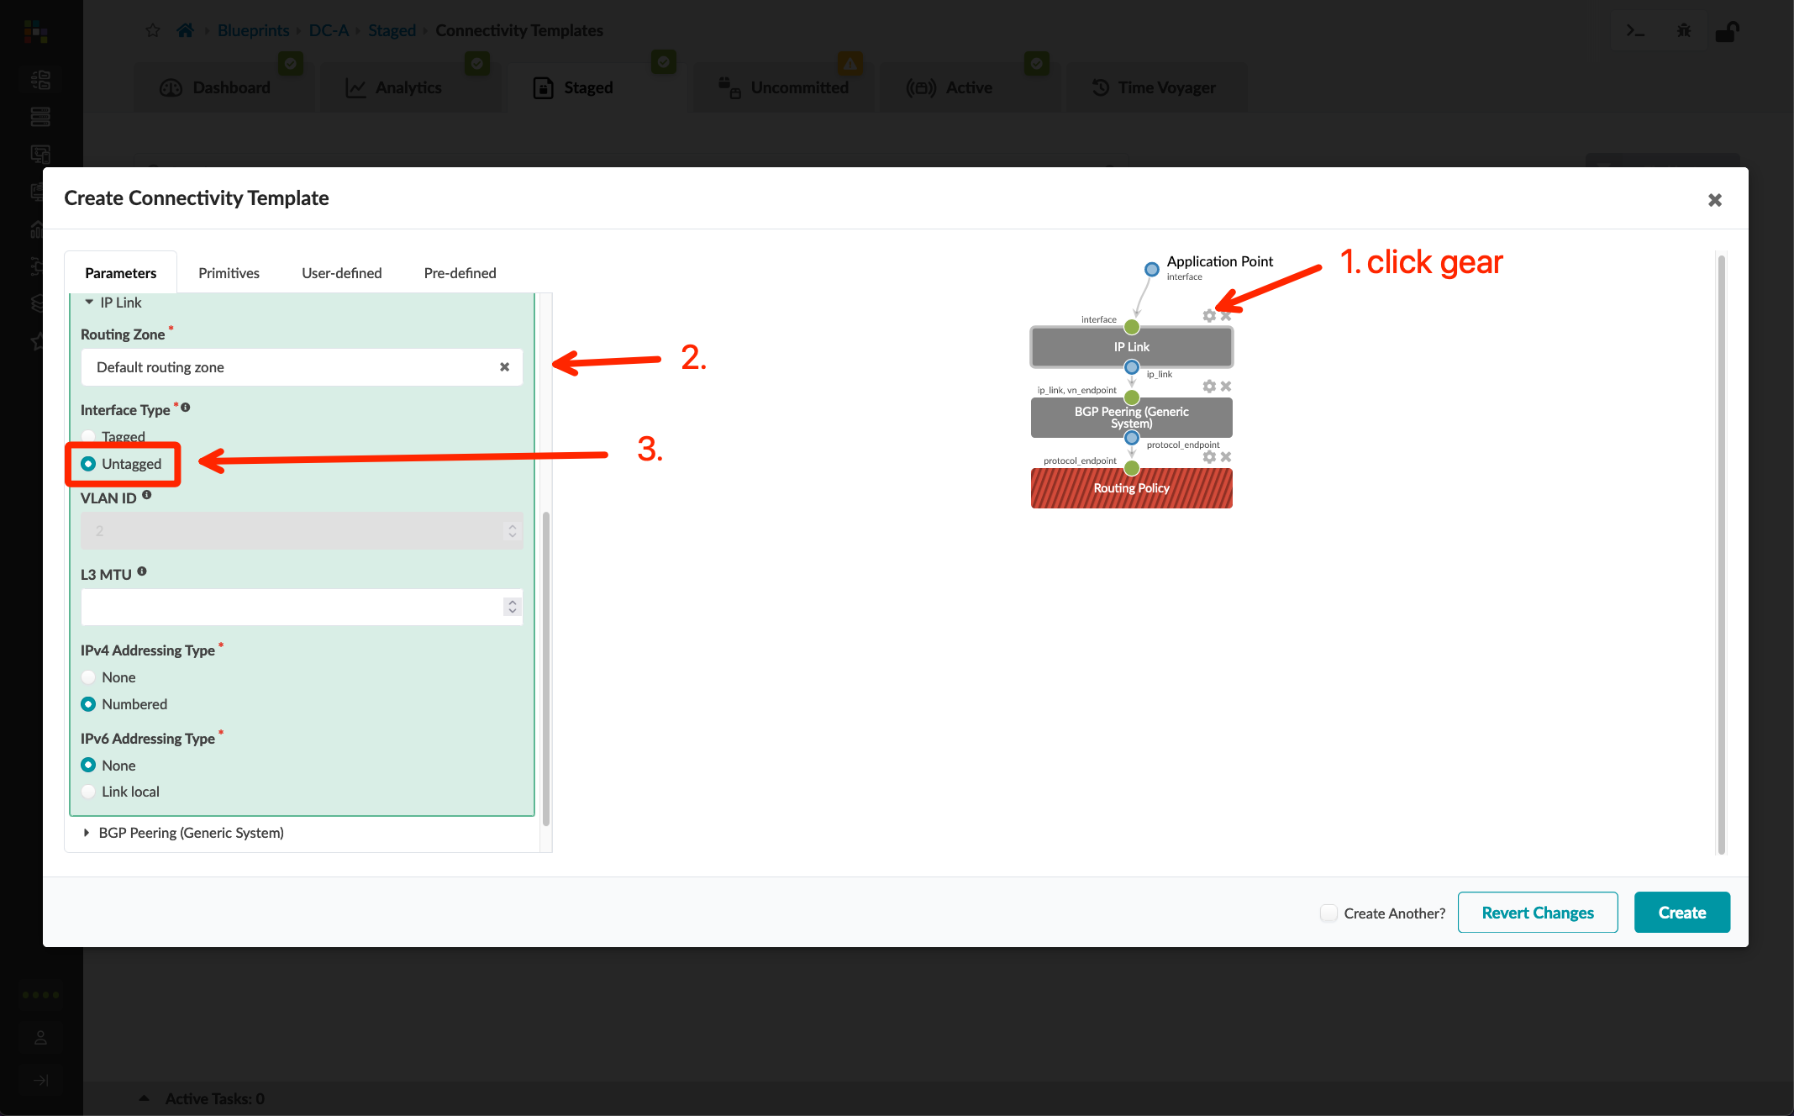
DCI Addendum: Direct Peering – Underlay
Go to Blueprints > DC-A > Staged > Connectivity Templates and create a new template called DCI-Direct
Follow the screenshots to create the connectivity template
Assign the connectivity template to the ge-0/0/5 interface of both border leaf switches
After assigning the connectivity template, we need to manually assign a static /31 transit network
Blueprints > DC-A > Staged > Virtual > Routing Zones and click the “default” VRF Name
Scroll to the bottom of the page, check the box for the spine2 ge-0/0/5 interface, and click the “edit” button
Assign the following IP’s
Interface 1: 192.168.3.0/31
Interface 2: 192.168.3.1/31
NOTE: The transit net IP’s you define must not reside within an IP resource pool that is assigned to an existing blueprint!
Commit the changes to the DC-A Blueprint.

Slide 14
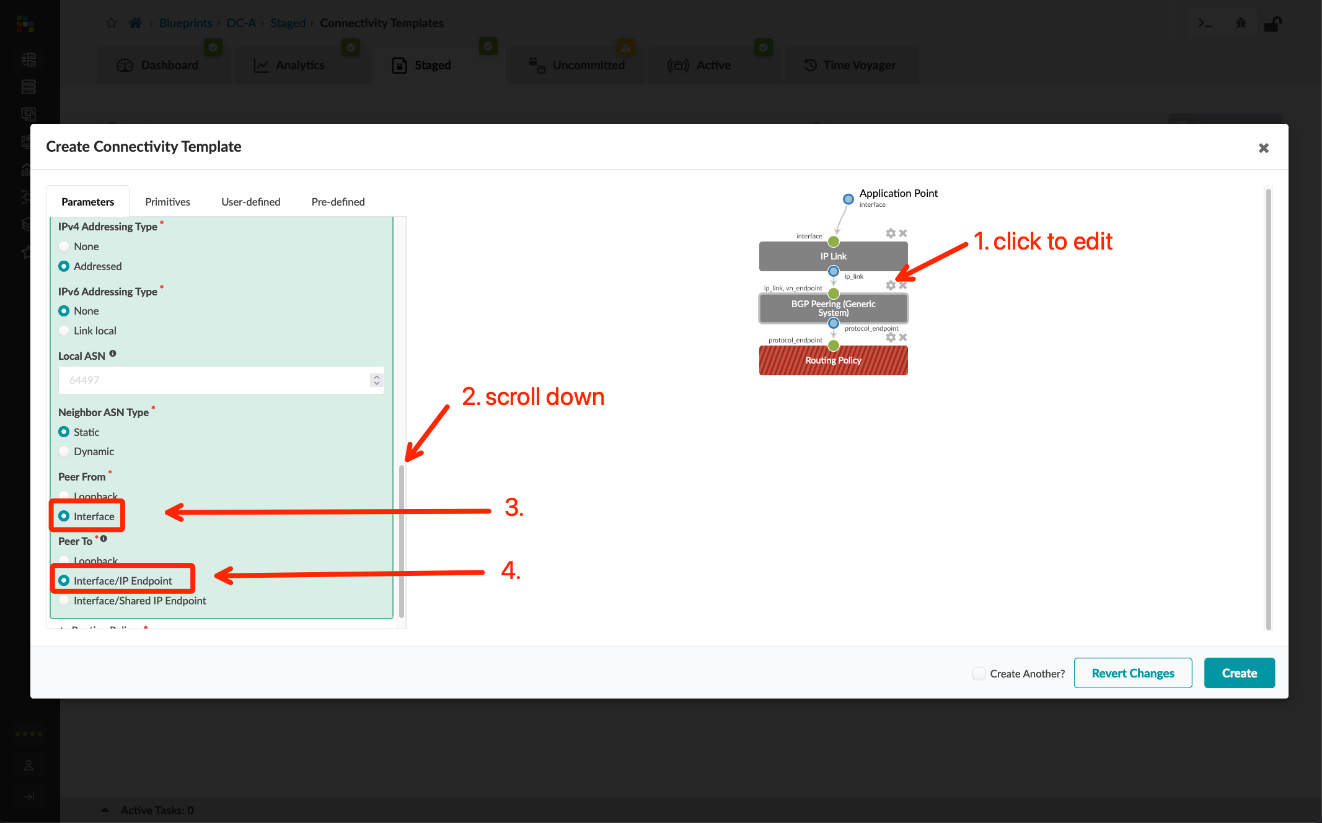
DCI Addendum: Direct Peering – Underlay
Go to Blueprints > DC-A > Staged > Connectivity Templates and create a new template called DCI-Direct
Follow the screenshots to create the connectivity template
Assign the connectivity template to the ge-0/0/5 interface of both border leaf switches
After assigning the connectivity template, we need to manually assign a static /31 transit network
Blueprints > DC-A > Staged > Virtual > Routing Zones and click the “default” VRF Name
Scroll to the bottom of the page, check the box for the spine2 ge-0/0/5 interface, and click the “edit” button
Assign the following IP’s
Interface 1: 192.168.3.0/31
Interface 2: 192.168.3.1/31
NOTE: The transit net IP’s you define must not reside within an IP resource pool that is assigned to an existing blueprint!
Commit the changes to the DC-A Blueprint.

Slide 15
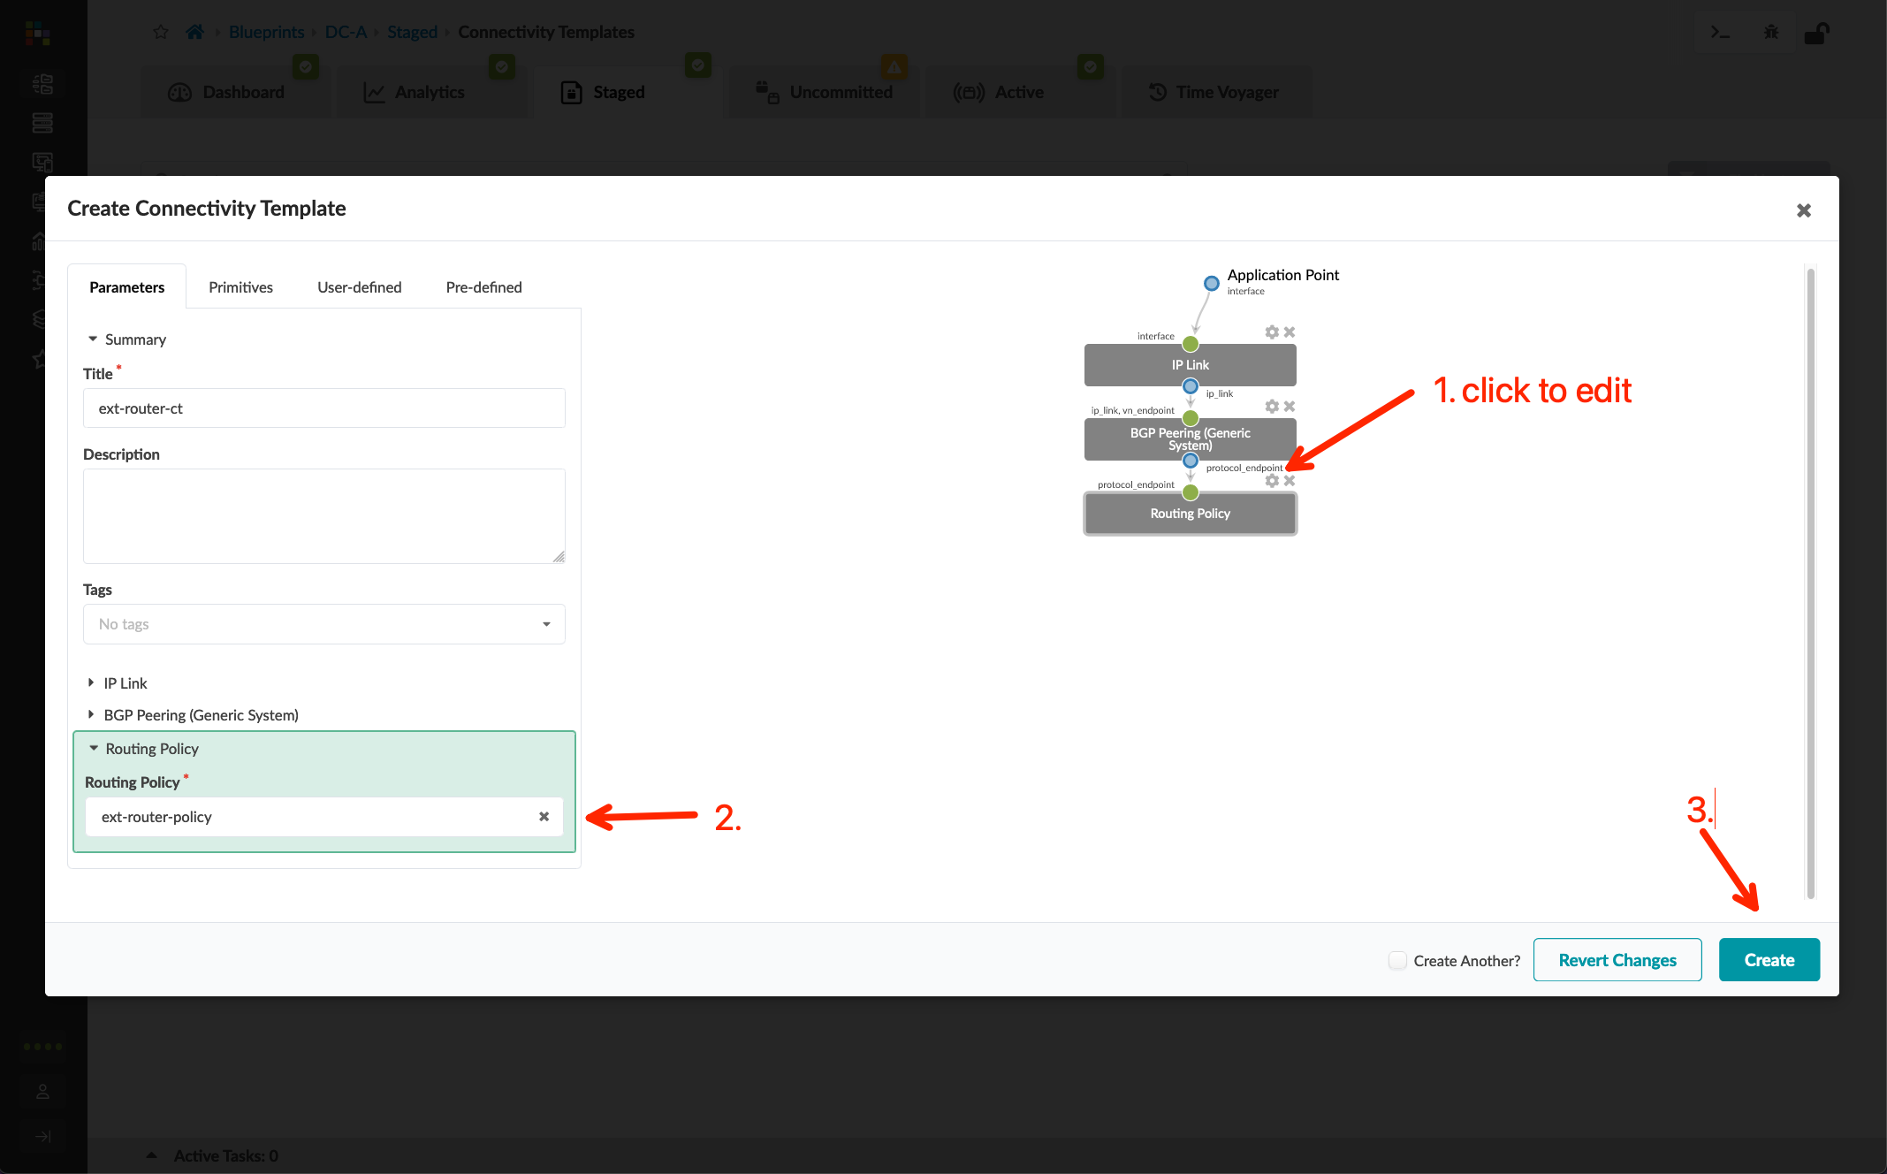
DCI Addendum: Direct Peering – Underlay
Go to Blueprints > DC-A > Staged > Connectivity Templates and create a new template called DCI-Direct
Follow the screenshots to create the connectivity template
Assign the connectivity template to the ge-0/0/5 interface of both border leaf switches
After assigning the connectivity template, we need to manually assign a static /31 transit network
Blueprints > DC-A > Staged > Virtual > Routing Zones and click the “default” VRF Name
Scroll to the bottom of the page, check the box for the spine2 ge-0/0/5 interface, and click the “edit” button
Assign the following IP’s
Interface 1: 192.168.3.0/31
Interface 2: 192.168.3.1/31
NOTE: The transit net IP’s you define must not reside within an IP resource pool that is assigned to an existing blueprint!
Commit the changes to the DC-A Blueprint.

Slide 16
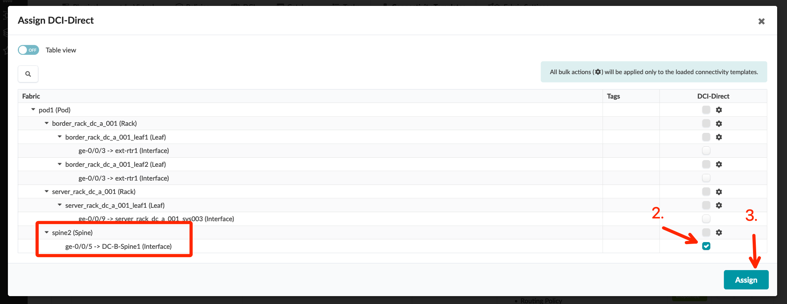
DCI Addendum: Direct Peering – Underlay
Go to Blueprints > DC-A > Staged > Connectivity Templates and create a new template called DCI-Direct
Follow the screenshots to create the connectivity template
Assign the connectivity template to the ge-0/0/5 interface of both border leaf switches
After assigning the connectivity template, we need to manually assign a static /31 transit network
Blueprints > DC-A > Staged > Virtual > Routing Zones and click the “default” VRF Name
Scroll to the bottom of the page, check the box for the spine2 ge-0/0/5 interface, and click the “edit” button
Assign the following IP’s
Interface 1: 192.168.3.0/31
Interface 2: 192.168.3.1/31
NOTE: The transit net IP’s you define must not reside within an IP resource pool that is assigned to an existing blueprint!
Commit the changes to the DC-A Blueprint.

Slide 17
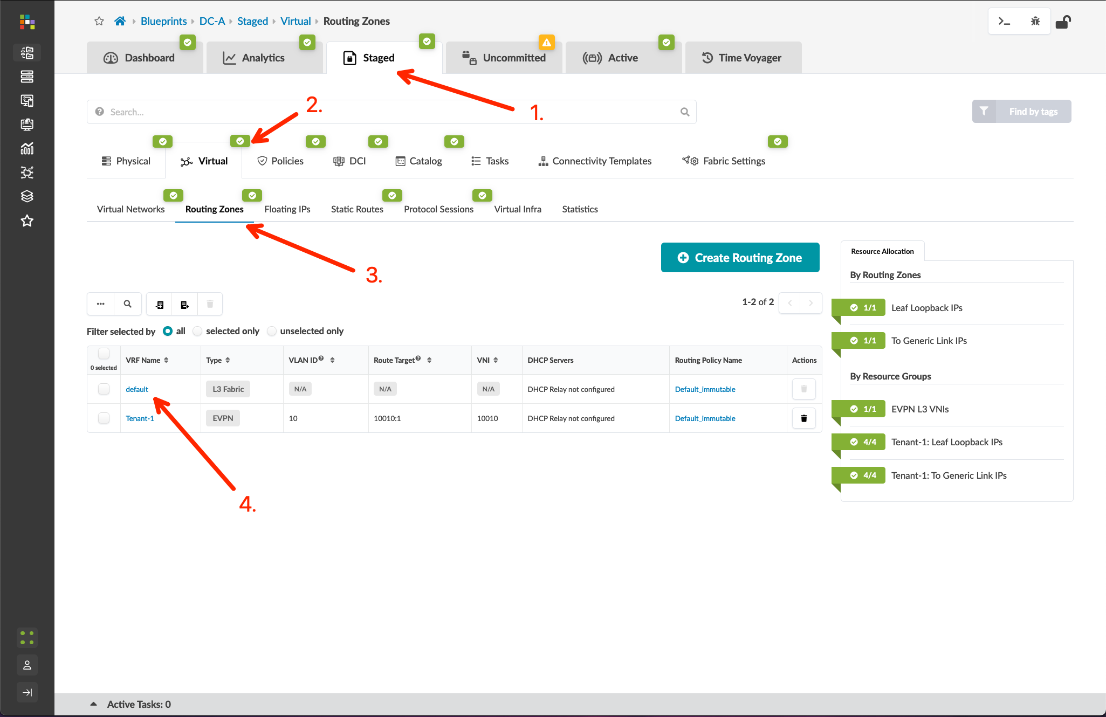
DCI Addendum: Direct Peering – Underlay
Go to Blueprints > DC-A > Staged > Connectivity Templates and create a new template called DCI-Direct
Follow the screenshots to create the connectivity template
Assign the connectivity template to the ge-0/0/5 interface of both border leaf switches
After assigning the connectivity template, we need to manually assign a static /31 transit network
Blueprints > DC-A > Staged > Virtual > Routing Zones and click the “default” VRF Name
Scroll to the bottom of the page, check the box for the spine2 ge-0/0/5 interface, and click the “edit” button
Assign the following IP’s
Interface 1: 192.168.3.0/31
Interface 2: 192.168.3.1/31
NOTE: The transit net IP’s you define must not reside within an IP resource pool that is assigned to an existing blueprint!
Commit the changes to the DC-A Blueprint.
NOTE: We cannot use a pool assignment for interface IP addressing. Apstra will reserve both available IP’s in a dynamic /31 allocation from a pool. This renders the remote IP unavailable for assignment to the spine1 in DC-B.

Slide 18
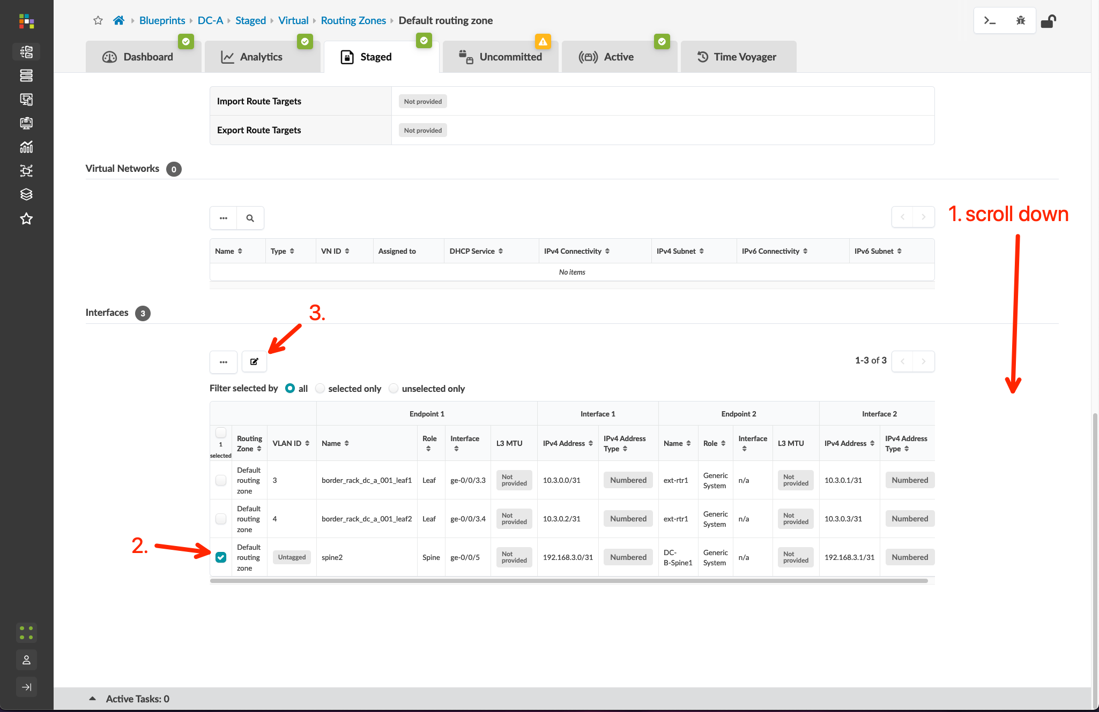
DCI Addendum: Direct Peering – Underlay
Go to Blueprints > DC-A > Staged > Connectivity Templates and create a new template called DCI-Direct
Follow the screenshots to create the connectivity template
Assign the connectivity template to the ge-0/0/5 interface of both border leaf switches
After assigning the connectivity template, we need to manually assign a static /31 transit network
Blueprints > DC-A > Staged > Virtual > Routing Zones and click the “default” VRF Name
Scroll to the bottom of the page, check the box for the spine2 ge-0/0/5 interface, and click the “edit” button
Assign the following IP’s
Interface 1: 192.168.3.0/31
Interface 2: 192.168.3.1/31
NOTE: The transit net IP’s you define must not reside within an IP resource pool that is assigned to an existing blueprint!
Commit the changes to the DC-A Blueprint.
NOTE: We cannot use a pool assignment for interface IP addressing. Apstra will reserve both available IP’s in a dynamic /31 allocation from a pool. This renders the remote IP unavailable for assignment to the spine1 in DC-B.

Slide 19
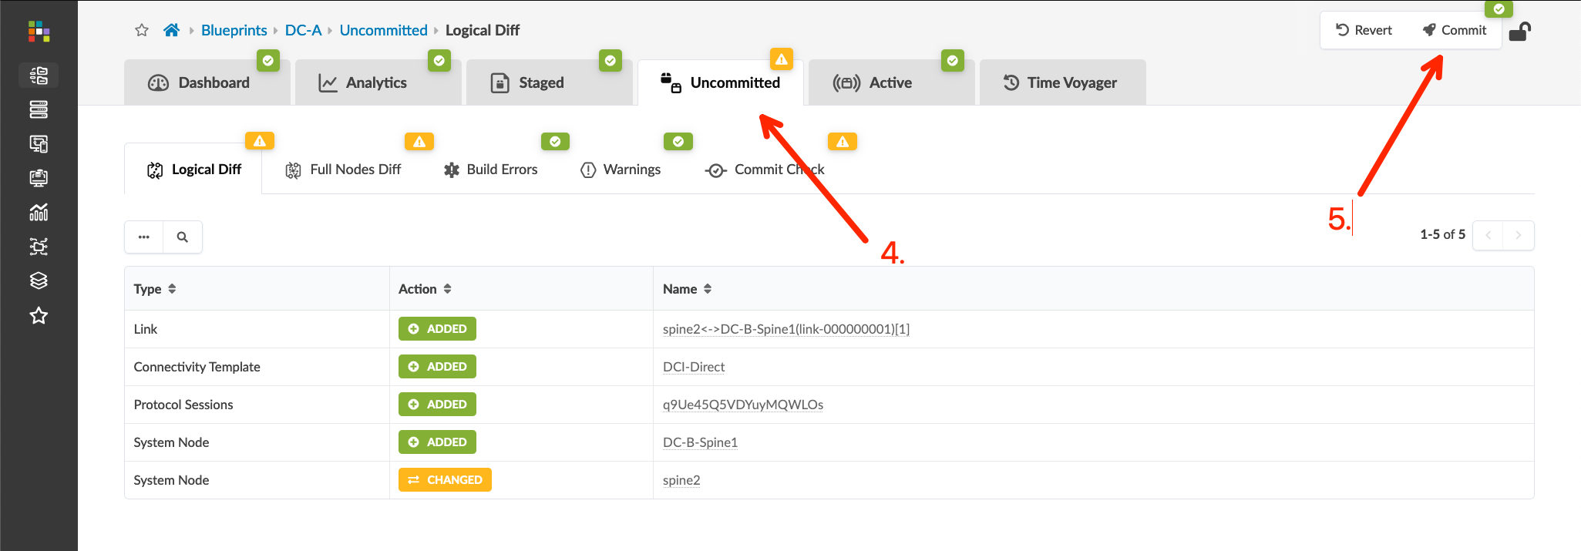
DCI Addendum: Direct Peering – Underlay
Go to Blueprints > DC-A > Staged > Connectivity Templates and create a new template called DCI-Direct
Follow the screenshots to create the connectivity template
Assign the connectivity template to the ge-0/0/5 interface of both border leaf switches
After assigning the connectivity template, we need to manually assign a static /31 transit network
Blueprints > DC-A > Staged > Virtual > Routing Zones and click the “default” VRF Name
Scroll to the bottom of the page, check the box for the spine2 ge-0/0/5 interface, and click the “edit” button
Assign the following IP’s
Interface 1: 192.168.3.0/31
Interface 2: 192.168.3.1/31
NOTE: The transit net IP’s you define must not reside within an IP resource pool that is assigned to an existing blueprint!
Commit the changes to the DC-A Blueprint
NOTE: We cannot use a pool assignment for interface IP addressing. Apstra will reserve both available IP’s in a dynamic /31 allocation from a pool. This renders the remote IP unavailable for assignment to the spine1 in DC-B.

Slide 20
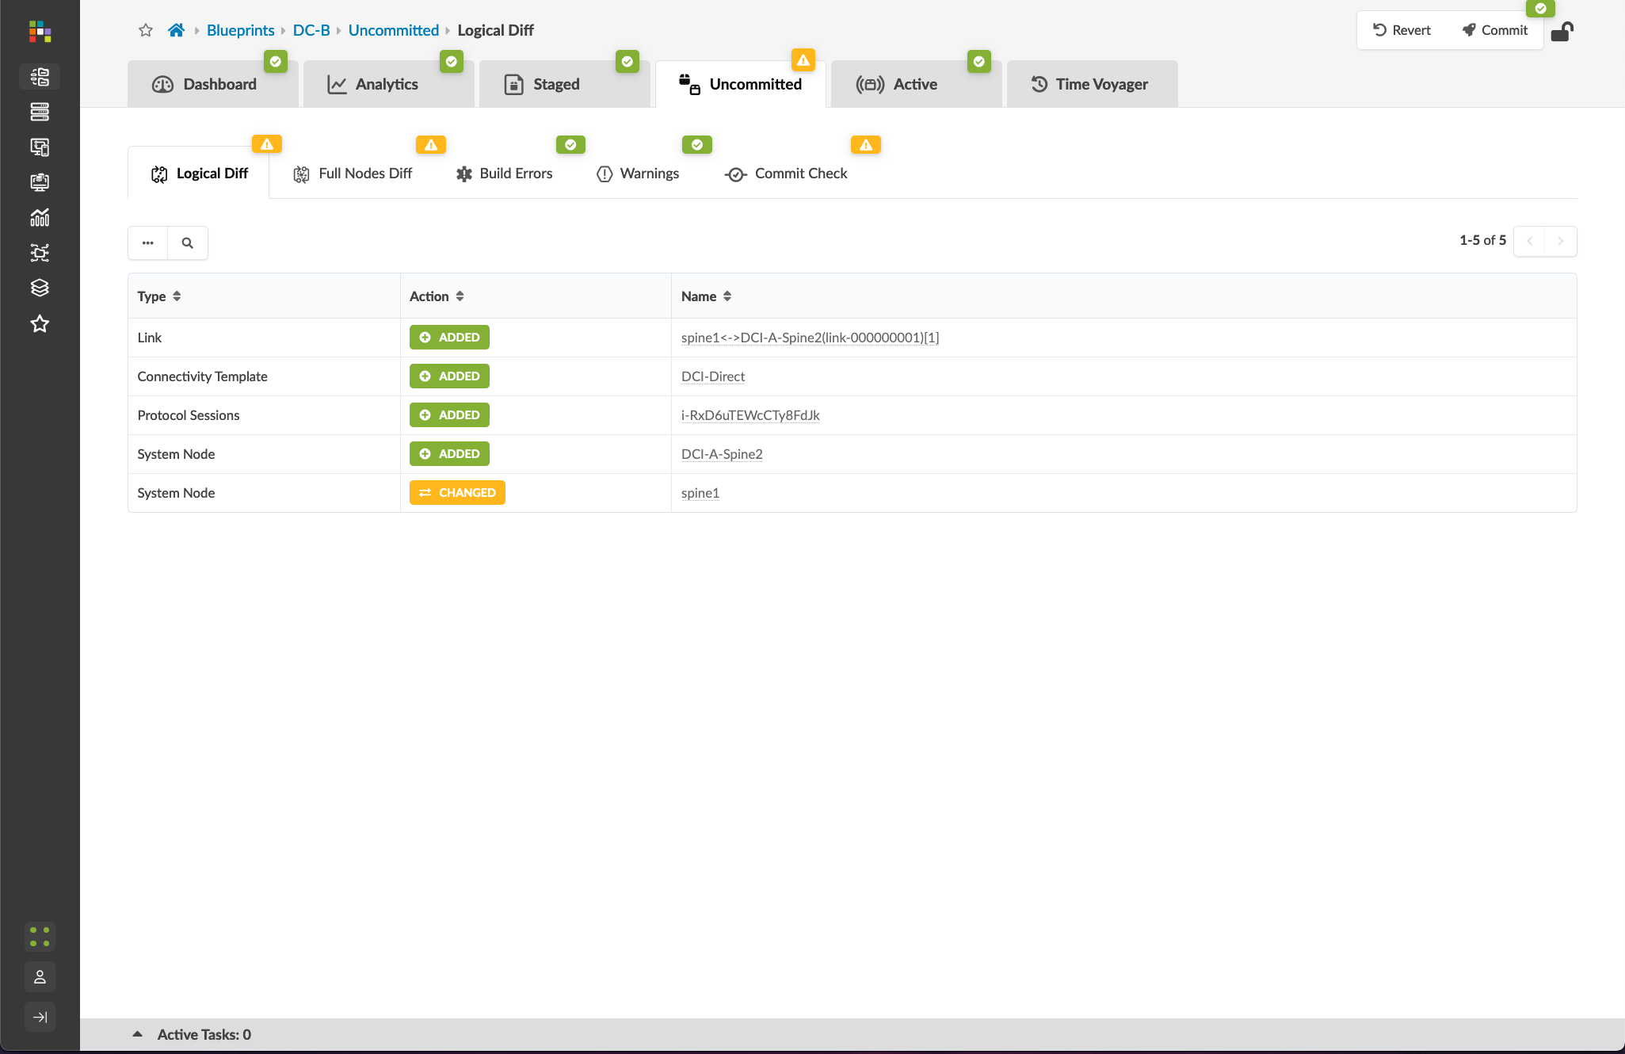
DCI Addendum: Direct Peering – Underlay
Go to Blueprints > DC-B and repeat the steps:
New generic external system connected to spine1 on ge-0/0/5 named DC-A-Spine2
Assign ASN 65101 to the DC-A-Spine2 generic system
Create a DCI-Direct Connectivity Template that matches the template created in DC-A
Assign the DCI-Direct Connectivity Template to ge-0/0/5 on spine1
Assign the following IP’s to the ge-0/0/5 interface in the default Routing Zone configuration
Interface 1: 192.168.3.1/31
Interface 2: 192.168.3.0/31
Commit the changes to the DC-B Blueprint

Slide 21
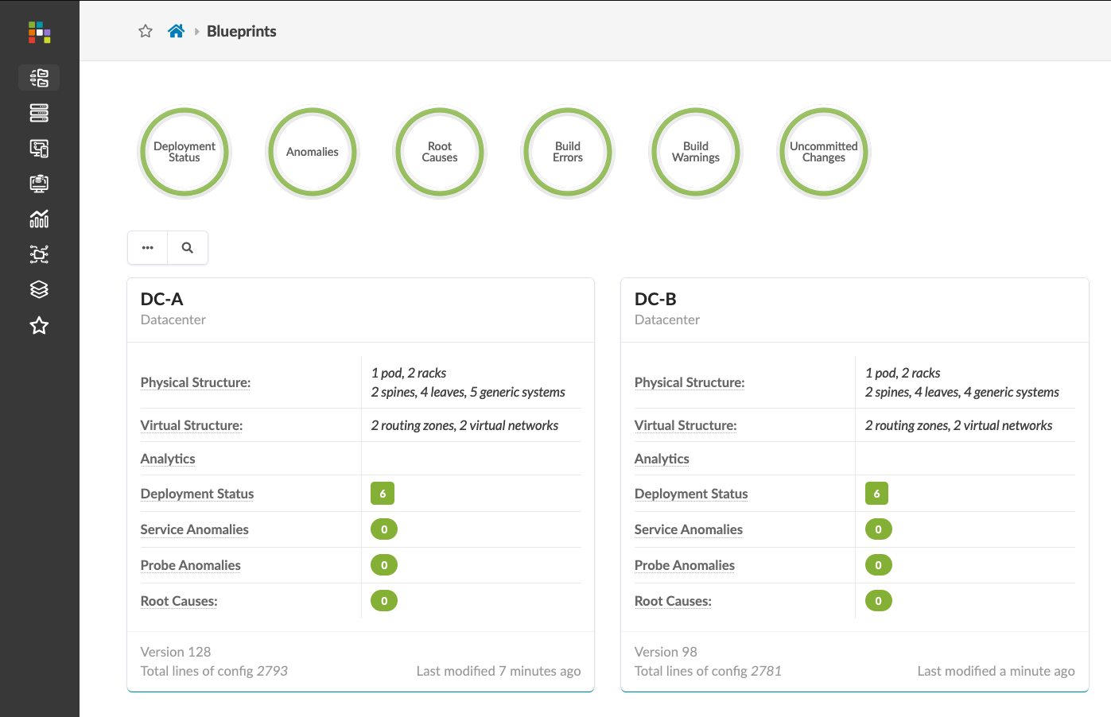
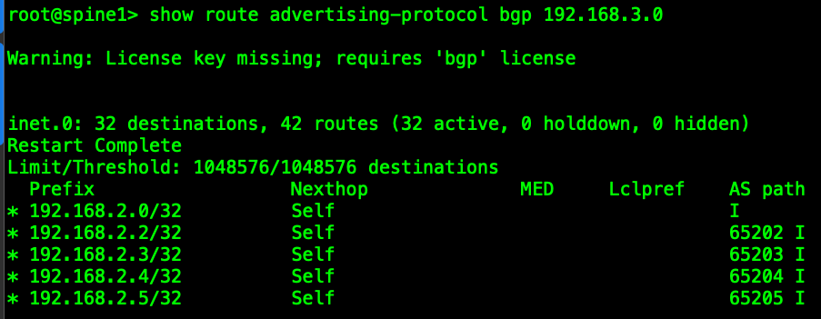
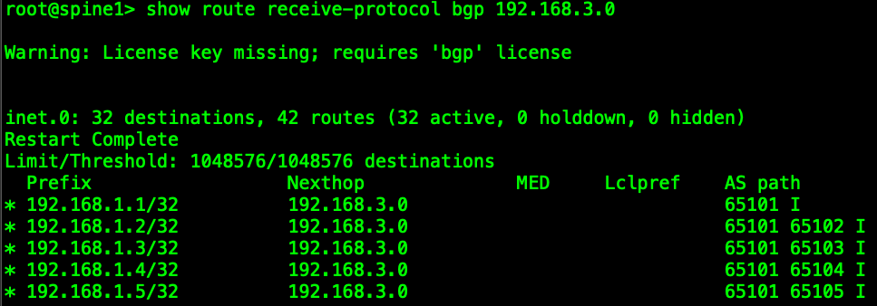
DCI Addendum: Direct Peering – Underlay
Verification
Verify no anomalies in DC-A or DC-B
CLI on DC-A-spine2
show bgp summary (verify 192.168.3.1 peer is up)
show route advertising-protocol bgp 192.168.3.1 (verify DC-A loopbacks are being advertised)
show route receive-protocol bgp 192.168.3.1 (verify DC-B loopbacks are being received)
CLI on DC-B-spine1
same commands as above with “192.168.3.0”

Slide 22
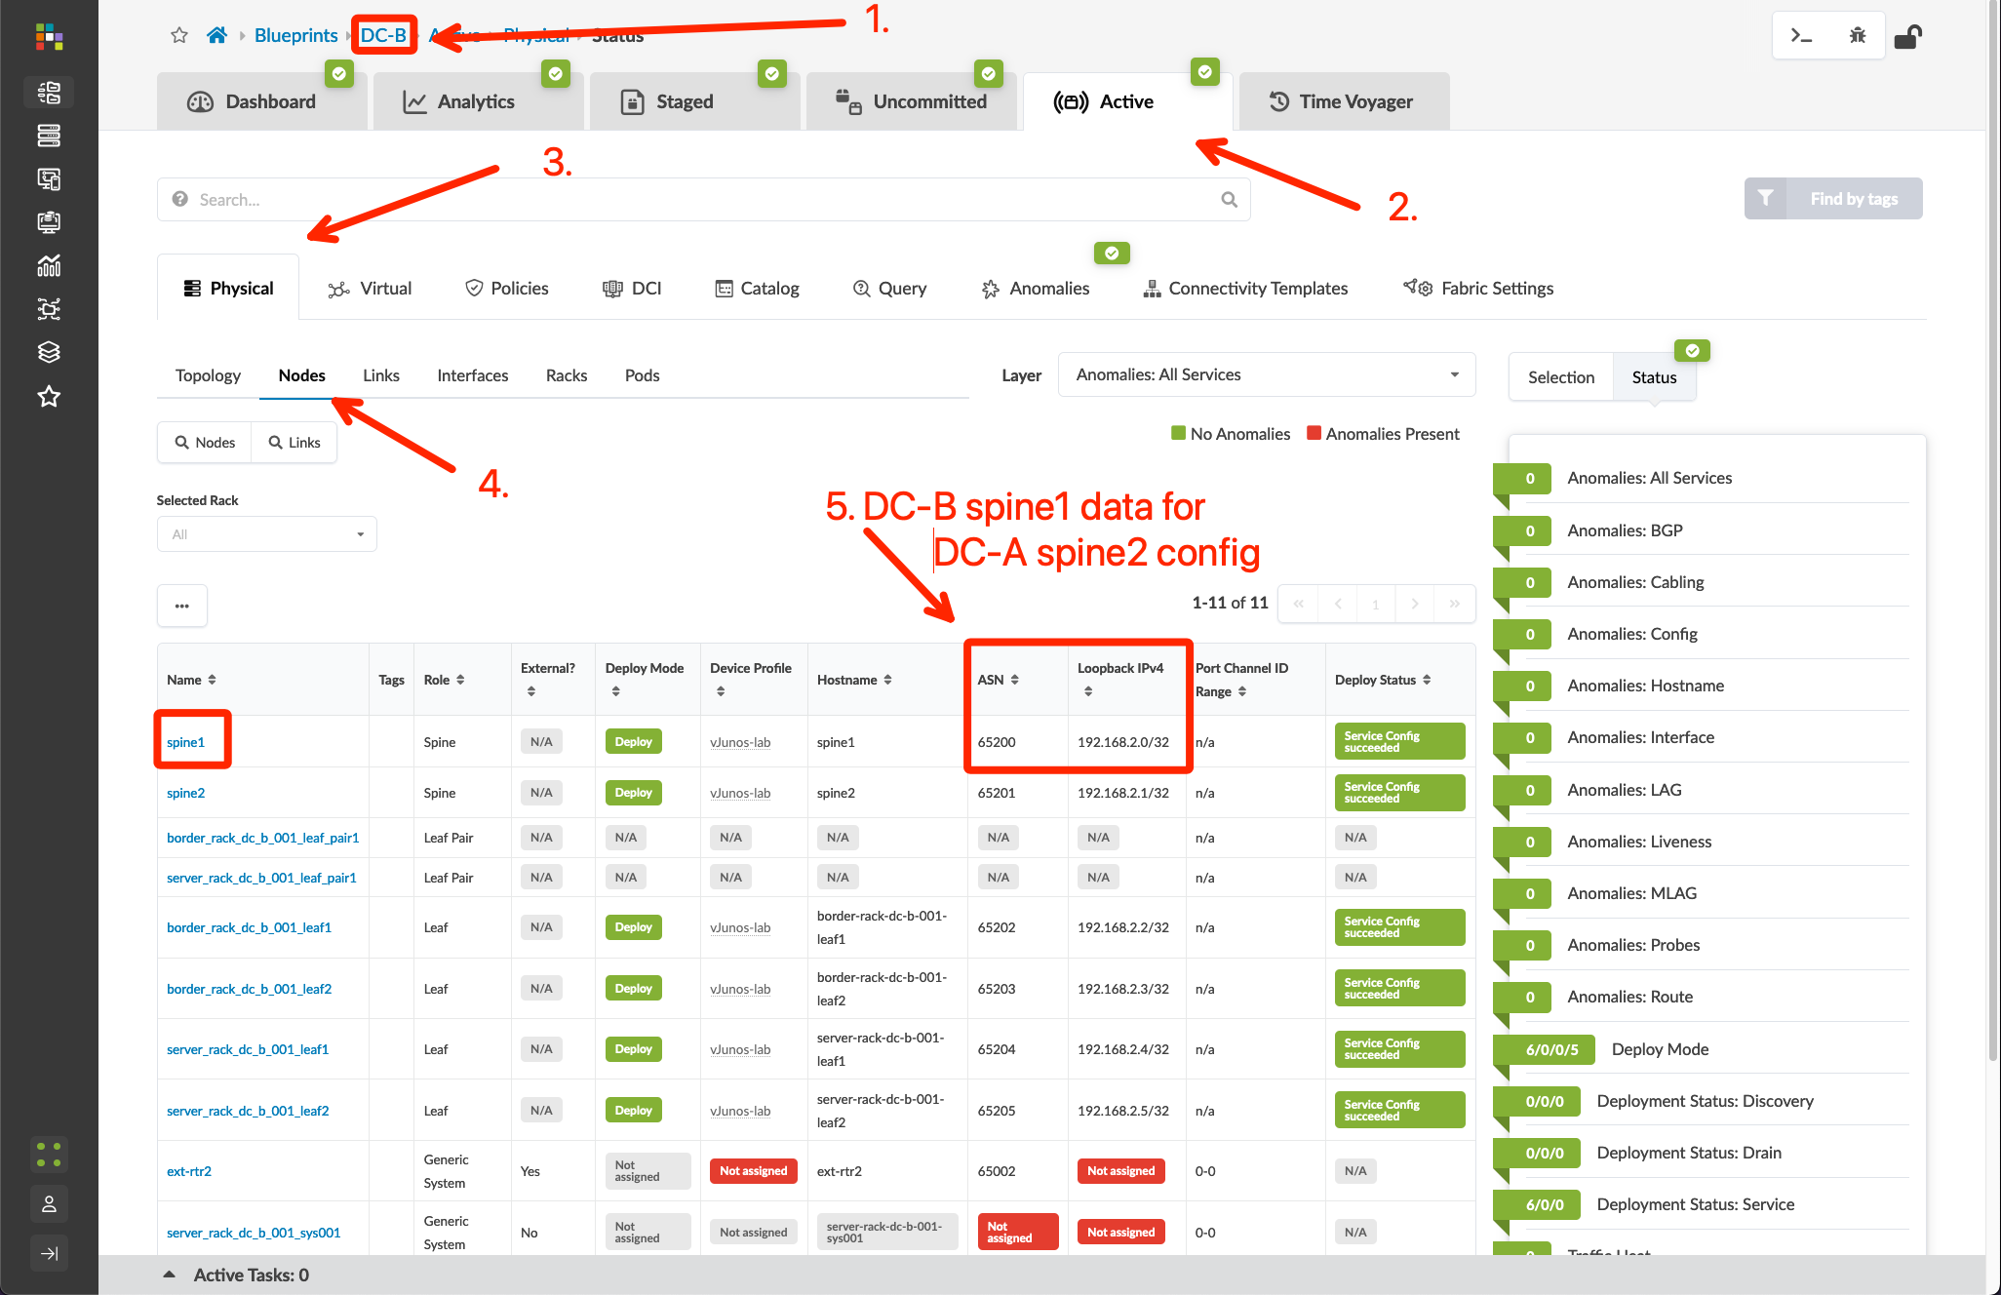
DCI Addendum: Direct Peering – Overlay
Go to Blueprints > DC-B > Active > Physical > Nodes and note the Loopback IP and ASN for the spine1 switch
Go to Blueprints > DC-A > Staged > DCI > Over the Top or External Gateways, click “Create Over the Top or External Gateway” button, then define the spine1 switch in DC-B as the remote EVPN gateway using the following table
Commit the Blueprint
Name | IP Address | ASN | Local Gateway
B-spine1 | 192.168.2.0 | 65200 | spine2 (DC-A)
Repeat for DC-B by recording DC-A’s loopback and ASN assignments

Slide 23
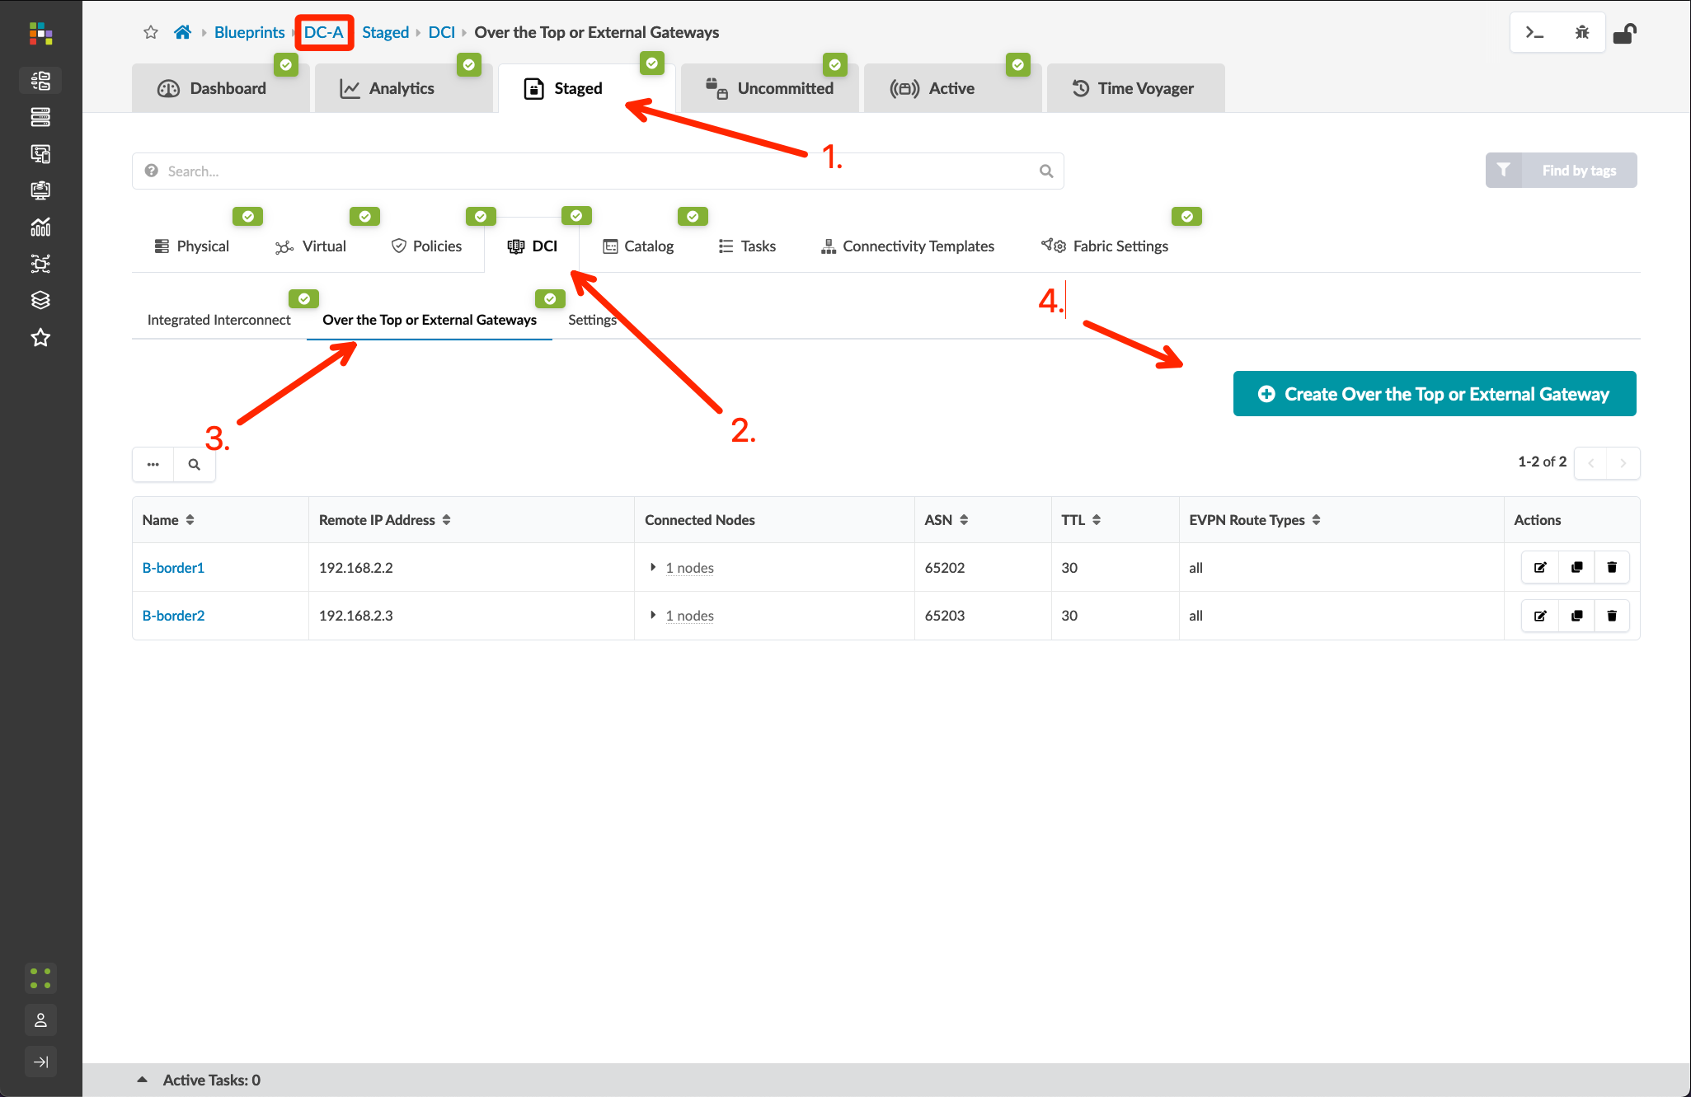
DCI Addendum: Direct Peering – Overlay
Go to Blueprints > DC-B > Active > Physical > Nodes and note the Loopback IP and ASN for the spine1 switch
Go to Blueprints > DC-A > Staged > DCI > Over the Top or External Gateways, click “Create Over the Top or External Gateway” button, then define the spine1 switch in DC-B as the remote EVPN gateway using the following table
Commit the Blueprint
Name | IP Address | ASN | Local Gateway
B-spine1 | 192.168.2.0 | 65200 | spine2 (DC-A)

Slide 24
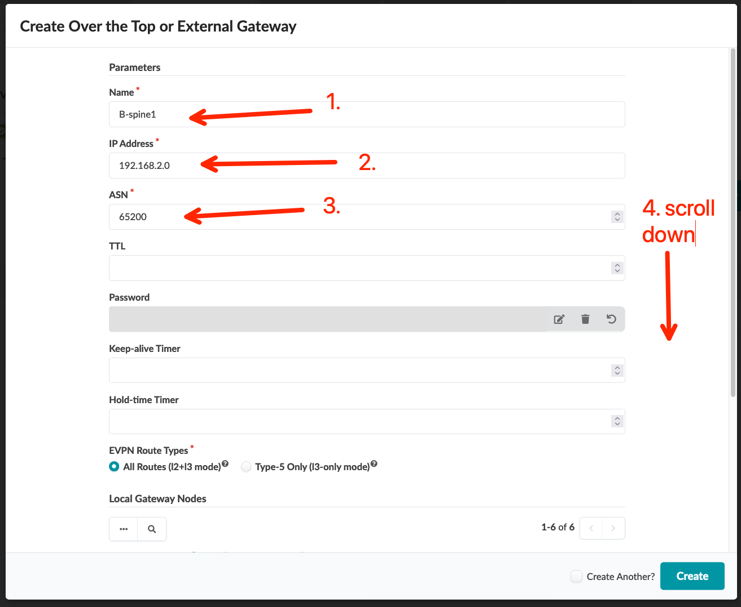
DCI Addendum: Direct Peering – Overlay
Go to Blueprints > DC-B > Active > Physical > Nodes and note the Loopback IP and ASN for the spine1 switch
Go to Blueprints > DC-A > Staged > DCI > Over the Top or External Gateways, click “Create Over the Top or External Gateway” button, then define the spine1 switch in DC-B as the remote EVPN gateway using the following table
Commit the Blueprint
Name | IP Address | ASN | Local Gateway
B-spine1 | 192.168.2.0 | 65200 | spine2 (DC-A)

Slide 25
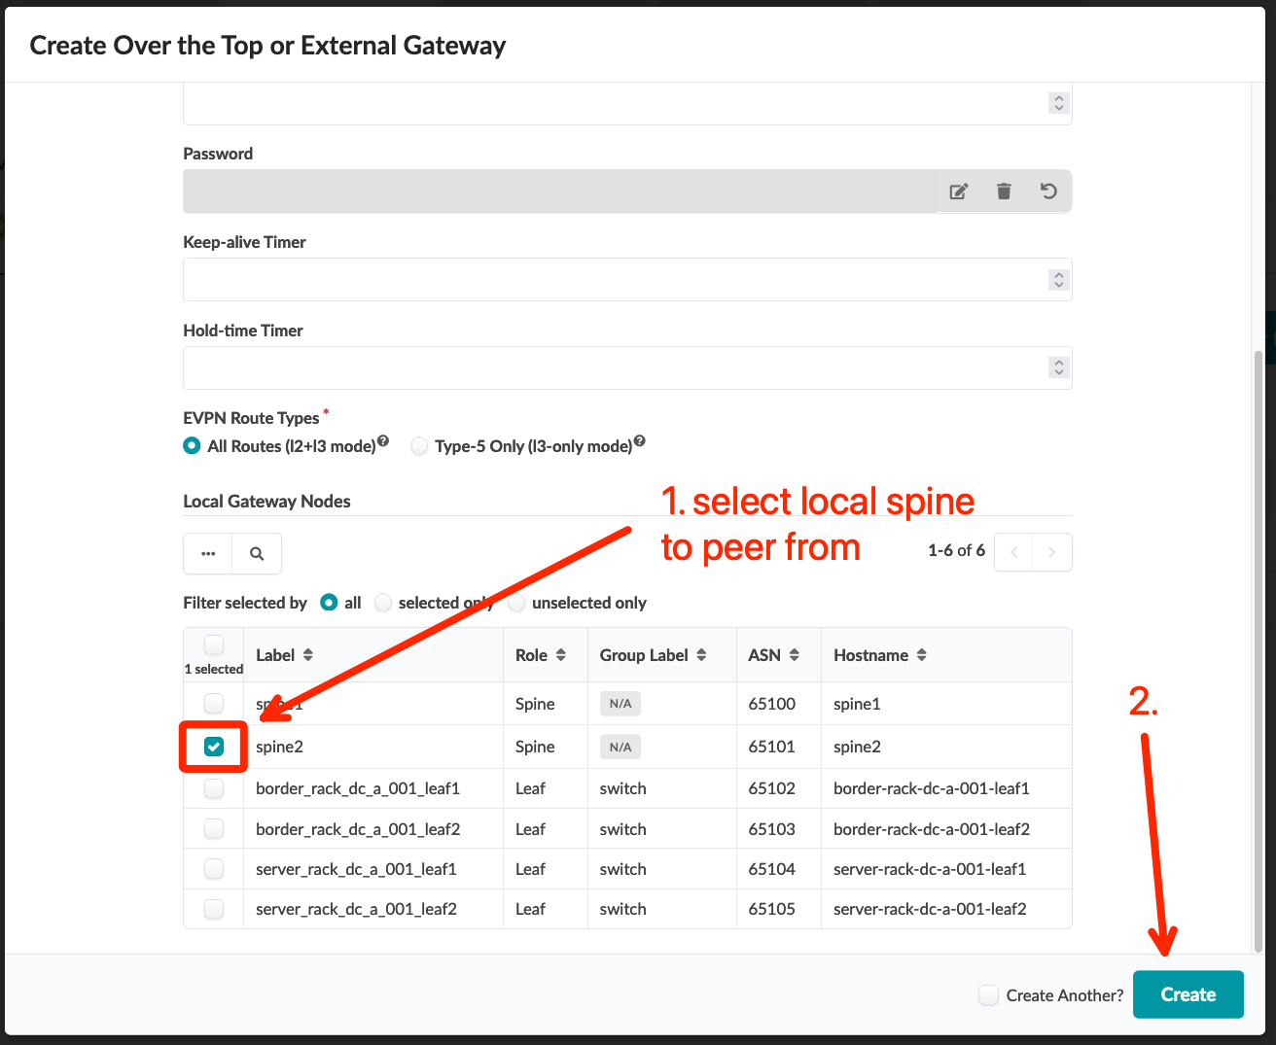
DCI Addendum: Direct Peering – Overlay
Go to Blueprints > DC-B > Active > Physical > Nodes and note the Loopback IP and ASN for the spine1 switch
Go to Blueprints > DC-A > Staged > DCI > Over the Top or External Gateways, click “Create Over the Top or External Gateway” button, then define the spine1 switch in DC-B as the remote EVPN gateway using the following table
Commit the Blueprint
Name | IP Address | ASN | Local Gateway
B-spine1 | 192.168.2.0 | 65200 | spine2 (DC-A)

Slide 26
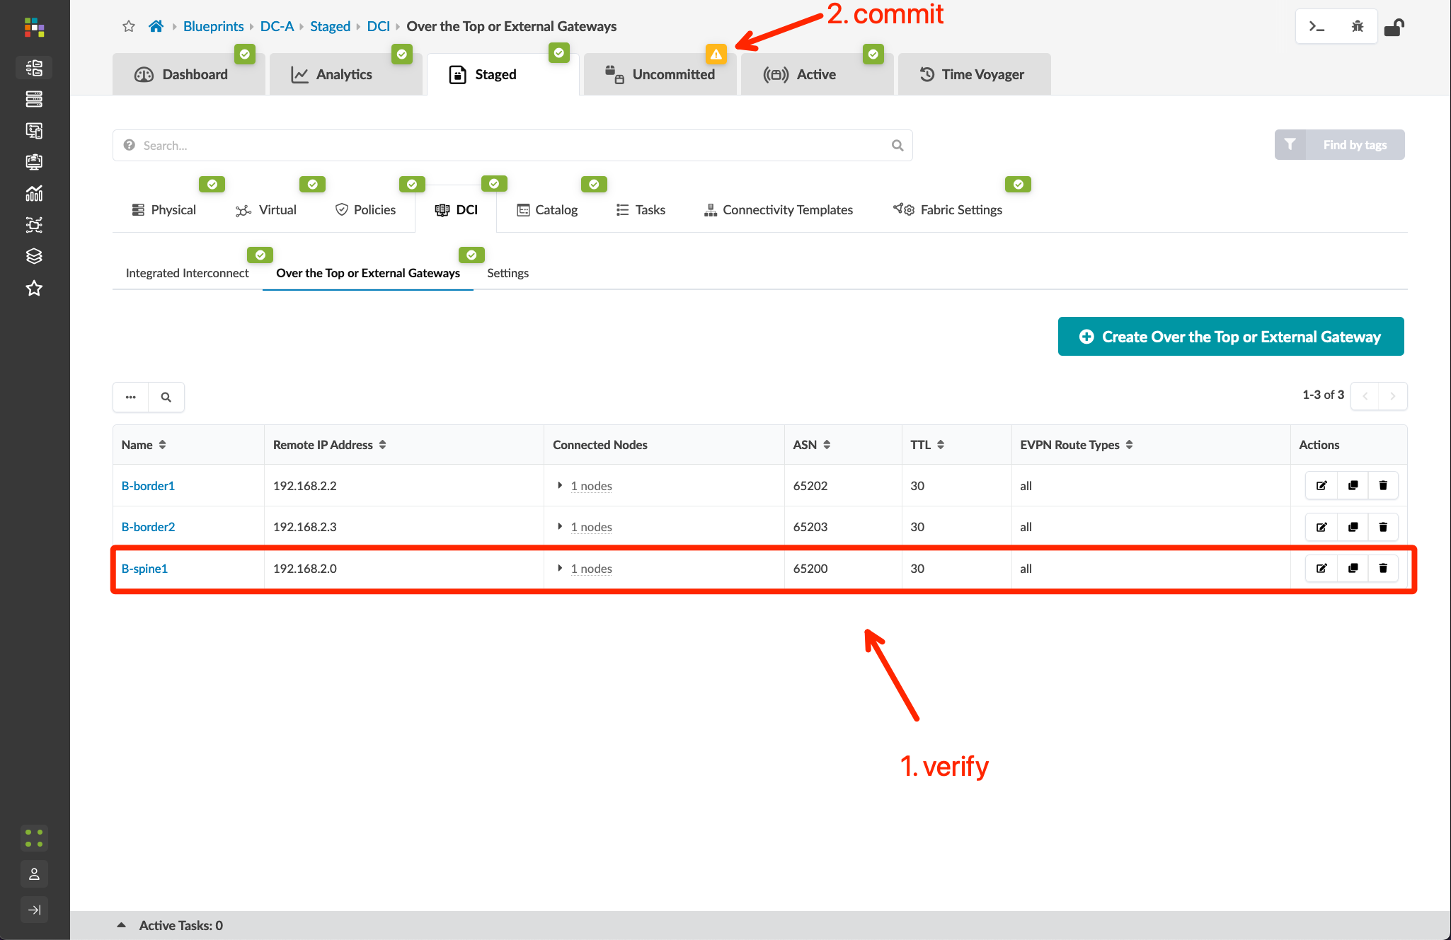
DCI Addendum: Direct Peering – Overlay
Go to Blueprints > DC-B > Active > Physical > Nodes and note the Loopback IP and ASN for the spine1 switch
Go to Blueprints > DC-A > Staged > DCI > Over the Top or External Gateways, click “Create Over the Top or External Gateway” button, then define the spine1 switch in DC-B as the remote EVPN gateway using the following table
Commit the Blueprint
Name | IP Address | ASN | Local Gateway
B-spine1 | 192.168.2.0 | 65200 | spine2 (DC-A)

Slide 27
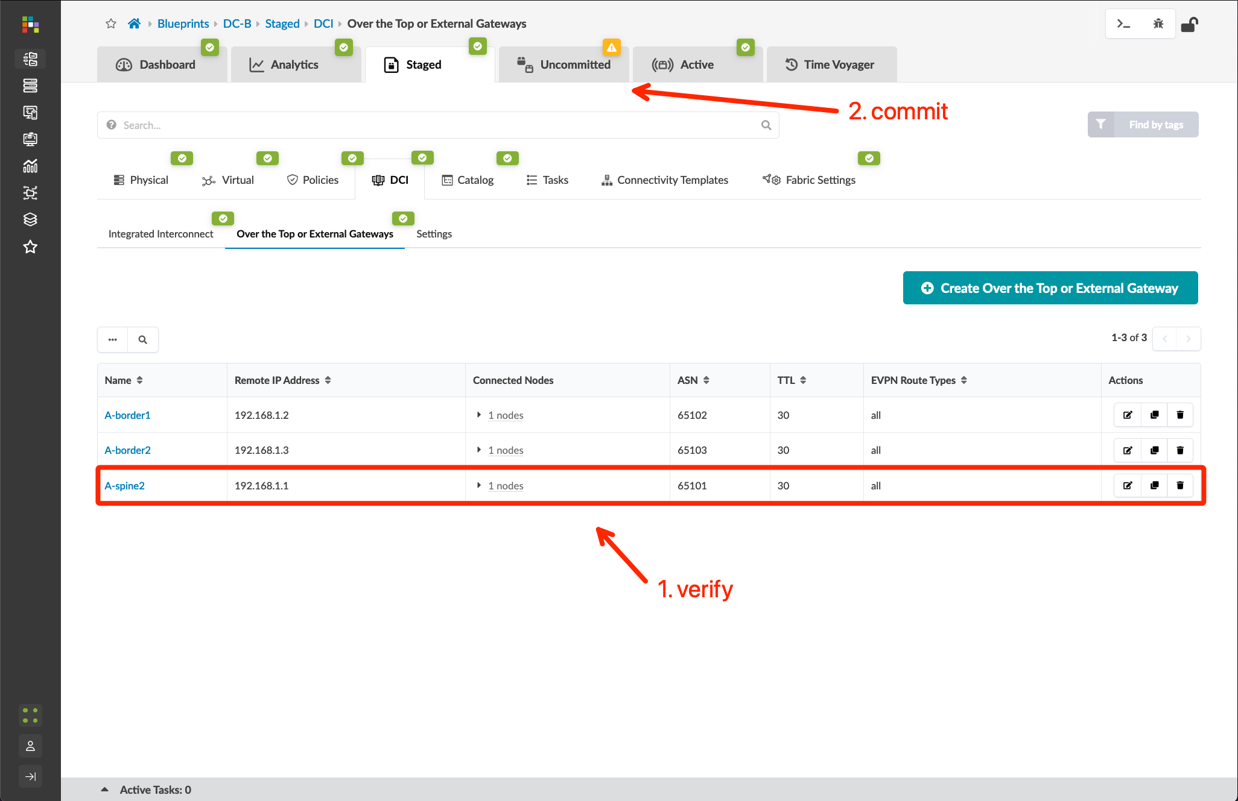
DCI Addendum: Direct Peering – Overlay
Go to Blueprints > DC-B > Staged > DCI > Over the Top or External Gateways and create EVPN BGP sessions between the local spine1 and spine2 in DC-A
Commit the Blueprint
Name | IP Address | ASN | Local Gateway
A-spine2 | 192.168.1.1 | 65101 | spine1 (DC-B)

Slide 28
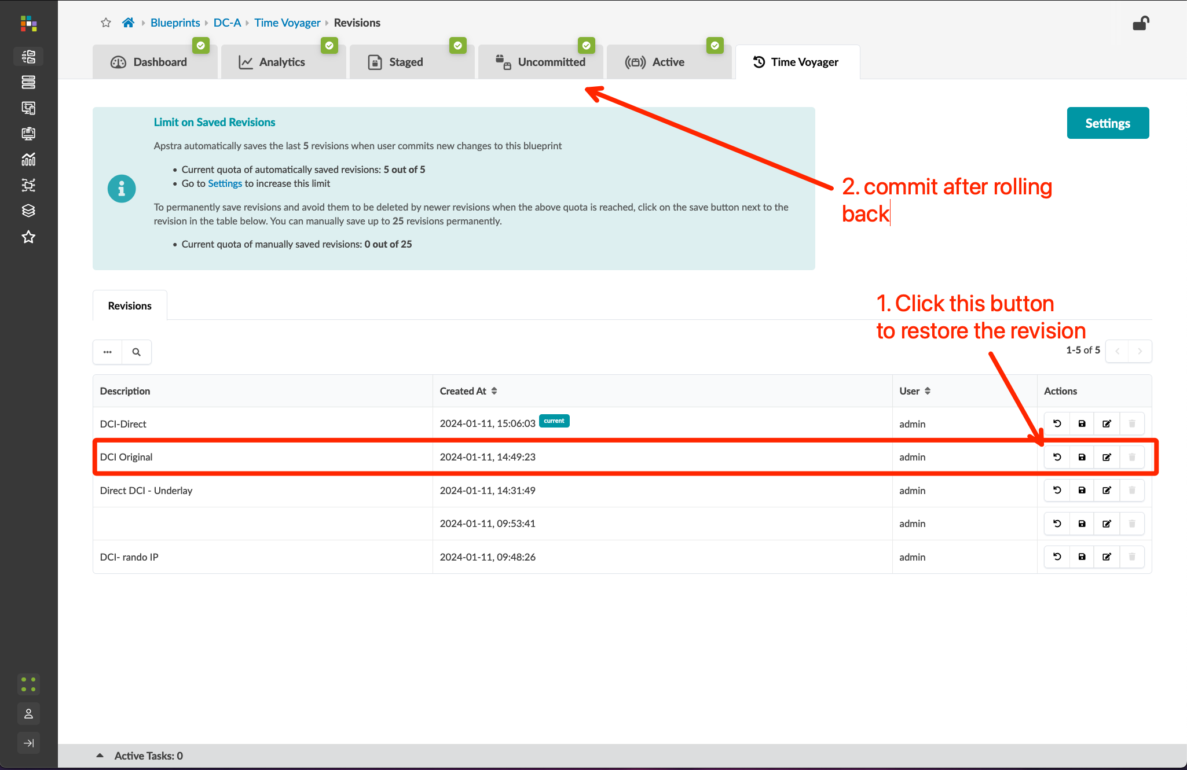
DCI Addendum: Direct Peering– Restoring the Lab
Because this Direct Peering use-case is adjacent to the lab design, I will remove the link from the eve-ng topology and use the Time Voyager feature in Apstra to restore the configuration to the previous state.
I’ve been adding descriptions to my commits, so restoring a previous state is easy. You can add a description to any previous revision after you commit, so if you forgot, no worries.

