Slide 1
Juniper Apstra 4.2.1 EVE-NG Virtual Lab Demo Video series companion guide Video 5: Day-1 Provisioning Services
Colin Doyle, Sr. CE AMER
See the complete video walkthrough on YouTube at: https://www.youtube.com/@5minutejunos
Ask questions at the Juniper Elevate Community using the hashtag #5minutejunos
Adapted from v4.0.0 documentation originally compiled by: - Raymond Lam, SSE APAC - Tony Chan, SSE APAC

Slide 2
Agenda
Prepping your Lab
Day-0 Fabric Onboarding
Virtual Device Profile Verification
Virtual Device Profile Cloning
Onboarding Virtual Nodes
Create ASN Pool and IP Pools
Create Logical Devices and Interface Maps
Create Rack Types
Create Templates
Create Blueprints
Day-1 Service Provisioning
Create Routing Zones
Create Virtual Networks
Assign Virtual Network to Switchports
Add Server Links
Data Center Interconnect
DCI Addendum: Direct Peering
Core/WAN Connectivity
Internet Connectivity
Day-2 Operational Scenarios
Incorrect Cable Patch (RCA, LLDP Link Discovery, Time Voyager)
Config Deviation Checking
Apply custom config through Configlet
View Telemetry Data
Hardware Replacement
Future Documentation
Firewall Service Chaining
Cluster with Service Block
Type-5 Route (fabric integrated) with MNHA
VLAN Stitching
vEvo Fabric

Slide 3
Day-1 Service Provisioning
Create Routing Zones
Create Virtual Networks
Assign Virtual Network to Switchports
Add Testing Hosts
Data Center Interconnect (OTT)
DCI Addendum – Direct Peering
Core Connectivity
Internet Connectivity

Slide 4
Create Routing Zones
A Routing Zone in Apstra is analgous to a routing-instance (VRF) in Junos. Virtual Networks (subnets) are assigned to Routing Zones when created. Like any standard network device, there is always a default instance regardless of any other VRF’s that may be created.
The below diagram illustrates the topology of the data centers after this section.
These diagrams will get more interesting, I promise!
DC-A Blueprint
DC-B Blueprint
Tenant-1 Routing Zone
Tenant-1 Routing Zone

Slide 5
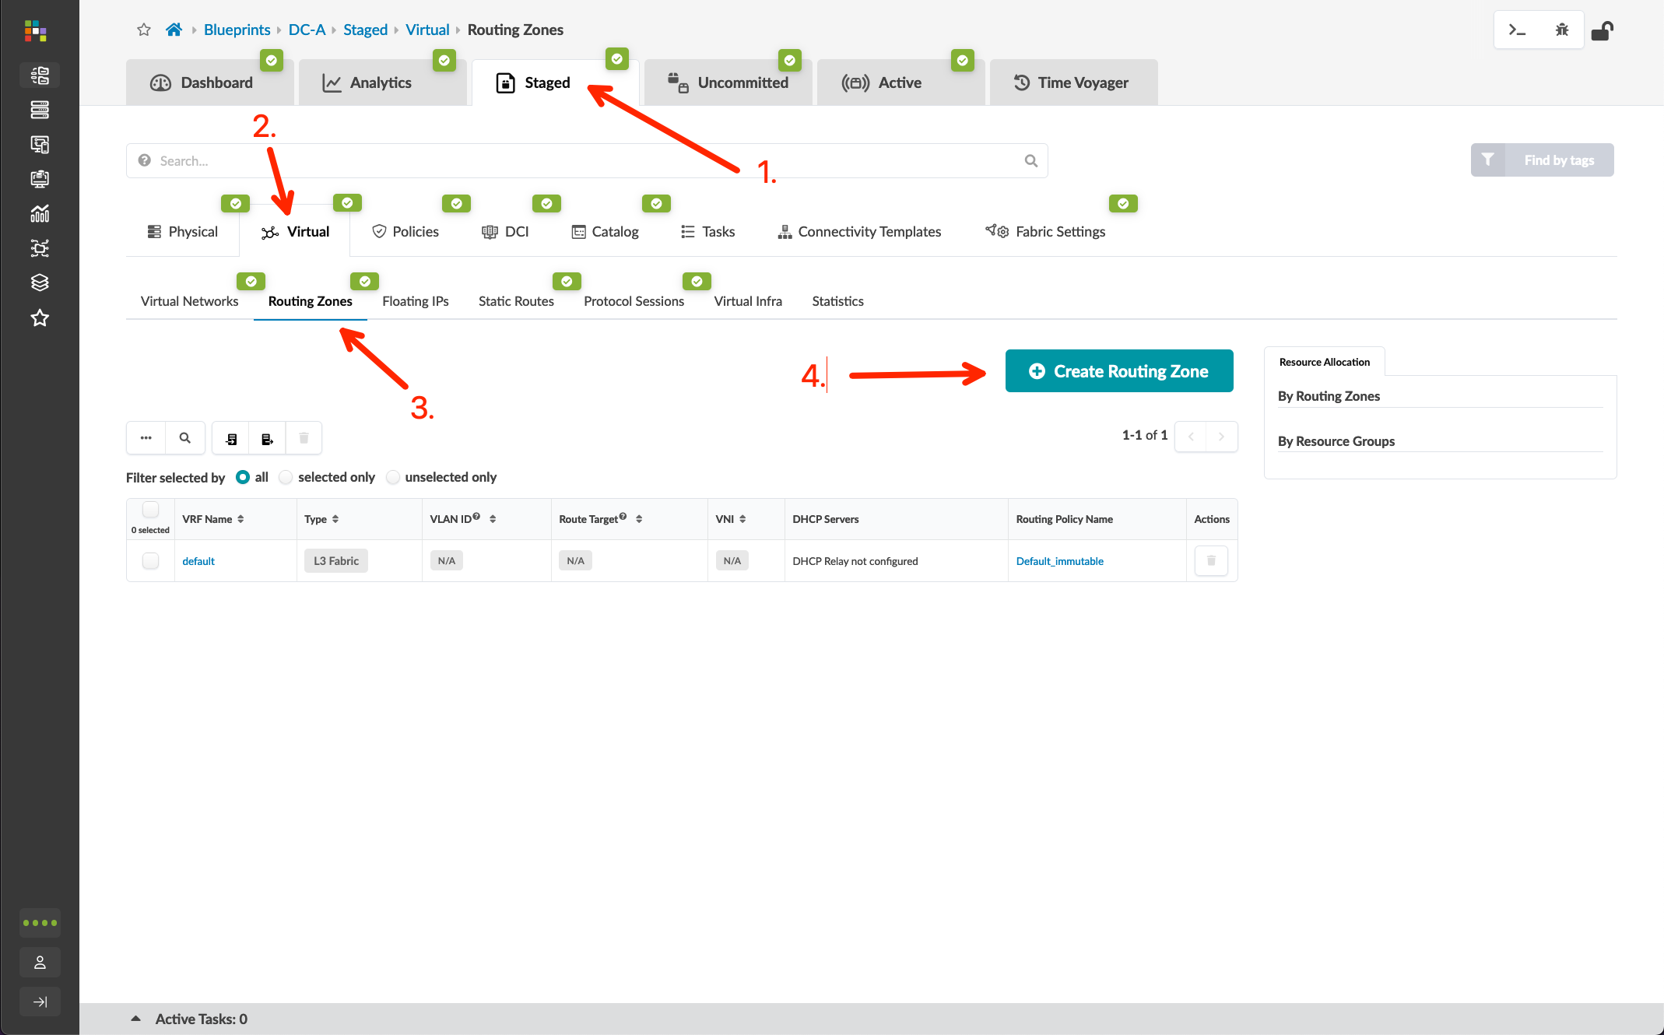
Create Routing Zones
Go to Blueprints > DC-A > Staged > Virtual > Routing Zones, click “Create Routing Zone”, and create a new zone using the information in the table below
VRF Name | Tenant-1
VLAN ID | 10
VNI | 10010
Symmetric IRB Mode | Symmetric (enabled)

Slide 6
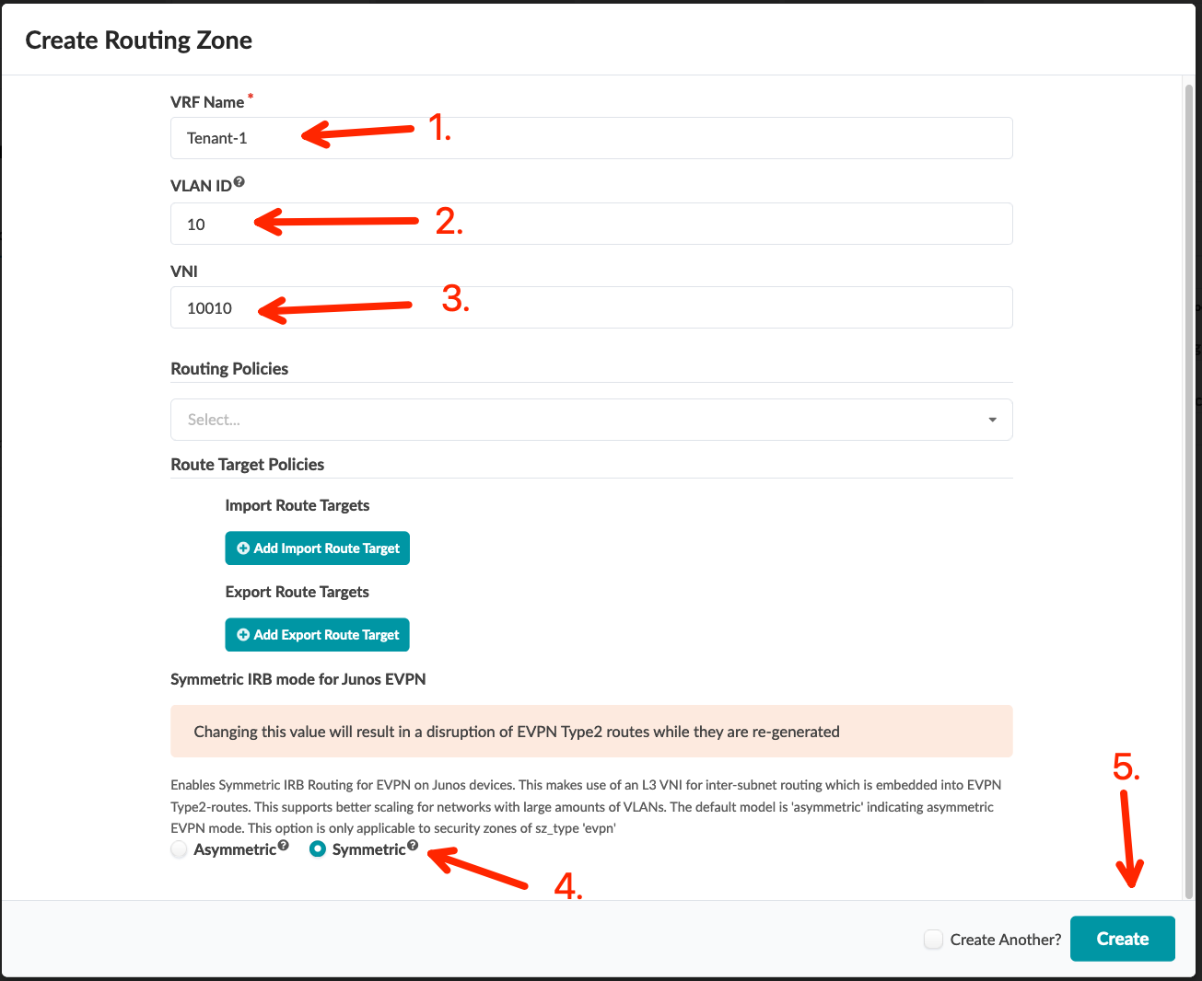
Create Routing Zones
Go to Blueprints > DC-A > Staged > Virtual > Routing Zones, click “Create Routing Zone”, and create a new zone using the information in the table below
VRF Name | Tenant-1
VLAN ID | 10
VNI | 10010
Symmetric IRB Mode | Symmetric (enabled)

Slide 7
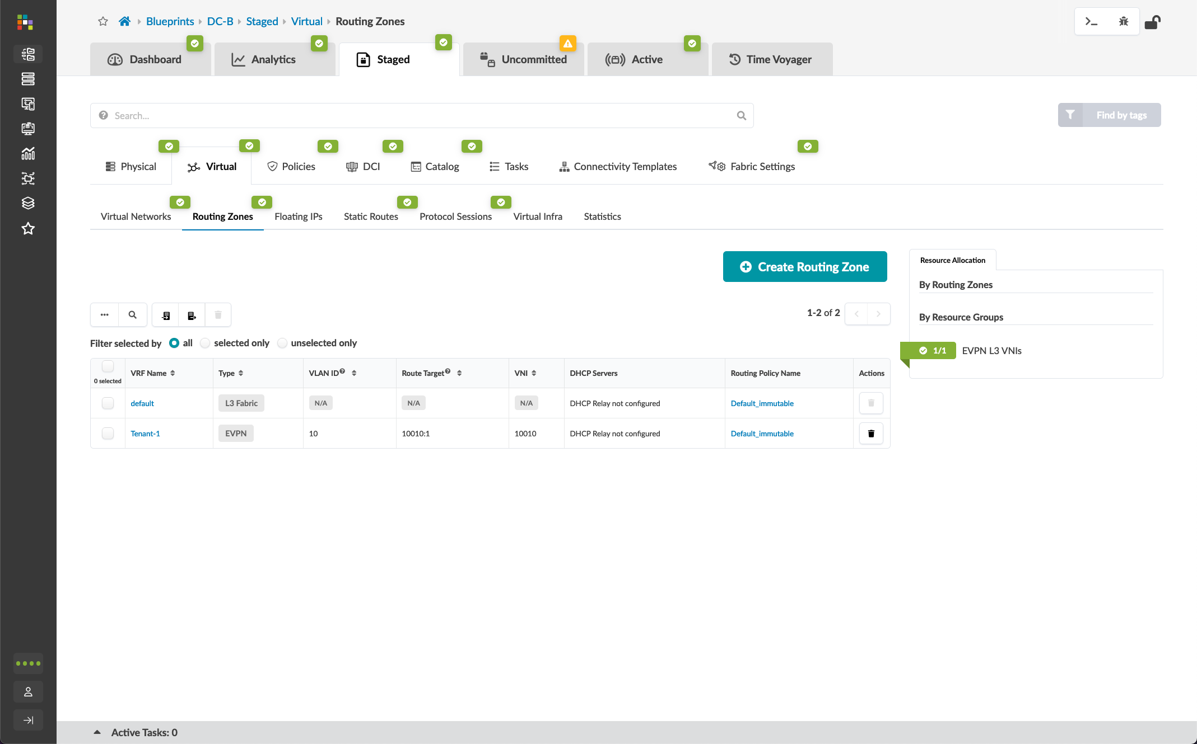
Create Routing Zones
Repeat the previous steps to create the same Tenant-1 routing zone in DC-B
VRF Name | Tenant-1
VLAN ID | 10
VNI | 10010
Symmetric IRB Mode | Symmetric (enabled)

Slide 8
Create Virtual Networks
Next, we will create two Virtual Networks (subnets) in Tenant-1.
The below diagram illustrates the topology of the data center after this section.
DC-A Blueprint
DC-B Blueprint
Tenant-1 Routing Zone
Tenant-1 Routing Zone
vn101 (192.168.101.0/24)
vn101 (192.168.101.0/24)
vn102 (192.168.102.0/24)
vn103 (192.168.103.0/24)

Slide 9
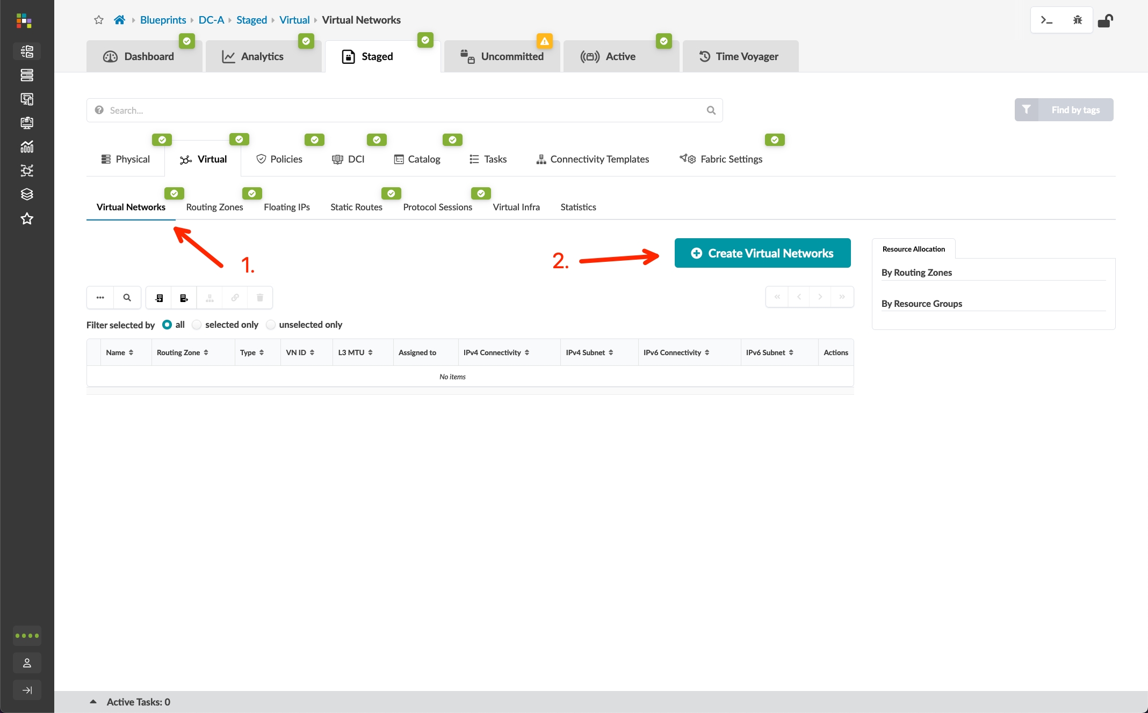
Create Virtual Networks
Go go Blueprints > DC-A > Staged > Virtual > Virtual Networks and create below two virtual networks
Type | VXLAN | VXLAN
Name | vn101 | vn102
Routing Zone | Tenant-1 | Tenant-1
VNI(s) | 10101 | 10102
Reserve Across Blueprint | Yes | Yes
VLAN ID (on leafs) | 101 | 102
IPv4 Subnet | 192.168.101.0/24 | 192.168.102.0/24
Virtual Gateway IPv4 | 192.168.101.1 | 192.168.102.1
Create Connectivity Templates for | Untagged | Untagged
Assign To Rack | server_rack_dc_a_001_leaf_pair1 | server_rack_dc_a_001_leaf_pair1

Slide 10
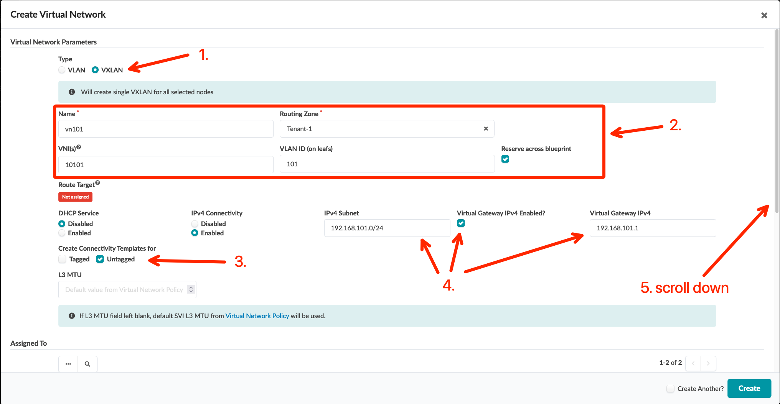
Create Virtual Networks
Go go Blueprints > DC-A > Staged > Virtual > Virtual Networks and create below two virtual networks
Type | VXLAN | VXLAN
Name | vn101 | vn102
Routing Zone | Tenant-1 | Tenant-1
VNI(s) | 10101 | 10102
Reserve Across Blueprint | Yes | Yes
VLAN ID (on leafs) | 101 | 102
IPv4 Subnet | 192.168.101.0/24 | 192.168.102.0/24
Virtual Gateway IPv4 | 192.168.101.1 | 192.168.102.1
Create Connectivity Templates for | Untagged | Untagged
Assign To Rack | server_rack_dc_a_001_leaf_pair1 | server_rack_dc_a_001_leaf_pair1
(example for vn101)

Slide 11
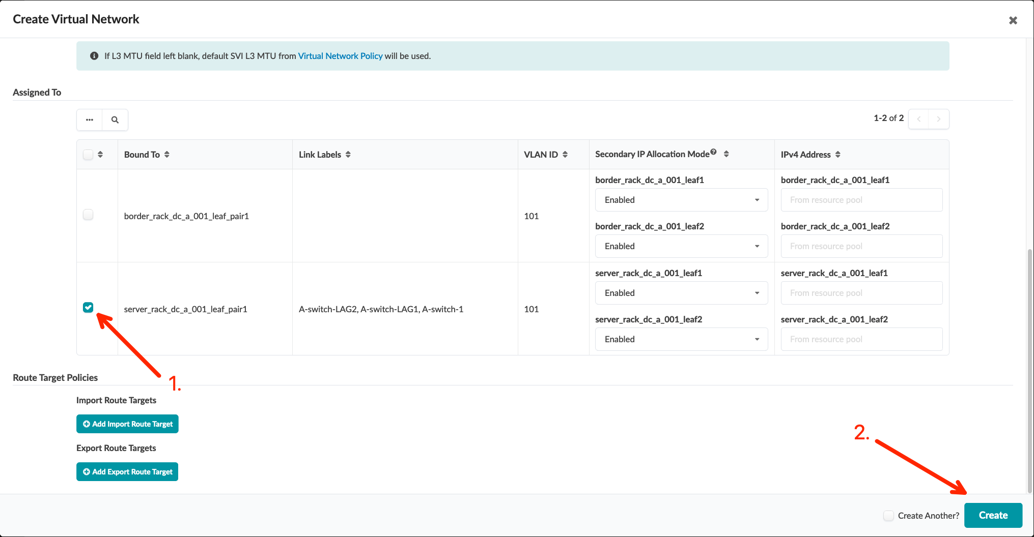
Create Virtual Networks
Go go Blueprints > DC-A > Staged > Virtual > Virtual Networks and create below two virtual networks
Type | VXLAN | VXLAN
Name | vn101 | vn102
Routing Zone | Tenant-1 | Tenant-1
VNI(s) | 10101 | 10102
Reserve Across Blueprint | Yes | Yes
VLAN ID (on leafs) | 101 | 102
IPv4 Subnet | 192.168.101.0/24 | 192.168.102.0/24
Virtual Gateway IPv4 | 192.168.101.1 | 192.168.102.1
Create Connectivity Templates for | Untagged | Untagged
Assign To Rack | server_rack_dc_a_001_leaf_pair1 | server_rack_dc_a_001_leaf_pair1

Slide 12
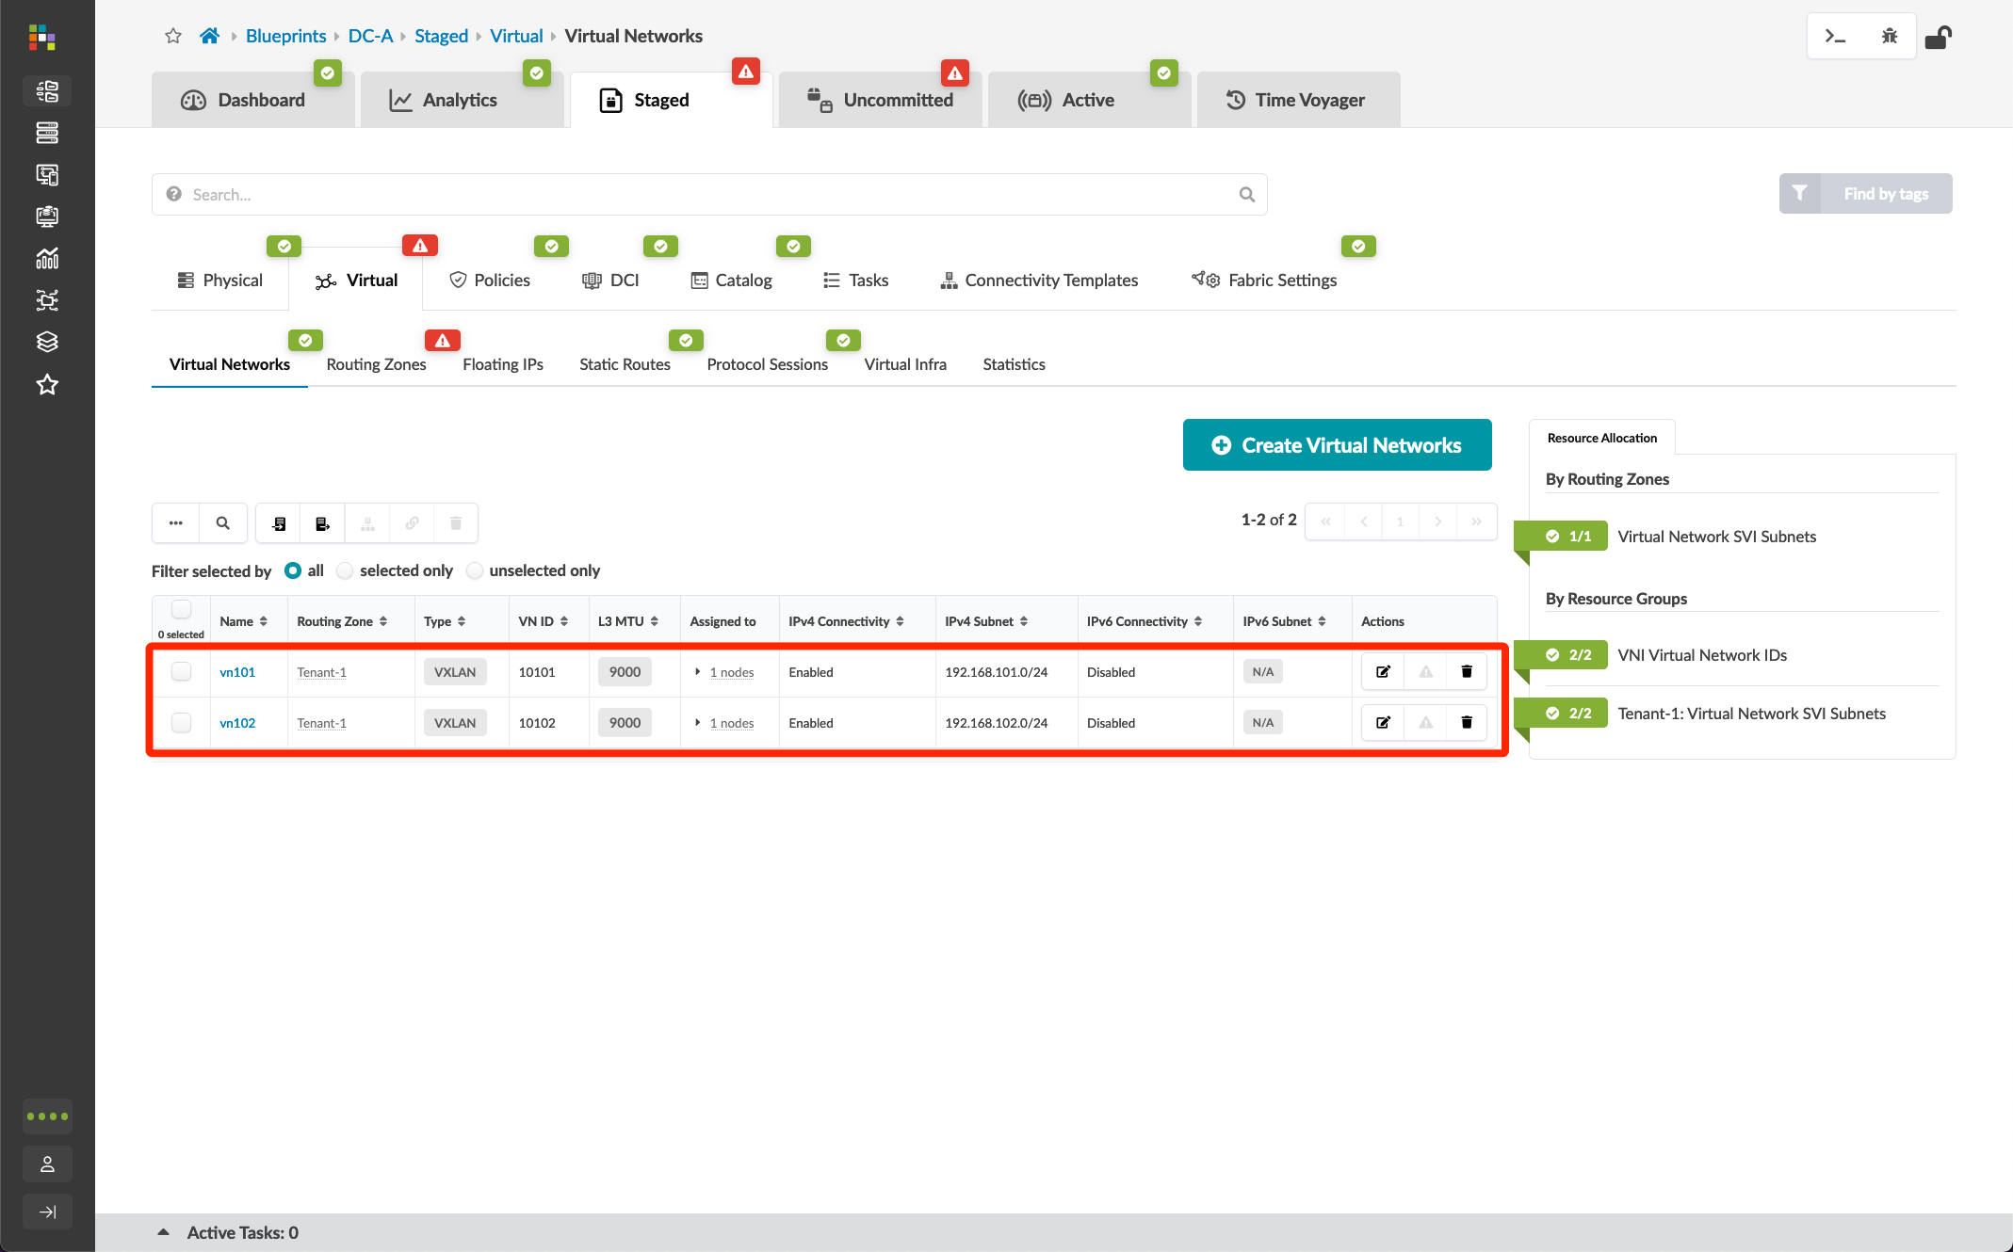
Create Virtual Networks
Go go Blueprints > DC-A > Staged > Virtual > Virtual Networks and create below two virtual networks
Type | VXLAN | VXLAN
Name | vn101 | vn102
Routing Zone | Tenant-1 | Tenant-1
VNI(s) | 10101 | 10102
Reserve Across Blueprint | Yes | Yes
VLAN ID (on leafs) | 101 | 102
IPv4 Subnet | 192.168.101.0/24 | 192.168.102.0/24
Virtual Gateway IPv4 | 192.168.101.1 | 192.168.102.1
Create Connectivity Templates for | Untagged | Untagged
Assign To Rack | server_rack_dc_a_001_leaf_pair1 | server_rack_dc_a_001_leaf_pair1

Slide 13
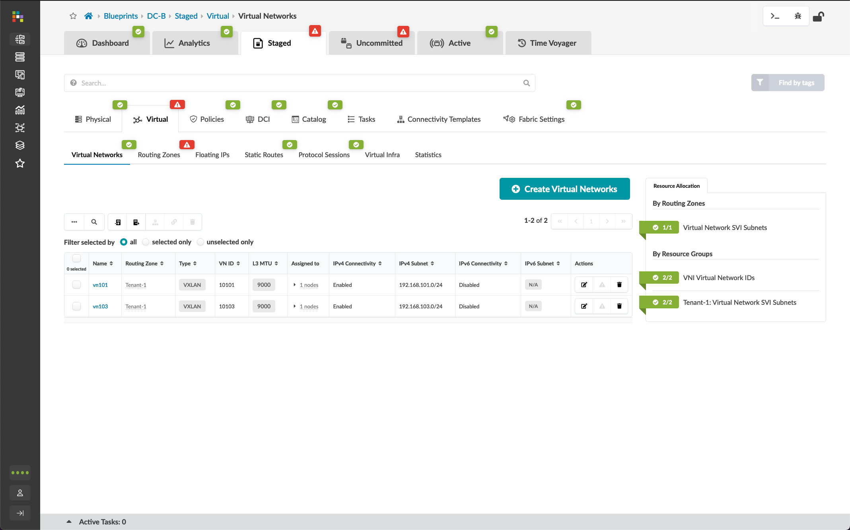
Create Virtual Networks
Repeat the previous steps to create vn101 and vn103 in DC-B
Type | VXLAN | VXLAN
Name | vn101 | vn103
Routing Zone | Tenant-1 | Tenant-1
VNI(s) | 10101 | 10103
Reserve Across Blueprint | Yes | Yes
VLAN ID (on leafs) | 101 | 103
IPv4 Subnet | 192.168.101.0/24 | 192.168.103.0/24
Virtual Gateway IPv4 | 192.168.101.1 | 192.168.103.1
Create Connectivity Templates for | Untagged | Untagged
Assign To Rack | server_rack_dc_b_001_leaf_pair1 | server_rack_dc_b_001_leaf_pair1

Slide 14
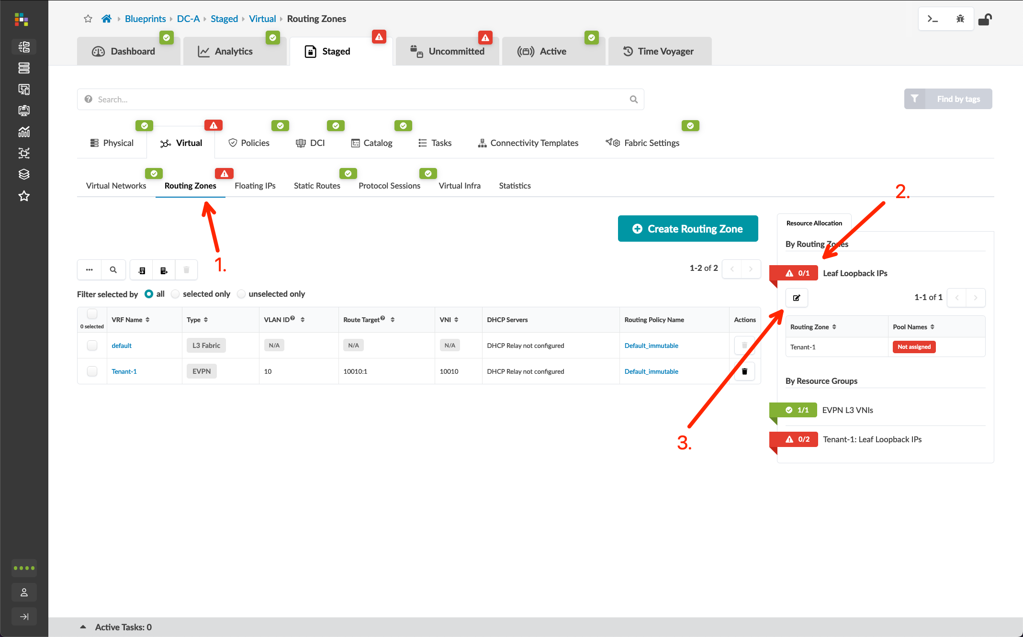
Add Routing Zone Loopback Pool
Go to Blueprints > DC-A > Staged > Virtual > Routing Zones, click the “Leaf Loopback Ips” option, and click the “Edit” button
Add DC-A Loopback to the Tenant-1 Routing Zone pool assignment
Repeat the process for DC-B, adding DC-B Loopback to Tenant-1 Routing Zone pool assignment
Commit the Blueprint for both DC-A and DC-B

Slide 15
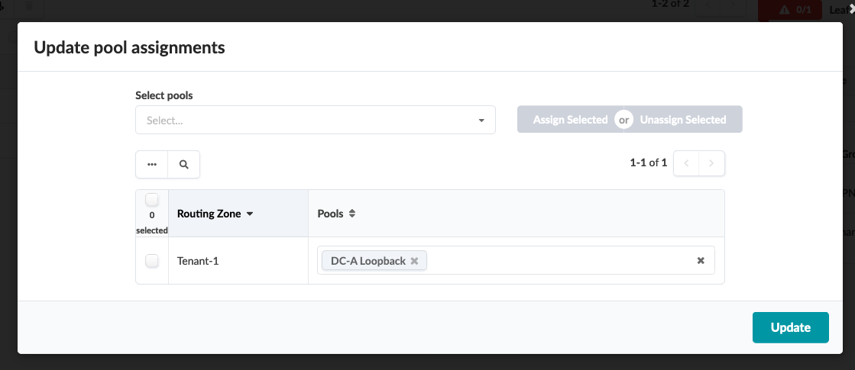
Add Routing Zone Loopback Pool
Go to Blueprints > DC-A > Staged > Virtual > Routing Zones, click the “Leaf Loopback Ips” option, and click the “Edit” button
Add DC-A Loopback to the Tenant-1 Routing Zone pool assignment
Repeat the process for DC-B, adding DC-B Loopback to Tenant-1 Routing Zone pool assignment
Commit the Blueprint for both DC-A and DC-B

Slide 16
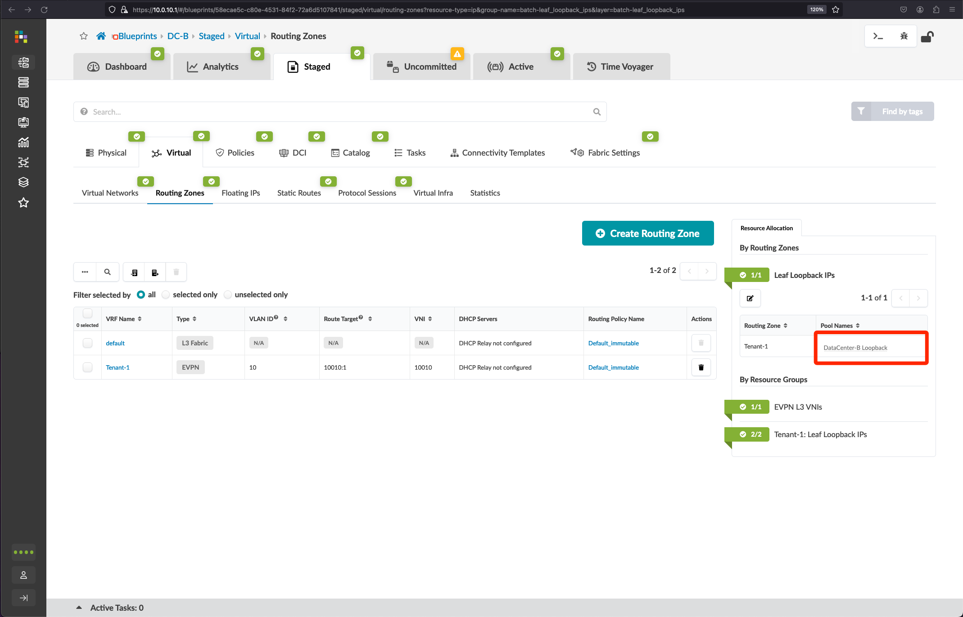
Add Routing Zone Loopback Pool
Go to Blueprints > DC-A > Staged > Virtual > Routing Zones, click the “Leaf Loopback Ips” option, and click the “Edit” button
Add DC-A Loopback to the Tenant-1 Routing Zone pool assignment
Repeat the process for DC-B, adding DC-B Loopback to Tenant-1 Routing Zone pool assignment
Commit the Blueprint for both DC-A and DC-B

Slide 17
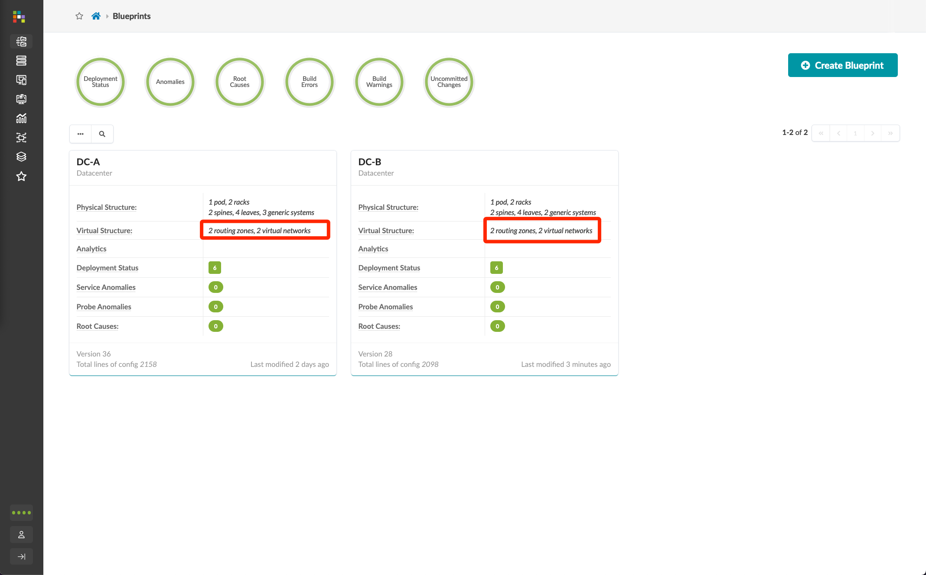
Add Routing Zone Loopback Pool
Go to Blueprints > DC-A > Staged > Virtual > Routing Zones, click the “Leaf Loopback Ips” option, and click the “Edit” button
Add DC-A Loopback to the Tenant-1 Routing Zone pool assignment
Repeat the process for DC-B, adding DC-B Loopback to Tenant-1 Routing Zone pool assignment
Commit the Blueprint for both DC-A and DC-B

Slide 18
Assign Virtual Network to Switchports/LAGs
When creating a Virtual Network, an untagged connectivity template is automatically created by Apstra. Connectivity templates are where you map Virtual Networks to node interfaces that connect to Generic Systems. The auto-generated untagged connectivity templates for our Virtual Networks will be used to assign the respective untagged VLANs to switch ports.
The below diagram illustrates the topology of the data centers after this section.
DC-A Blueprint
Tenant-1 Routing Zone
DC-B Blueprint
Tenant-1 Routing Zone
ae1
vn101 (192.168.101.0/24)
ae1
vn101 (192.168.101.0/24)
vn102 (192.168.102.0/24)
ae2
vn103 (192.168.103.0/24)
ae2
To A-leaf1
ge-0/0/7
To A-leaf2
ge-0/0/7
To A-leaf1
ge-0/0/8
To A-leaf2
ge-0/0/8
To A-leaf1
ge-0/0/9
To B-leaf1
ge-0/0/7
To B-leaf2
ge-0/0/7
To B-leaf1
ge-0/0/8
To B-leaf2
ge-0/0/8
A-bms-1_bridge
A-bms-2_bridge
A-bms-3
B-bms-1_bridge
B-bms-2_bridge
vSRX
vSRX
vSRX
vSRX

Slide 19
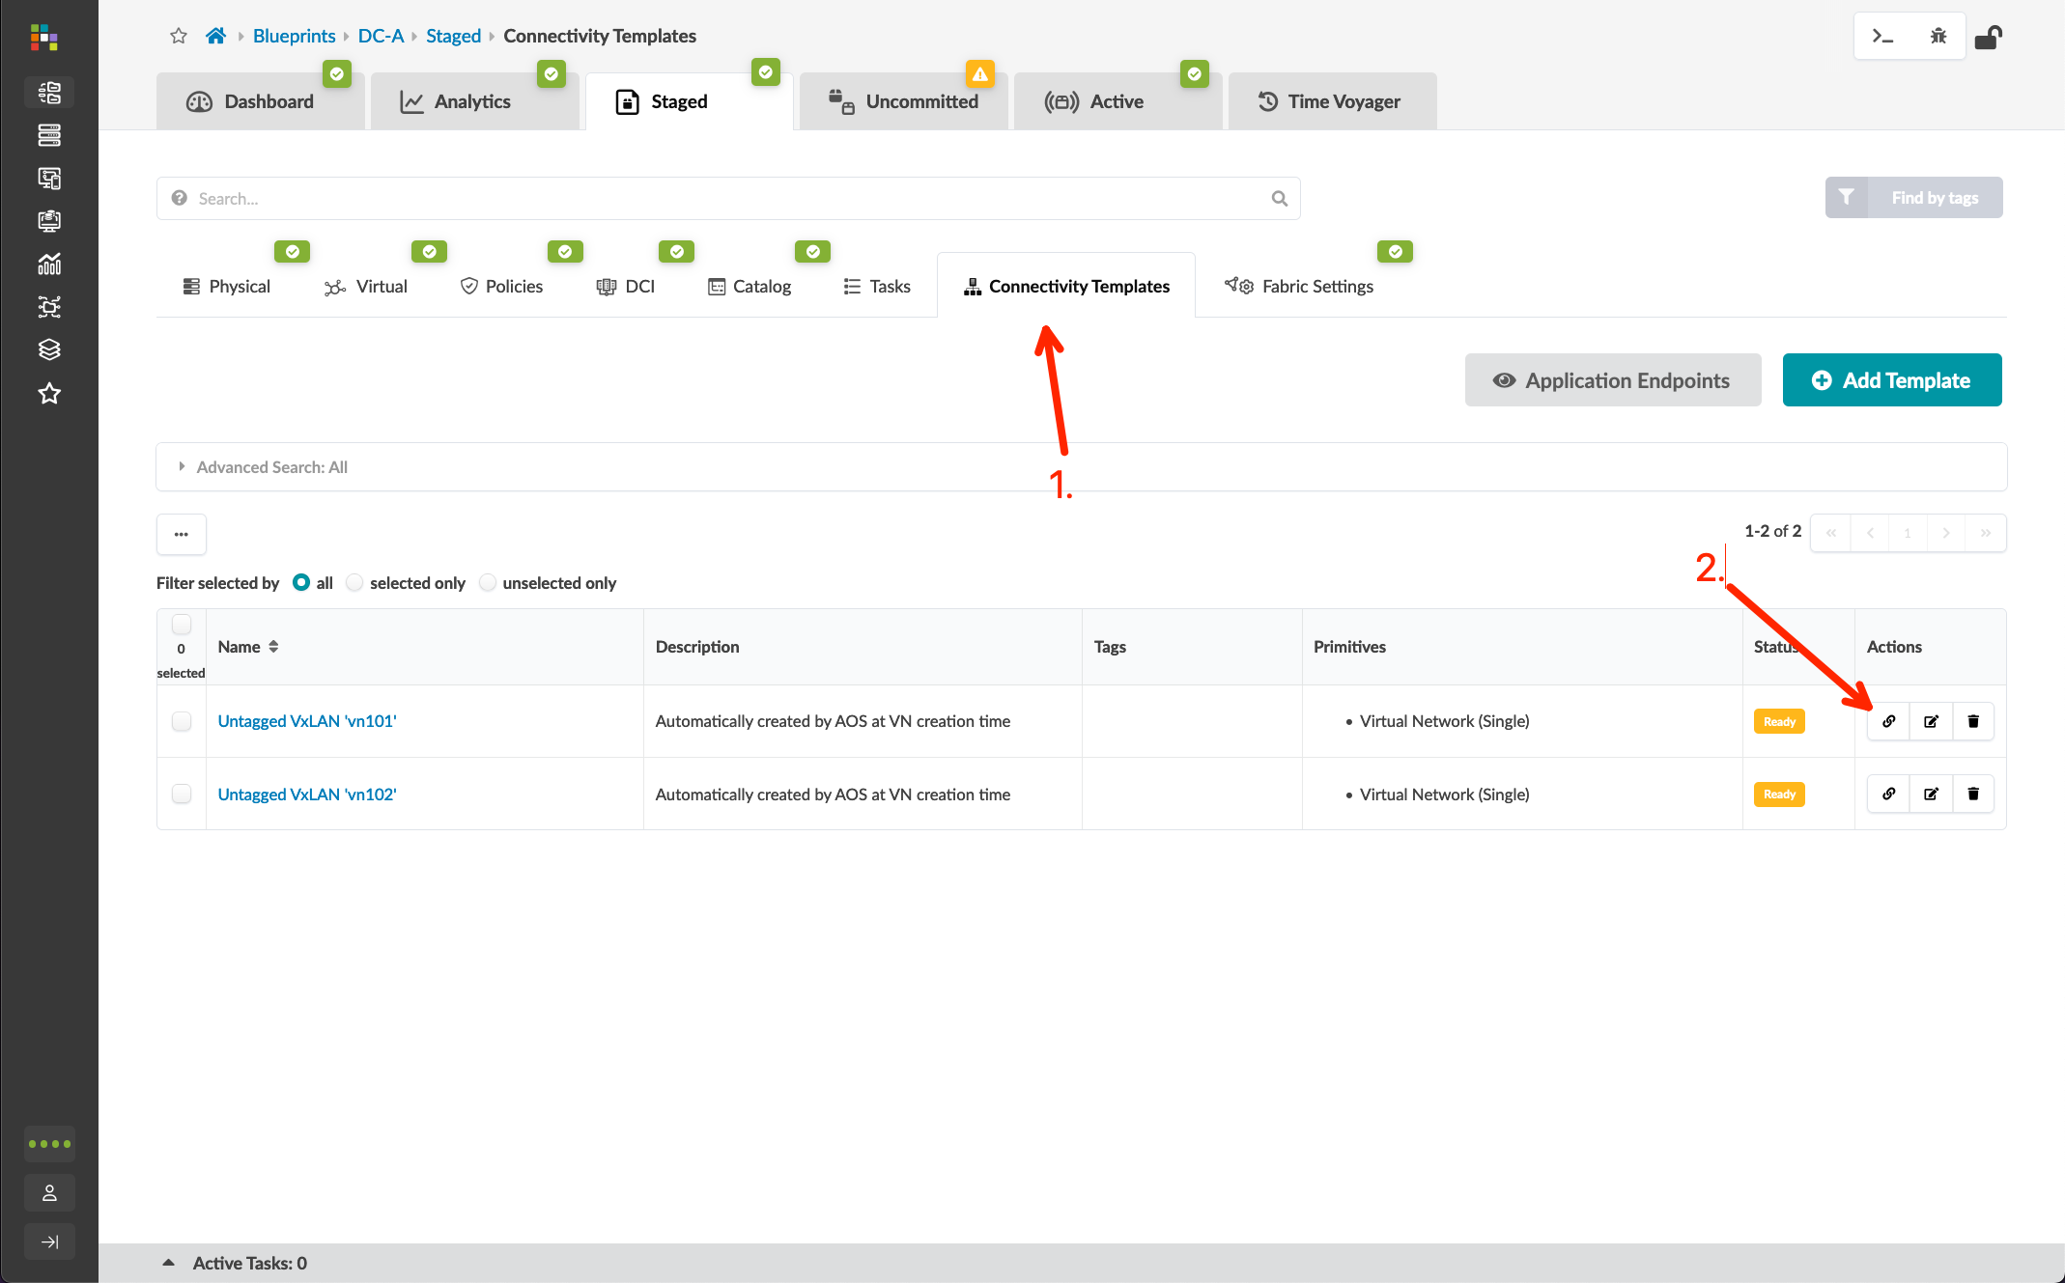
Assign Virtual Network to Switchports/LAGs
Go to Blueprints > DC-A > Staged > Connectivity Templates and click the “Assign” button of the connectivity template you wish to assign
Select the target interface using the table below:
Verify the status of both connectivity templates and click “Application Endpoints” to view the status
From the Application Endpoints page, you can view the assigned template for each switch ports
Update the cable map server links
Go to Staged > Physical > Links and click the “Edit” button
Update the links for the Generic Systems to match your lab topology
Commit the Blueprint
VN | Switch Name | Interface
vn101 | server_rack_dc_a_001_leaf1 / server_rack_dc_a_001_leaf2 (Leaf-pair) | ae1
 | server_rack_dc_a_001_leaf1 (Leaf) | ge-0/0/4
vn102 | server_rack_dc_a_001_leaf1 / server_rack_dc_a_001_leaf2 (Leaf-pair) | ae2

Slide 20
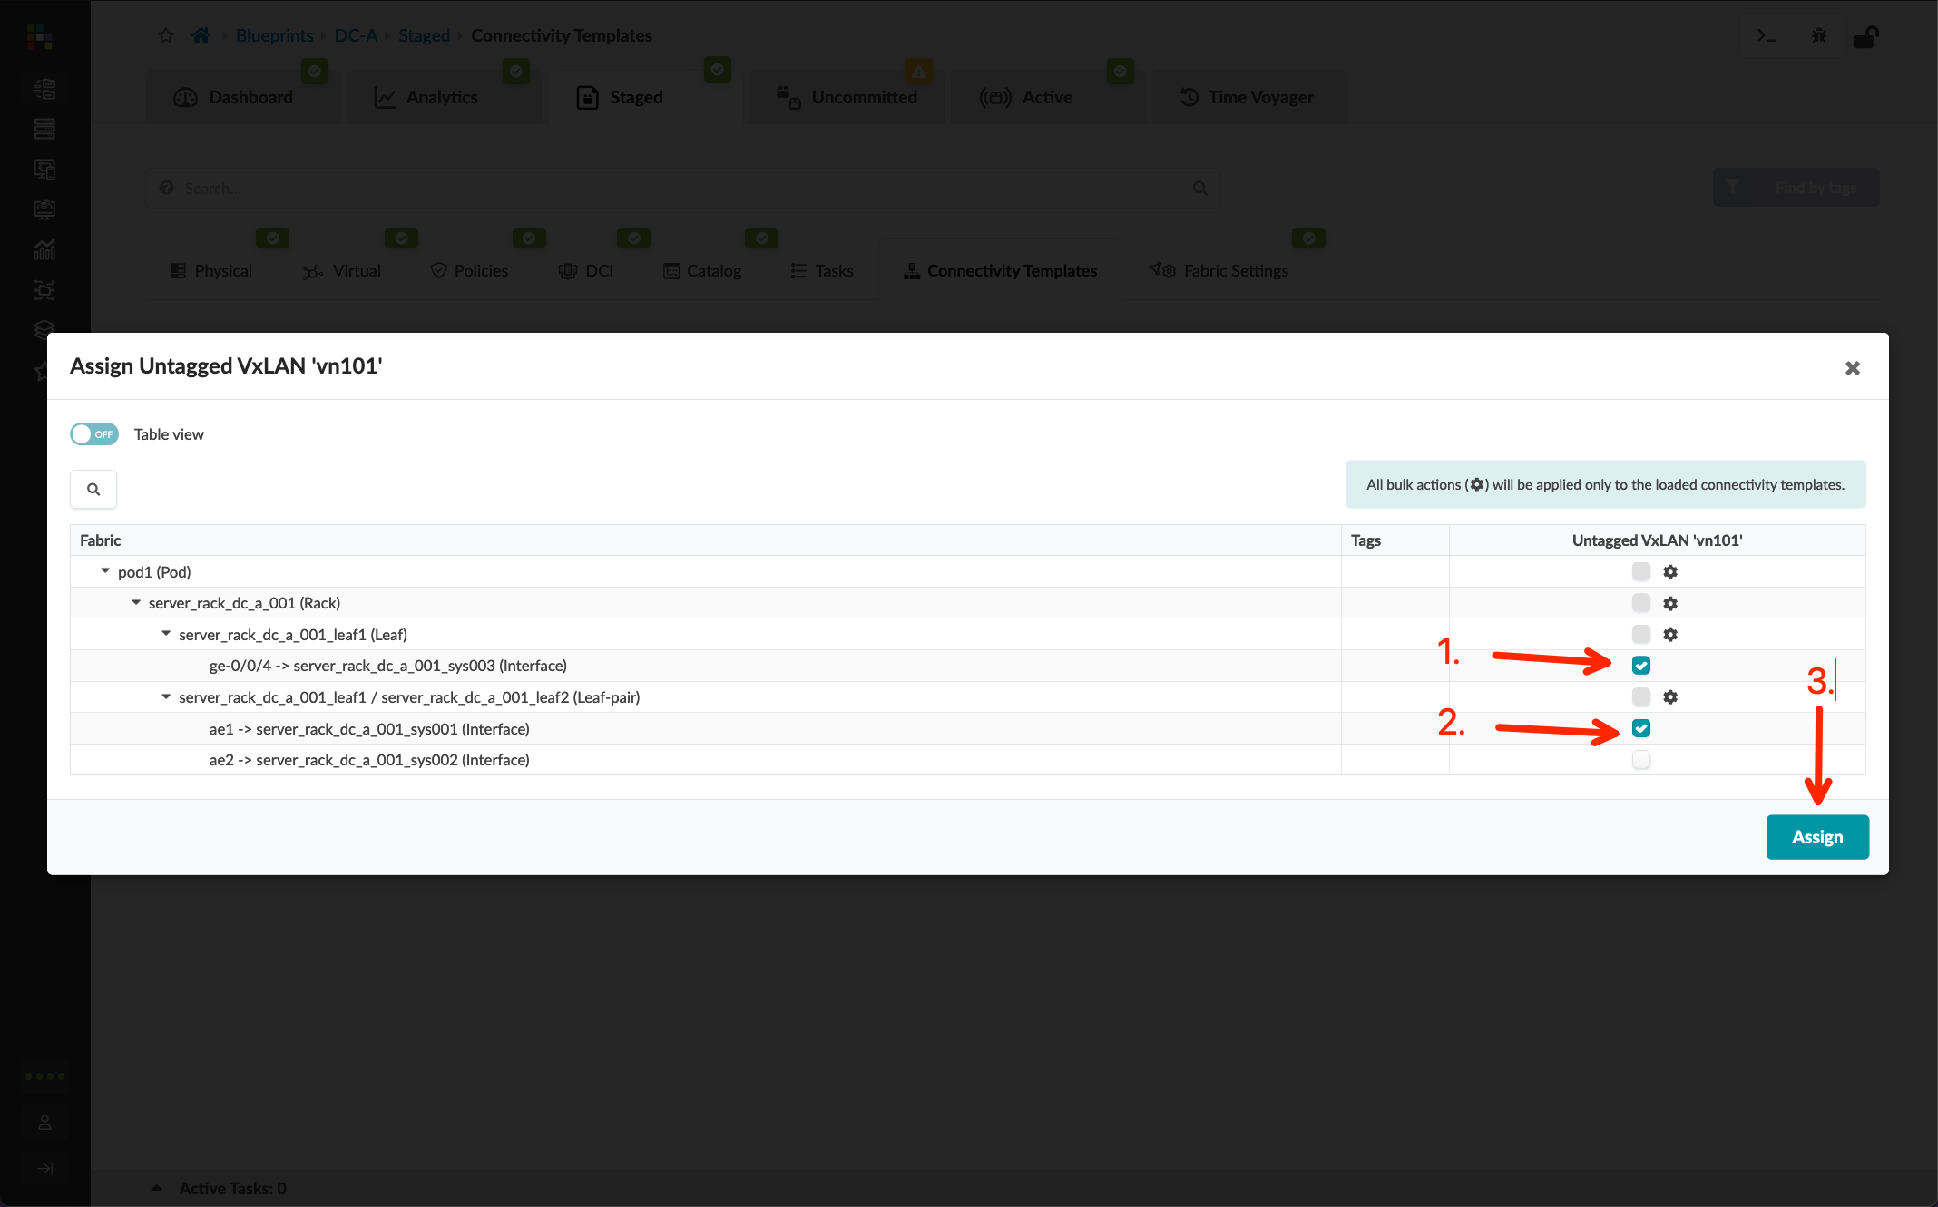
Assign Virtual Network to Switchports/LAGs
Go to Blueprints > DC-A > Staged > Connectivity Templates and click the “Assign” button of the connectivity template you wish to assign
Select the target interface using the table below:
Verify the status of both connectivity templates and click “Application Endpoints” to view the status
From the Application Endpoints page, you can view the assigned template for each switch ports
Update the cable map server links
Go to Staged > Physical > Links and click the “Edit” button
Update the links for the Generic Systems to match your lab topology
Commit the Blueprint
VN | Switch Name | Interface
vn101 | server_rack_dc_a_001_leaf1 / server_rack_dc_a_001_leaf2 (Leaf-pair) | ae1
 | server_rack_dc_a_001_leaf1 (Leaf) | ge-0/0/4
vn102 | server_rack_dc_a_001_leaf1 / server_rack_dc_a_001_leaf2 (Leaf-pair) | ae2
(example shows vn101 – repeat for vn102)

Slide 21
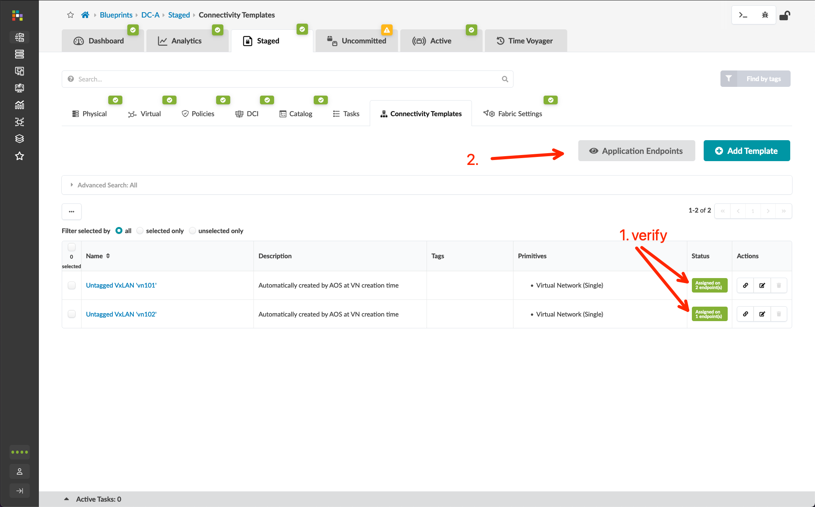
Assign Virtual Network to Switchports/LAGs
Go to Blueprints > DC-A > Staged > Connectivity Templates and click the “Assign” button of the connectivity template you wish to assign
Select the target interface using the table below:
Verify the status of both connectivity templates and click “Application Endpoints” to view the status
From the Application Endpoints page, you can view the assigned template for each switch ports
Update the cable map server links
Go to Staged > Physical > Links and click the “Edit” button
Update the links for the Generic Systems to match your lab topology
Commit the Blueprint
VN | Switch Name | Interface
vn101 | server_rack_dc_a_001_leaf1 / server_rack_dc_a_001_leaf2 (Leaf-pair) | ae1
 | server_rack_dc_a_001_leaf1 (Leaf) | ge-0/0/4
vn102 | server_rack_dc_a_001_leaf1 / server_rack_dc_a_001_leaf2 (Leaf-pair) | ae2

Slide 22
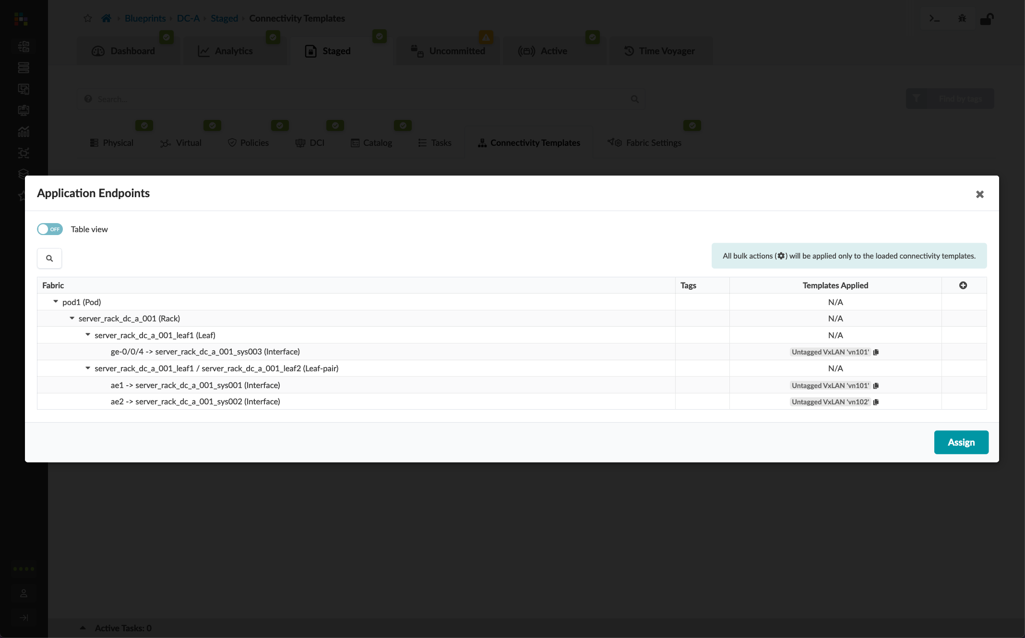
Assign Virtual Network to Switchports/LAGs
Go to Blueprints > DC-A > Staged > Connectivity Templates and click the “Assign” button of the connectivity template you wish to assign
Select the target interface using the table below:
Verify the status of both connectivity templates and click “Application Endpoints” to view the status
From the Application Endpoints page, you can view the assigned template for each switch ports
Update the cable map server links
Go to Staged > Physical > Links and click the “Edit” button
Update the links for the Generic Systems to match your lab topology
Commit the Blueprint
VN | Switch Name | Interface
vn101 | server_rack_dc_a_001_leaf1 / server_rack_dc_a_001_leaf2 (Leaf-pair) | ae1
 | server_rack_dc_a_001_leaf1 (Leaf) | ge-0/0/4
vn102 | server_rack_dc_a_001_leaf1 / server_rack_dc_a_001_leaf2 (Leaf-pair) | ae2

Slide 23
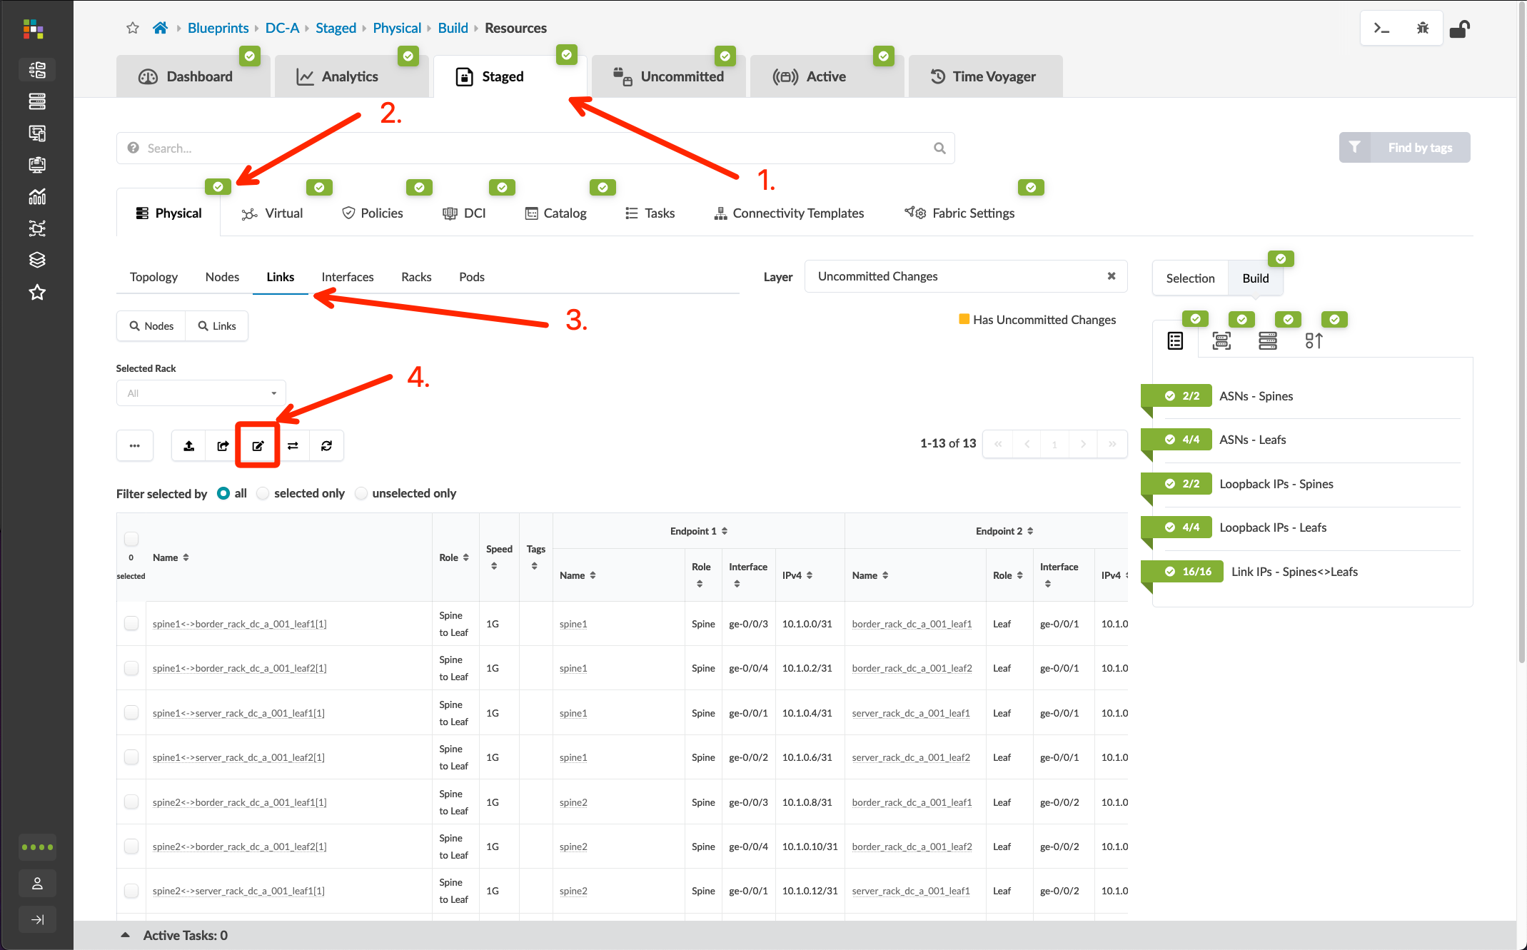
Assign Virtual Network to Switchports/LAGs
Go to Blueprints > DC-A > Staged > Connectivity Templates and click the “Assign” button of the connectivity template you wish to assign
Select the target interface using the table below:
Verify the status of both connectivity templates and click “Application Endpoints” to view the status
From the Application Endpoints page, you can view the assigned template for each switch ports
Update the cable map server links
Go to Staged > Physical > Links and click the “Edit” button
Update the links for the Generic Systems to match your lab topology
Commit the Blueprint
VN | Switch Name | Interface
vn101 | server_rack_dc_a_001_leaf1 / server_rack_dc_a_001_leaf2 (Leaf-pair) | ae1
 | server_rack_dc_a_001_leaf1 (Leaf) | ge-0/0/4
vn102 | server_rack_dc_a_001_leaf1 / server_rack_dc_a_001_leaf2 (Leaf-pair) | ae2

Slide 24
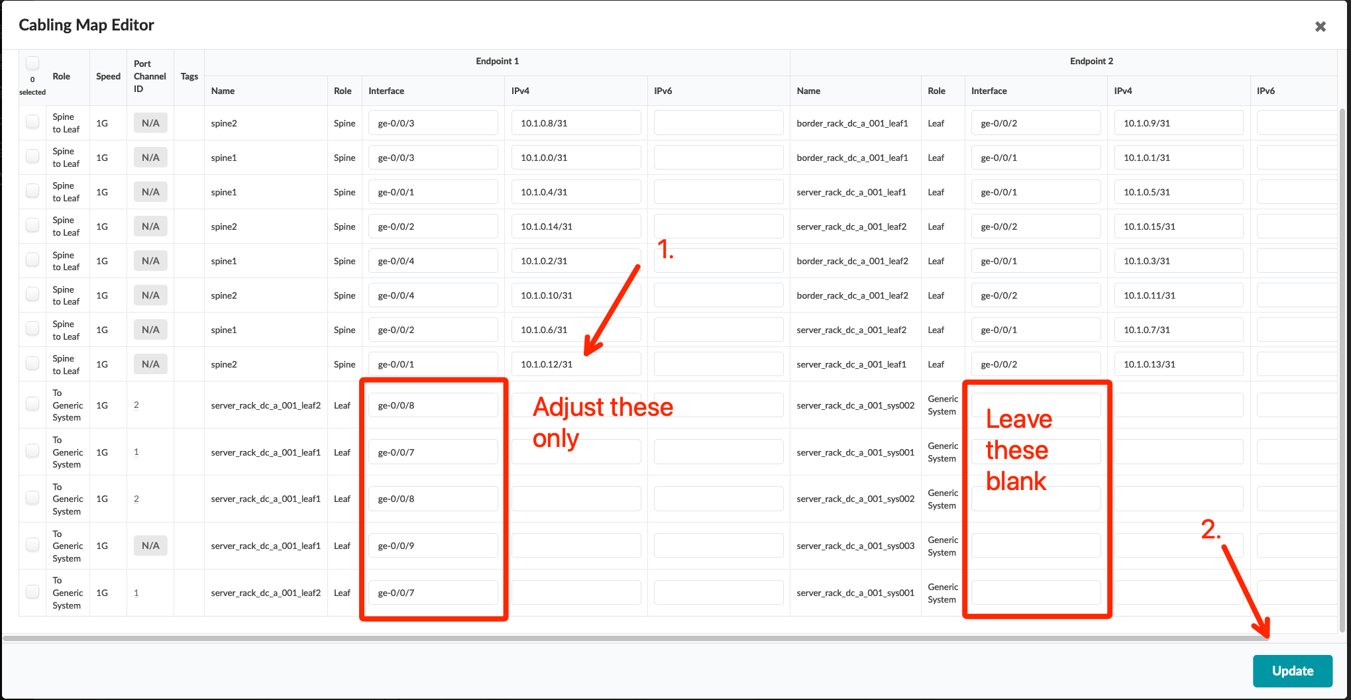
Assign Virtual Network to Switchports/LAGs
Port Channel ID (ae) | Endpoint 1 (switch) | Interface | Endpoint 2 (server)
1 | server_rack_dc_a_001_leaf1 | ge-0/0/7 | server_rack_dc_a_001_sys001
2 | server_rack_dc_a_001_leaf1 | ge-0/0/8 | server_rack_dc_a_001_sys002
n/a | server_rack_dc_a_001_leaf1 | ge-0/0/9 | server_rack_dc_a_001_sys003
1 | server_rack_dc_a_001_leaf2 | ge-0/0/7 | server_rack_dc_a_001_sys001
2 | server_rack_dc_a_001_leaf2 | ge-0/0/8 | server_rack_dc_a_001_sys002
Go to Blueprints > DC-A > Staged > Connectivity Templates and click the “Assign” button of the connectivity template you wish to assign
Select the target interface using the table below:
Verify the status of both connectivity templates and click “Application Endpoints” to view the status
From the Application Endpoints page, you can view the assigned template for each switch ports
Update the cable map server links
Go to Staged > Physical > Links and click the “Edit” button
Update the links for the Generic Systems to match your lab topology
Commit the Blueprint
VN | Switch Name | Interface
vn101 | server_rack_dc_a_001_leaf1 / server_rack_dc_a_001_leaf2 (Leaf-pair) | ae1
 | server_rack_dc_a_001_leaf1 (Leaf) | ge-0/0/4
vn102 | server_rack_dc_a_001_leaf1 / server_rack_dc_a_001_leaf2 (Leaf-pair) | ae2

Slide 25
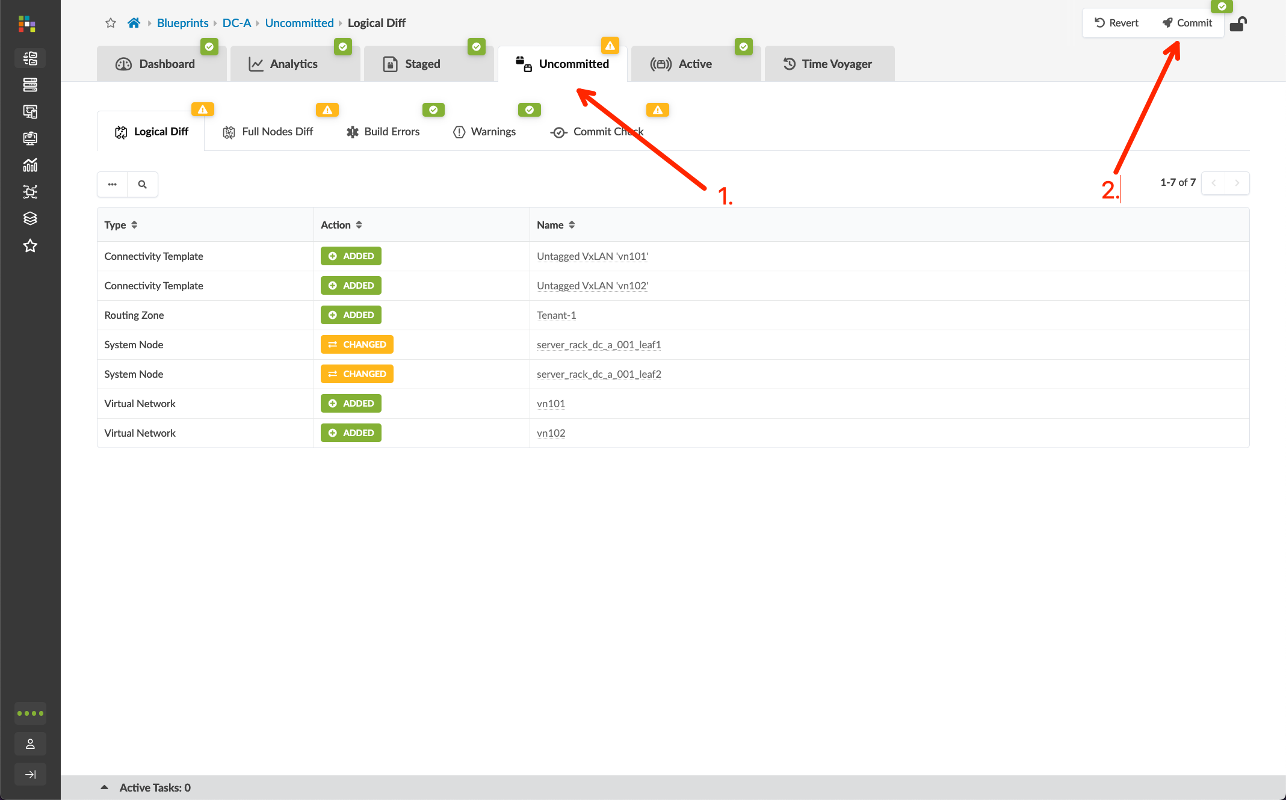
Assign Virtual Network to Switchports/LAGs
Go to Blueprints > DC-A > Staged > Connectivity Templates and click the “Assign” button of the connectivity template you wish to assign
Select the target interface using the table below:
Verify the status of both connectivity templates and click “Application Endpoints” to view the status
From the Application Endpoints page, you can view the assigned template for each switch ports
Update the cable map server links
Go to Staged > Physical > Links and click the “Edit” button
Update the links for the Generic Systems to match your lab topology
Commit the Blueprint
VN | Switch Name | Interface
vn101 | server_rack_dc_a_001_leaf1 / server_rack_dc_a_001_leaf2 (Leaf-pair) | ae1
 | server_rack_dc_a_001_leaf1 (Leaf) | ge-0/0/4
vn102 | server_rack_dc_a_001_leaf1 / server_rack_dc_a_001_leaf2 (Leaf-pair) | ae2

Slide 26
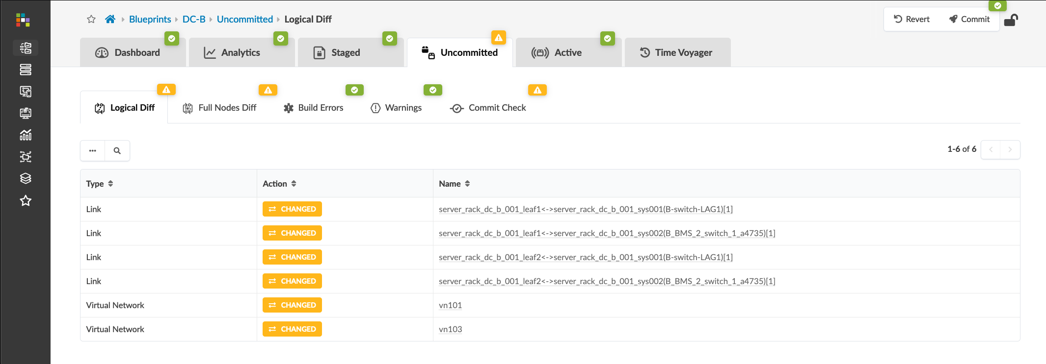
Assign Virtual Network to Switchports/LAGs
Repeat the process for DC-B and commit the Blueprint
Update Switchport= Assignments
Assign Virtual Networks to LAGs
Port Channel ID (ae) | Endpoint 1 (switch) | Interface | Endpoint 2 (server)
1 | server_rack_dc_b_001_leaf1 | ge-0/0/7 | server_rack_dc_b_001_sys001
2 | server_rack_dc_b_001_leaf1 | ge-0/0/8 | server_rack_dc_b_001_sys002
1 | server_rack_dc_b_001_leaf2 | ge-0/0/7 | server_rack_dc_b_001_sys001
2 | server_rack_dc_b_001_leaf2 | ge-0/0/8 | server_rack_dc_b_001_sys002
VN | Switch Name | Interface
vn101 | server_rack_dc_b_001_leaf1 / server_rack_dc_b_001_leaf2 (Leaf-pair) | ae1
vn103 | server_rack_dc_b_001_leaf1 / server_rack_dc_b_001_leaf2 (Leaf-pair) | ae2

