Slide 1
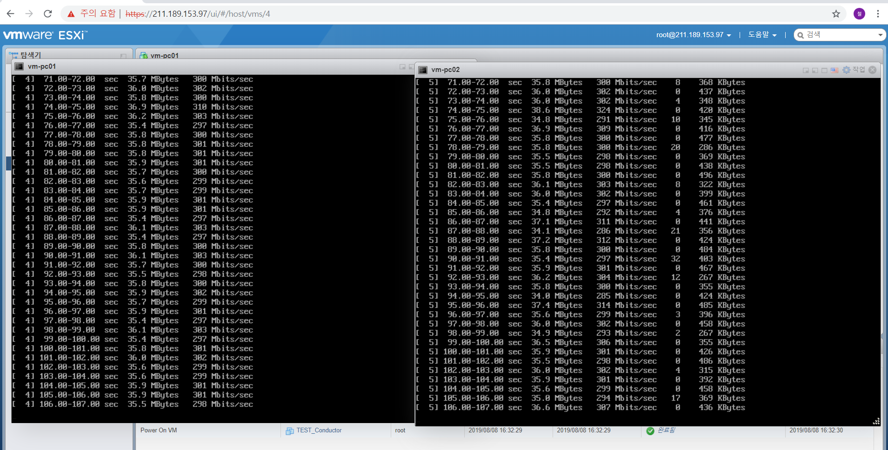
Iperf screenshot

Slide 2
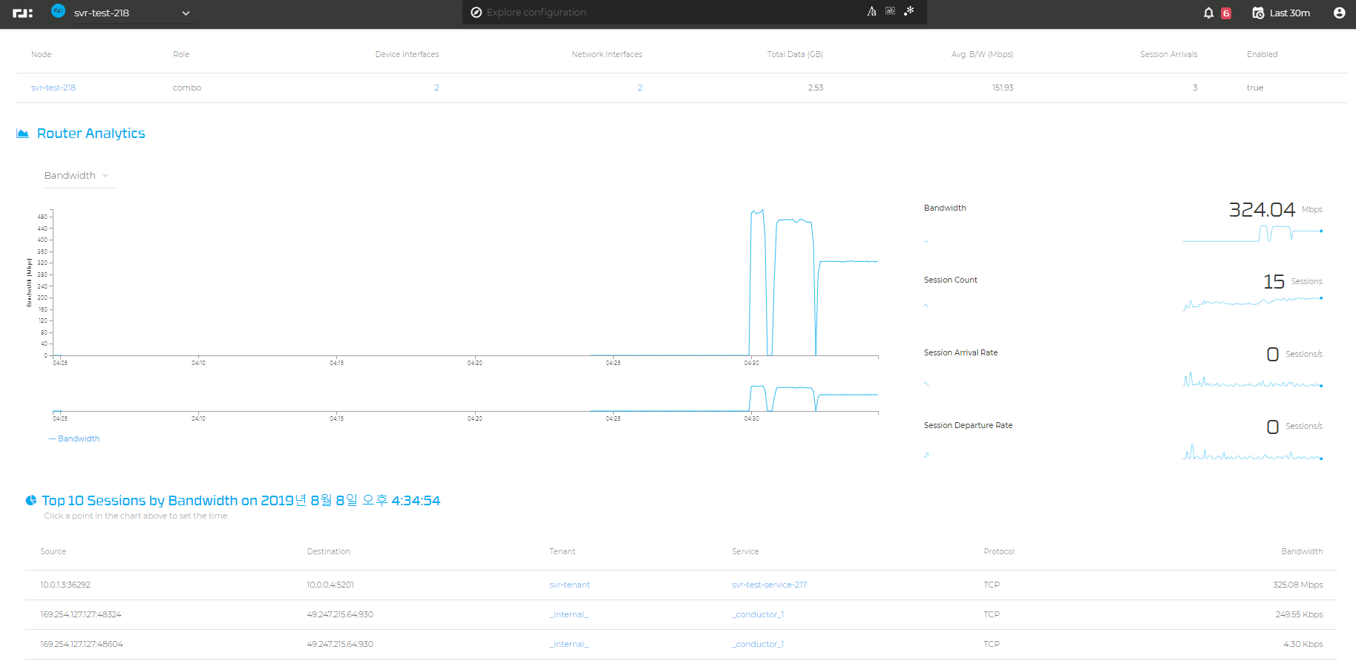
Screenshot of conductor

