Slide 1
Juniper Apstra 4.2.1 EVE-NG Virtual Lab Demo Video series companion guide Video 9: Day-1 Core/WAN Connectivity
Colin Doyle, Sr. CE AMER
See the complete video walkthrough on YouTube at: https://www.youtube.com/@5minutejunos
Ask questions at the Juniper Elevate Community using the hashtag #5minutejunos
Adapted from v4.0.0 documentation originally compiled by: - Raymond Lam, SSE APAC - Tony Chan, SSE APAC

Slide 2
Agenda
Prepping your Lab
Day-0 Fabric Onboarding
Virtual Device Profile Verification
Virtual Device Profile Cloning
Onboarding Virtual Nodes
Create ASN Pool and IP Pools
Create Logical Devices and Interface Maps
Create Rack Types
Create Templates
Create Blueprints
Day-1 Service Provisioning
Create Routing Zones
Create Virtual Networks
Assign Virtual Network to Switchports
Add Server Links
Data Center Interconnect
DCI Addendum: Direct Peering
Core/WAN Connectivity
Internet Connectivity
Day-2 Operational Scenarios
Incorrect Cable Patch (RCA, LLDP Link Discovery, Time Voyager)
Config Deviation Checking
Apply custom config through Configlet
View Telemetry Data
Hardware Replacement
Future Documentation
Firewall Service Chaining
Cluster with Service Block
Type-5 Route (fabric integrated) with MNHA
VLAN Stitching
vEvo Fabric

Slide 3
Day-1 Service Provisioning
Create Routing Zones
Create Virtual Networks
Assign Virtual Network to Switchports
Add Testing Hosts
Data Center Interconnect (OTT)
DCI Addendum – Direct Peering
Core Connectivity
Internet Connectivity

Slide 4
Core/WAN Connectivity
Core/WAN connectivity can be simulated using a few different methods:
Connecting your external DCI routers to additional nodes and hosts your lab
Connecting your external DCI routers to a network outside of your lab with hosts and Internet connectivity
A combination
This section of our lab will contain elements that are very specific to my (author’s) lab environment. I will make every effort to provide instructions that allow the you to understand the intent so that intent can be applied to your own lab. You may find that your own lab requires significant deviation from my specific design, but hopefully the core-concepts will remain relevant.

Slide 5
Core/WAN Connectivity
In our example, the external DCI routers will connect to a single vSRX gateway that connects into a physical lab network. The vSRX will learn about the fabric networks using BGP and advertise those networks to an external lab firewall. This external lab firewall will provide direct connectivity to the public Internet, as well as a few other lab hosts that can be used for testing.
External Network
HSIA
DC-A Blueprint
DC-B Blueprint
Tenant-1 Routing Zone
Tenant-1 Routing Zone
Stretch L2 OTT DCI
ae1
vn101 (192.168.101.0/24)
ae1
vn101 (192.168.101.0/24)
vn102 (192.168.102.0/24)
ae2
vn103 (192.168.103.0/24)
ae2
A-bms-1
A-bms-2
A-bms-3
B-bms-1
B-bms-2
192.168.101.11
192.168.102.22
192.168.101.33
192.168.101.44
192.168.103.55

Slide 6
Core/WAN Connectivity (a few other notes)
As I’ve been building out this section, I’ve encountered a few other items of note that are worth calling out here at the start.
Connectivity Templates
Method 1: Build discrete templates for DCI and Core connections
Method 2: Combing DCI and Core connections into existing templates based on the border leaf interface they are assigned to
I can make operational arguments for both methods, so I’ll use Method 1 for DC-A, and Method 2 for DC-B. Functionally, there is no difference.
External (non-fabric/non-Apstra-managed) devices, default route advertisement, and route policy in general
I’ll do my best to explain the intent of these elements (like external DCI routers, WAN router, IGP’s, etc…) in my own lab and trust that you can apply this intent to your own environment. To keep things simple, I’m not building separate routing instances to isolate DCI and Core peering. My import/export policies are bare-minimum. I’m not using type-5 routes on external routers (this would optimize host reachability). It’s about putting just enough configuration in place to get things working. This lab is a starting point for use-case specific customization.
- Colin

Slide 7
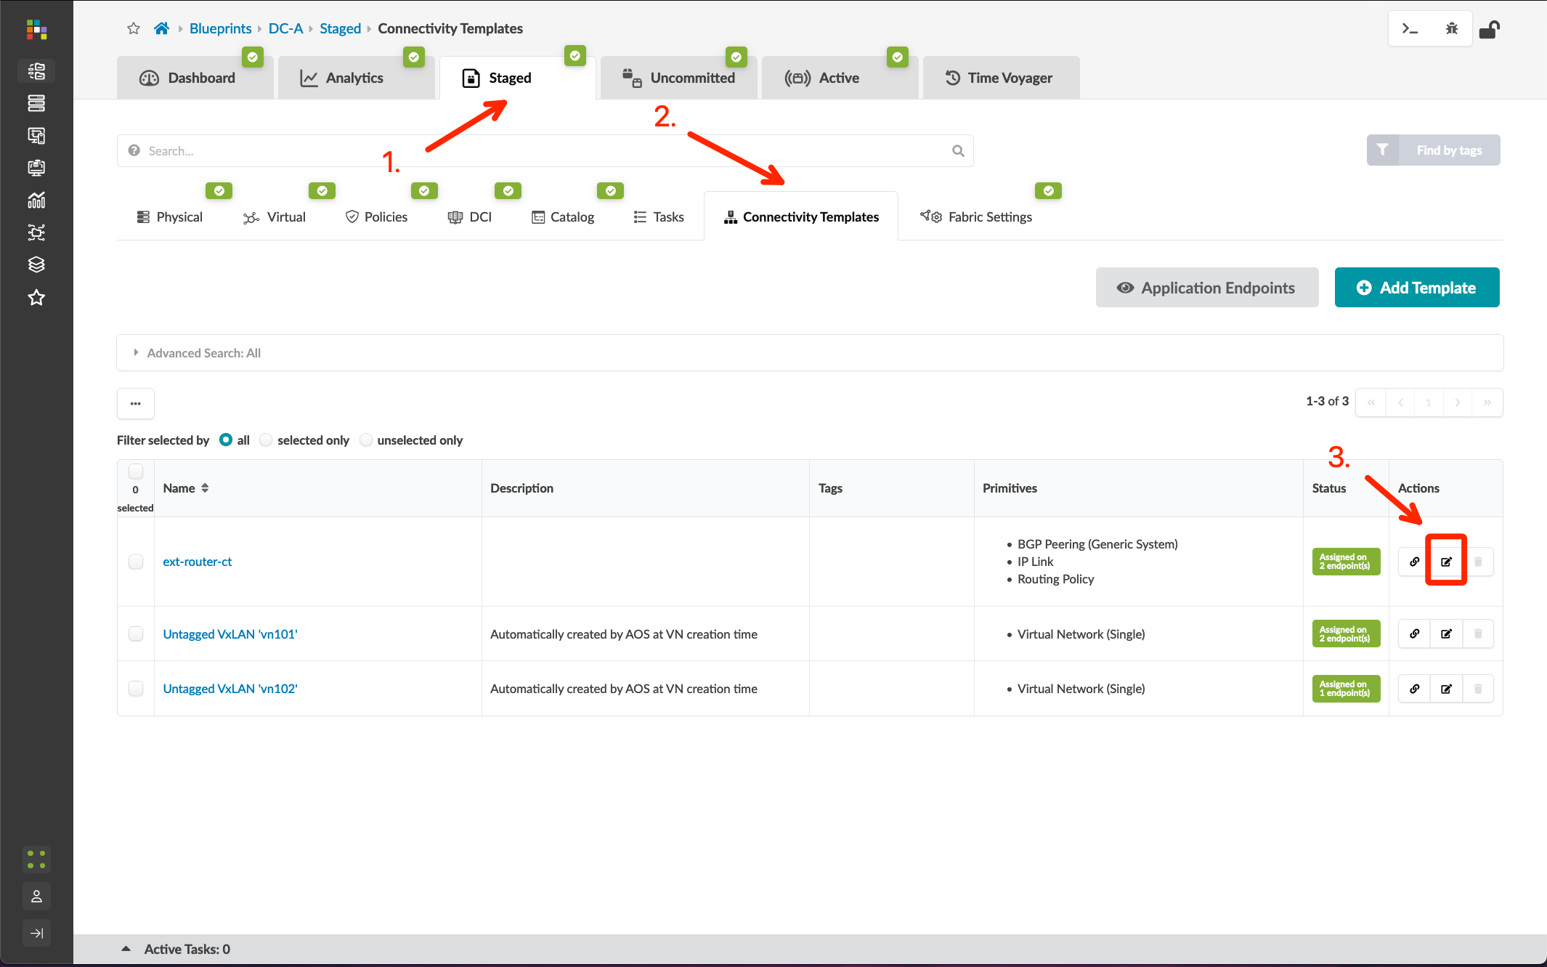
Segmenting the DCI
Method 1 (DC-A): Discrete Connectivity Templates
Go to Blueprints > DC-A > Staged > Connectivity Templates and edit the ext-router-ct template
Change the Title to ext-router-ct_Border1
Edit the IP Link primitive, change the Interface Type to Tagged, add the VLAN ID 3, and click “Update”
Add a new template named ext-router-ct_Border2, and add the IP Link, BGP Peering (Generic System), and Routing Policy primitives with the following configurations:
IP Link
Routing Zone: Default routing zone
Interface Type: Tagged
VLAN ID: 4
BGP Peering (Generic System)
Peer From: Interface
Peer To: Interface/IP Endpoint
Routing Policy
Routing Policy: ext-router-policy
Unassign the ext-router-ct_Border1 template from border_rack_dc_a_001_leaf2 and assign the ext-router-ct_Border2 template, then Commit the blueprint

Slide 8
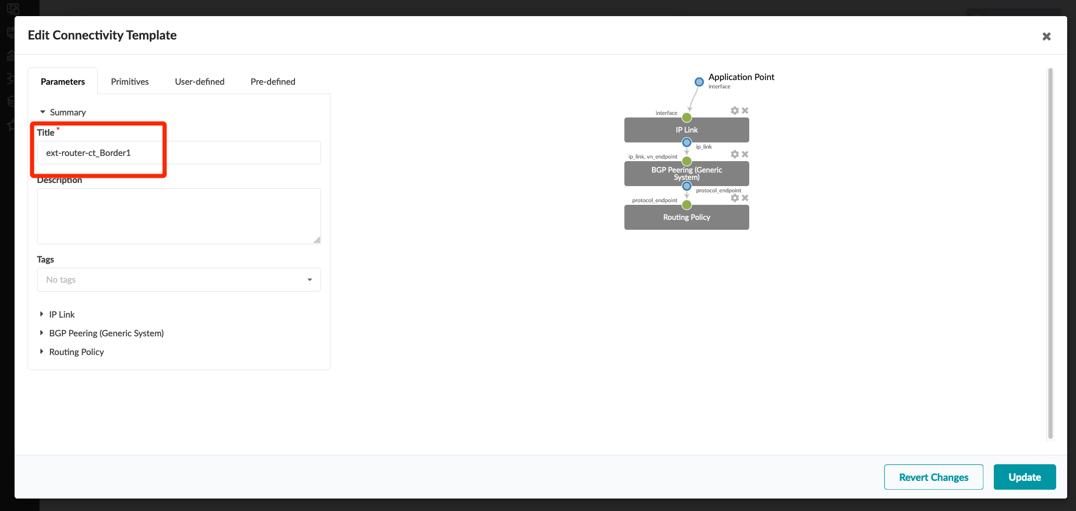
Segmenting the DCI
Method 1 (DC-A): Discrete Connectivity Templates
Go to Blueprints > DC-A > Staged > Connectivity Templates and edit the ext-router-ct template
Change the Title to ext-router-ct_Border1
Edit the IP Link primitive, change the Interface Type to Tagged, add the VLAN ID 3, and click “Update”
Add a new template named ext-router-ct_Border2, and add the IP Link, BGP Peering (Generic System), and Routing Policy primitives with the following configurations:
IP Link
Routing Zone: Default routing zone
Interface Type: Tagged
VLAN ID: 4
BGP Peering (Generic System)
Peer From: Interface
Peer To: Interface/IP Endpoint
Routing Policy
Routing Policy: ext-router-policy
Unassign the ext-router-ct_Border1 template from border_rack_dc_a_001_leaf2 and assign the ext-router-ct_Border2 template, then Commit the blueprint

Slide 9
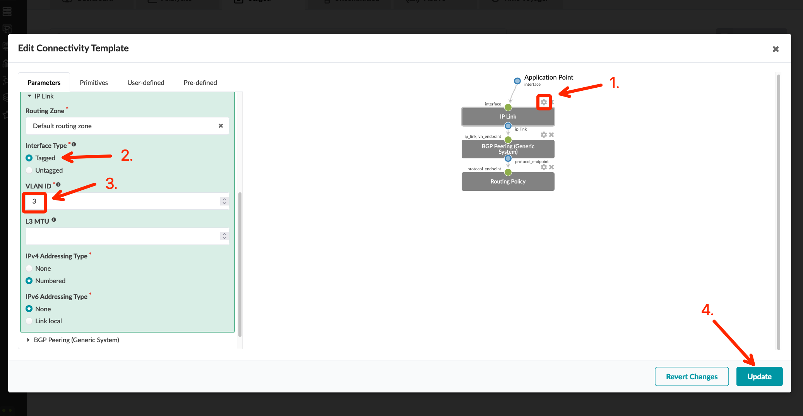
Segmenting the DCI
Method 1 (DC-A): Discrete Connectivity Templates
Go to Blueprints > DC-A > Staged > Connectivity Templates and edit the ext-router-ct template
Change the Title to ext-router-ct_Border1
Edit the IP Link primitive, change the Interface Type to Tagged, add the VLAN ID 3, and click “Update”
Add a new template named ext-router-ct_Border2, and add the IP Link, BGP Peering (Generic System), and Routing Policy primitives with the following configurations:
IP Link
Routing Zone: Default routing zone
Interface Type: Tagged
VLAN ID: 4
BGP Peering (Generic System)
Peer From: Interface
Peer To: Interface/IP Endpoint
Routing Policy
Routing Policy: ext-router-policy
Unassign the ext-router-ct_Border1 template from border_rack_dc_a_001_leaf2 and assign the ext-router-ct_Border2 template, then Commit the blueprint

Slide 10
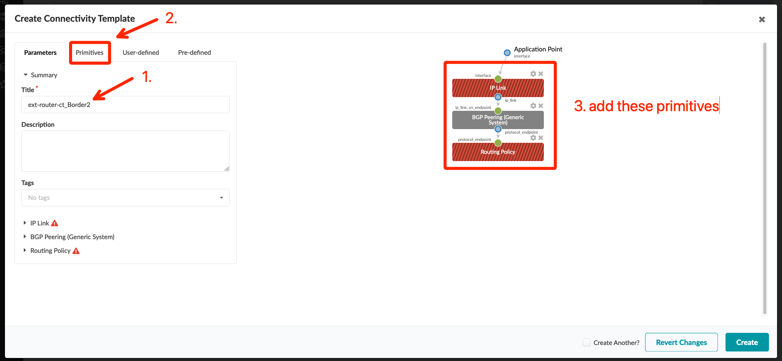
Segmenting the DCI
Method 1 (DC-A): Discrete Connectivity Templates
Go to Blueprints > DC-A > Staged > Connectivity Templates and edit the ext-router-ct template
Change the Title to ext-router-ct_Border1
Edit the IP Link primitive, change the Interface Type to Tagged, add the VLAN ID 3, and click “Update”
Add a new template named ext-router-ct_Border2, and add the IP Link, BGP Peering (Generic System), and Routing Policy primitives with the following configurations:
IP Link
Routing Zone: Default routing zone
Interface Type: Tagged
VLAN ID: 4
BGP Peering (Generic System)
Peer From: Interface
Peer To: Interface/IP Endpoint
Routing Policy
Routing Policy: ext-router-policy
Unassign the ext-router-ct_Border1 template from border_rack_dc_a_001_leaf2 and assign the ext-router-ct_Border2 template, then Commit the blueprint

Slide 11
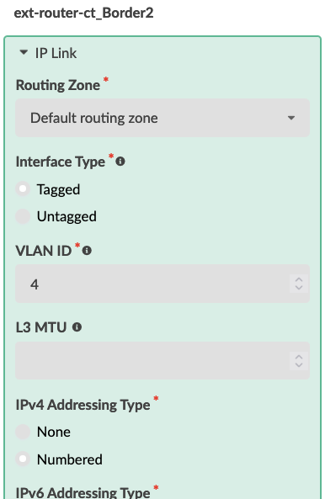
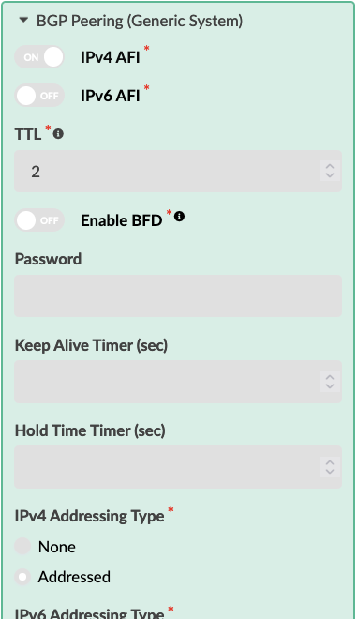
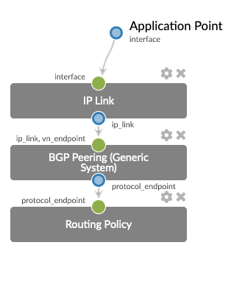
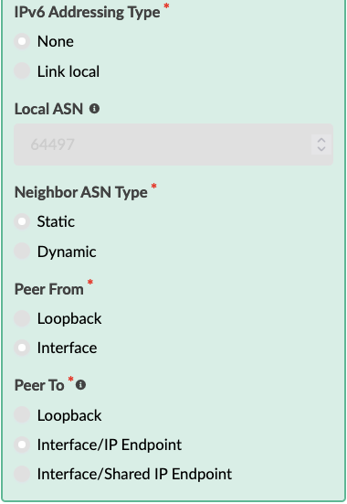
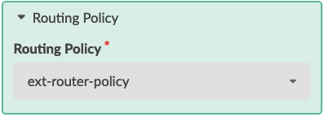
Segmenting the DCI
Method 1 (DC-A): Discrete Connectivity Templates
see the “Data Center Interconnect #1 – Underlay” section for a step-by-step walkthrough
Go to Blueprints > DC-A > Staged > Connectivity Templates and edit the ext-router-ct template
Change the Title to ext-router-ct_Border1
Edit the IP Link primitive, change the Interface Type to Tagged, add the VLAN ID 3, and click “Update”
Add a new template named ext-router-ct_Border2, and add the IP Link, BGP Peering (Generic System), and Routing Policy primitives with the following configurations:
IP Link
Routing Zone: Default routing zone
Interface Type: Tagged
VLAN ID: 4
BGP Peering (Generic System)
Peer From: Interface
Peer To: Interface/IP Endpoint
Routing Policy
Routing Policy: ext-router-policy
Unassign the ext-router-ct_Border1 template from border_rack_dc_a_001_leaf2 and assign the ext-router-ct_Border2 template, then Commit the blueprint
1.
3.
2.
5.
4.

Slide 12
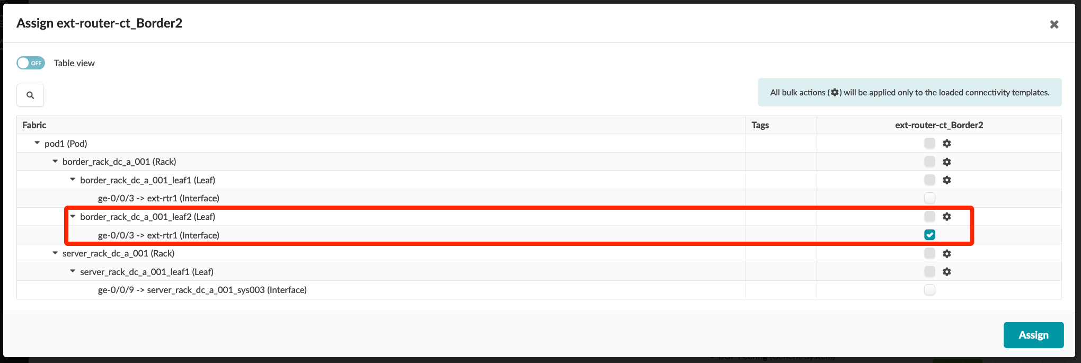
Segmenting the DCI
Method 1 (DC-A): Discrete Connectivity Templates
Go to Blueprints > DC-A > Staged > Connectivity Templates and edit the ext-router-ct template
Change the Title to ext-router-ct_Border1
Edit the IP Link primitive, change the Interface Type to Tagged, add the VLAN ID 3, and click “Update”
Add a new template named ext-router-ct_Border2, and add the IP Link, BGP Peering (Generic System), and Routing Policy primitives with the following configurations:
IP Link
Routing Zone: Default routing zone
Interface Type: Tagged
VLAN ID: 4
BGP Peering (Generic System)
Peer From: Interface
Peer To: Interface/IP Endpoint
Routing Policy
Routing Policy: ext-router-policy
Unassign the ext-router-ct_Border1 template from border_rack_dc_a_001_leaf2 and assign the ext-router-ct_Border2 template, then Commit the blueprint

Slide 13
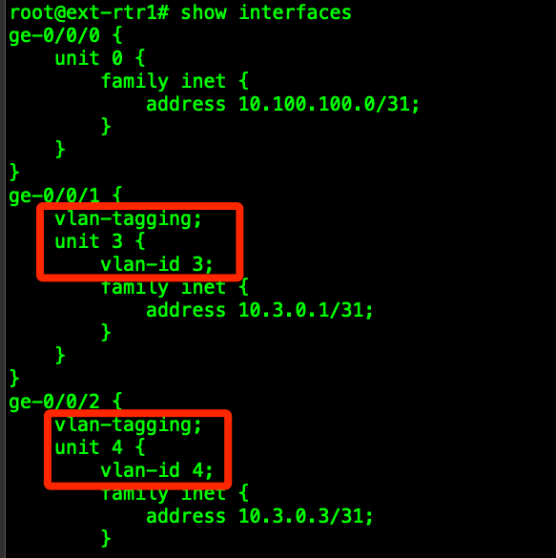
Updating ext-rtr1
Method 1 (DC-A): Discrete Connectivity Templates
The border leafs in DC-A are now configured to use /31 transit nets on discrete, tagged VLAN’s for connecting to ext-rtr1. To restore DCI underlay peering, we must update ext-rtr1 to use these new VLAN’s.
Log into ext-rtr1 and run the following commands (or equivalent if your lab uses different virtual nodes/interfaces/ etc…)
rename interfaces ge-0/0/1 unit 0 to unit 3
set interfaces ge-0/0/1 vlan-tagging unit 3 vlan-id 3
rename interfaces ge-0/0/2 unit 0 to unit 4
set interfaces ge-0/0/2 vlan-tagging unit 4 vlan-id 4
commit and-quit
Verify the peers come back up using “show bgp summary” from operational mode.
My original DCI transit nets did not change after updating/adding connectivity templates and committing.
NOTE: If your peers don’t come back up, go to Staged > Virtual > Protocol Sessions and verify your transit network IP’s. Because IP’s are assigned from a pool, it is possible for these to change when we modify the links/peers. If one or both change, update the Interface and BGP peer addresses on the external router.

Slide 14
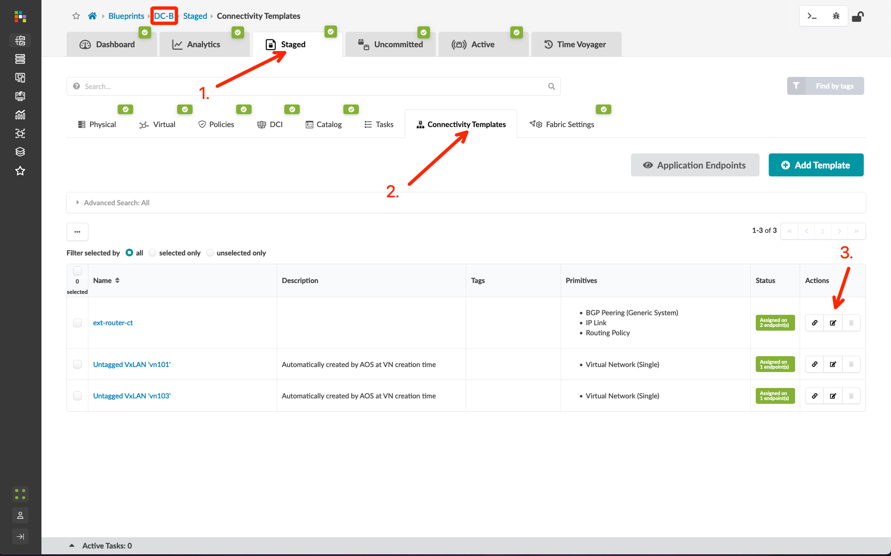
Segmenting the DCI
Method 2 (DC-B): Combined Connectivity Templates
Go to Blueprints > DC-B > Staged > Connectivity Templates and edit the ext-router-ct template
Change the Title to ext-router-ct_Border1
Edit the IP Link primitive, change the Interface Type to “Tagged”, add the VLAN ID 13, and click “Update”
Add a new template named ext-router-ct_Border2, and add the IP Link, BGP Peering (Generic System), and Routing Policy primitives with the following configurations:
IP Link
Routing Zone: Default routing zone
Interface Type: Tagged
VLAN ID: 14
BGP Peering (Generic System)
Peer From: Interface
Peer To: Interface/IP Endpoint
Routing Policy
Routing Policy: ext-router-policy
Unassign the ext-router-ct_Border1 template from border_rack_dc_b_001_leaf2 and assign the ext-router-ct_Border2 template, then Commit the blueprint

Slide 15
Segmenting the DCI
Method 2 (DC-B): Combined Connectivity Templates
Go to Blueprints > DC-B > Staged > Connectivity Templates and edit the ext-router-ct template
Change the Title to ext-router-ct_Border1
Edit the IP Link primitive, change the Interface Type to “Tagged”, add the VLAN ID 13, and click “Update”
Add a new template named ext-router-ct_Border2, and add the IP Link, BGP Peering (Generic System), and Routing Policy primitives with the following configurations:
IP Link
Routing Zone: Default routing zone
Interface Type: Tagged
VLAN ID: 14
BGP Peering (Generic System)
Peer From: Interface
Peer To: Interface/IP Endpoint
Routing Policy
Routing Policy: ext-router-policy
Unassign the ext-router-ct_Border1 template from border_rack_dc_b_001_leaf2 and assign the ext-router-ct_Border2 template, then Commit the blueprint

Slide 16
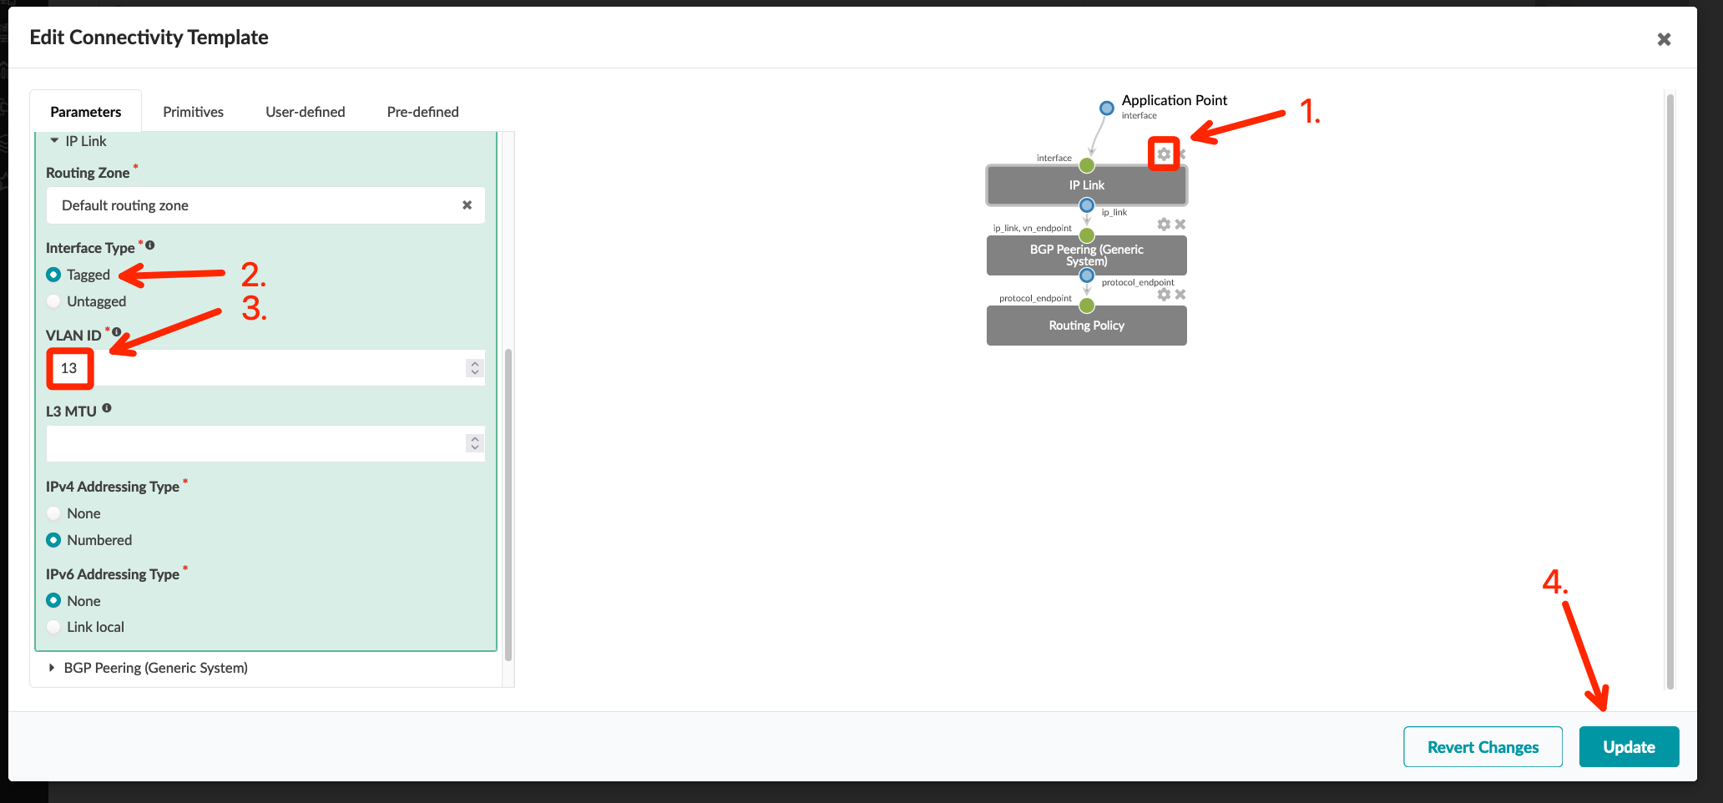
Segmenting the DCI
Method 2 (DC-B): Combined Connectivity Templates
Go to Blueprints > DC-B > Staged > Connectivity Templates and edit the ext-router-ct template
Change the Title to ext-router-ct_Border1
Edit the IP Link primitive, change the Interface Type to “Tagged”, add the VLAN ID 13, and click “Update”
Add a new template named ext-router-ct_Border2, and add the IP Link, BGP Peering (Generic System), and Routing Policy primitives with the following configurations:
IP Link
Routing Zone: Default routing zone
Interface Type: Tagged
VLAN ID: 14
BGP Peering (Generic System)
Peer From: Interface
Peer To: Interface/IP Endpoint
Routing Policy
Routing Policy: ext-router-policy
Unassign the ext-router-ct_Border1 template from border_rack_dc_b_001_leaf2 and assign the ext-router-ct_Border2 template, then Commit the blueprint

Slide 17
Segmenting the DCI
Method 2 (DC-B): Combined Connectivity Templates
Go to Blueprints > DC-B > Staged > Connectivity Templates and edit the ext-router-ct template
Change the Title to ext-router-ct_Border1
Edit the IP Link primitive, change the Interface Type to “Tagged”, add the VLAN ID 13, and click “Update”
Add a new template named ext-router-ct_Border2, and add the IP Link, BGP Peering (Generic System), and Routing Policy primitives with the following configurations:
IP Link
Routing Zone: Default routing zone
Interface Type: Tagged
VLAN ID: 14
BGP Peering (Generic System)
Peer From: Interface
Peer To: Interface/IP Endpoint
Routing Policy
Routing Policy: ext-router-policy
Unassign the ext-router-ct_Border1 template from border_rack_dc_b_001_leaf2 and assign the ext-router-ct_Border2 template, then Commit the blueprint

Slide 18
Segmenting the DCI
Method 2 (DC-B): Combined Connectivity Templates
see the “Data Center Interconnect #1 – Underlay” section for a step-by-step walkthrough
Go to Blueprints > DC-B > Staged > Connectivity Templates and edit the ext-router-ct template
Change the Title to ext-router-ct_Border1
Edit the IP Link primitive, change the Interface Type to “Tagged”, add the VLAN ID 13, and click “Update”
Add a new template named ext-router-ct_Border2, and add the IP Link, BGP Peering (Generic System), and Routing Policy primitives with the following configurations:
IP Link
Routing Zone: Default routing zone
Interface Type: Tagged
VLAN ID: 14
BGP Peering (Generic System)
Peer From: Interface
Peer To: Interface/IP Endpoint
Routing Policy
Routing Policy: ext-router-policy
Unassign the ext-router-ct_Border1 template from border_rack_dc_b_001_leaf2 and assign the ext-router-ct_Border2 template, then Commit the blueprint
1.
3.

Slide 19
Segmenting the DCI
Method 2 (DC-B): Combined Connectivity Templates
Go to Blueprints > DC-B > Staged > Connectivity Templates and edit the ext-router-ct template
Change the Title to ext-router-ct_Border1
Edit the IP Link primitive, change the Interface Type to “Tagged”, add the VLAN ID 13, and click “Update”
Add a new template named ext-router-ct_Border2, and add the IP Link, BGP Peering (Generic System), and Routing Policy primitives with the following configurations:
IP Link
Routing Zone: Default routing zone
Interface Type: Tagged
VLAN ID: 14
BGP Peering (Generic System)
Peer From: Interface
Peer To: Interface/IP Endpoint
Routing Policy
Routing Policy: ext-router-policy
Unassign the ext-router-ct_Border1 template from border_rack_dc_b_001_leaf2 and assign the ext-router-ct_Border2 template, then Commit the blueprint

Slide 20
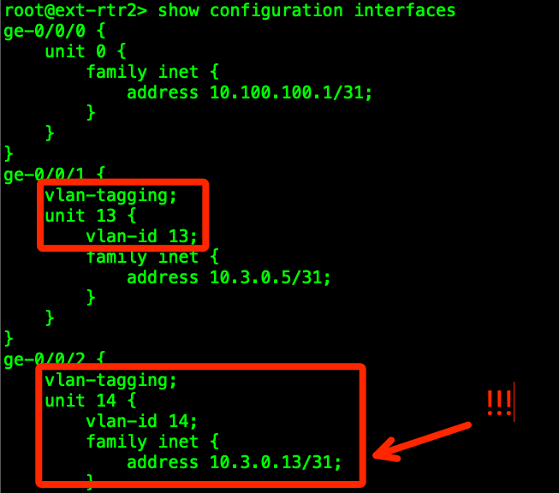
Updating ext-rtr2
Method 2 (DC-B): Combined Connectivity Templates
The border leafs in DC-B are now configured to use /31 transit nets on discrete, tagged VLAN’s for connecting to ext-rtr1. To restore DCI underlay peering, we must update ext-rtr1 to use these new VLAN’s.
Log into ext-rtr2 and run the following commands (or equivalent if your lab uses different virtual nodes/interfaces/ etc…)
rename interfaces ge-0/0/1 unit 0 to unit 13
set interfaces ge-0/0/1 vlan-tagging unit 13 vlan-id 13
rename interfaces ge-0/0/2 unit 0 to unit 14
set interfaces ge-0/0/2 vlan-tagging unit 14 vlan-id 14
commit and-quit
Verify the peers come back up using show bgp summary from operational mode.
My original DCI transit nets did change after updating/adding connectivity templates and committing! I needed to update the interface and BGP peer IP’s on ext-rtr2 links to border2.
Now I need to go back and update all my lab topology screenshots. Doh!
NOTE: If your peers don’t come back up, go to Staged > Virtual > Protocol Sessions and verify your transit network IP’s. Because IP’s are assigned from a pool, it is possible for these to change when we modify the links/peers. If one or both change, update the Interface and BGP peer addresses on the external router.

Slide 21
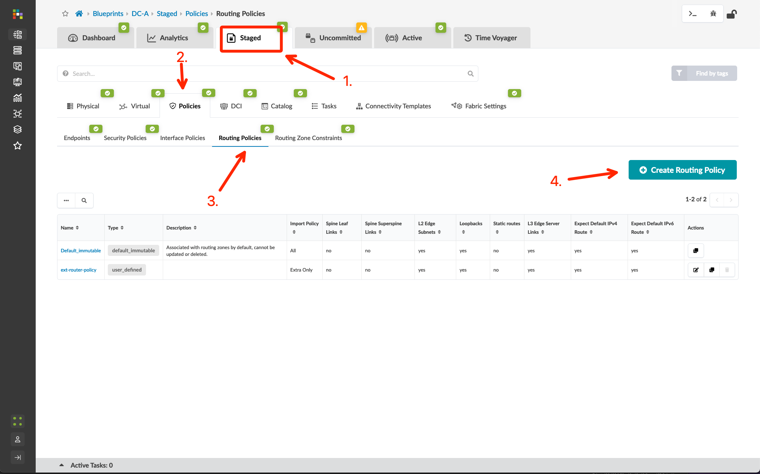
Configure Core/WAN Routing Policies
Method 1 (DC-A): Discrete Connectivity Templates
Go to Blueprints > DC-A > Staged > Policies > Routing Policies and click “Create Routing Policy”
Create the policy with the following information:
Name: core-router-policy
Import Policy: Default
Export Policy: L3 Edge Server Links and L2 Edge Subnets

Slide 22
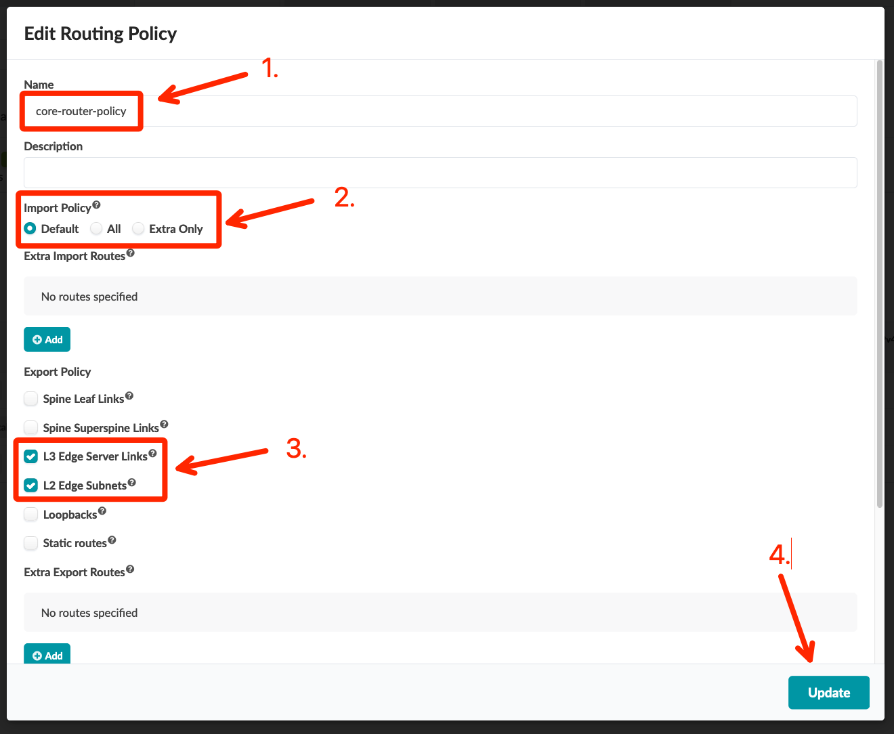
Configure the Core/WAN Routing Policies
Method 1 (DC-A): Discrete Connectivity Templates
Go to Blueprints > DC-A > Staged > Policies > Routing Policies and click “Create Routing Policy”
Create the policy with the following information:
Name: core-router-policy
Import Policy: Default
Export Policy: L3 Edge Server Links and L2 Edge Subnets

Slide 23
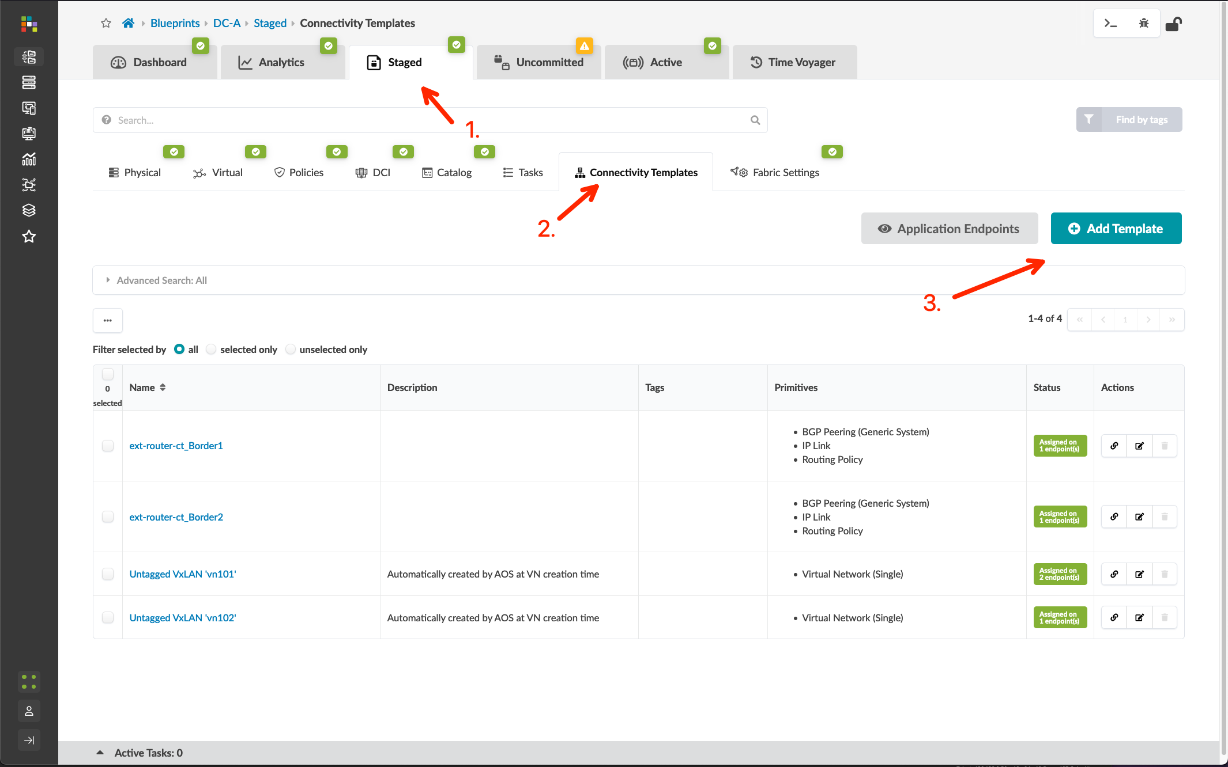
Configure the Core/WAN Connectivity Templates
Method 1 (DC-A): Discrete Connectivity Templates
Go to Blueprints > DC-A > Staged > Connectivity Templates and click “Add Template”
Enter the Title ext-rtr_Border1_Core, then add the IP Link, BGP Peering (Generic System), and Routing Policy primitives with the following configurations:
IP Link
Routing Zone: Tenant-1
Interface Type: Tagged
VLAN ID: 5
BGP Peering (Generic System)
Peer From: Interface
Peer To: Interface/IP Endpoint
Routing Policy
Routing Policy: core-router-policy
Assign the ext-rtr_Border1_Core template to border_rack_dc_a_001_Leaf1, ge-0/0/3

Slide 24
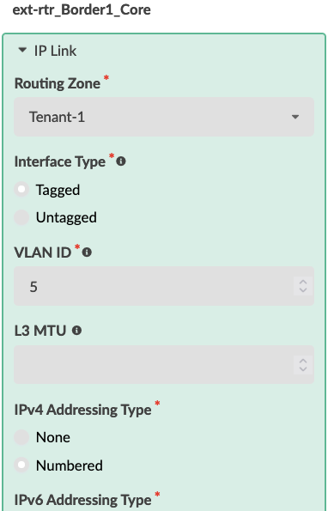
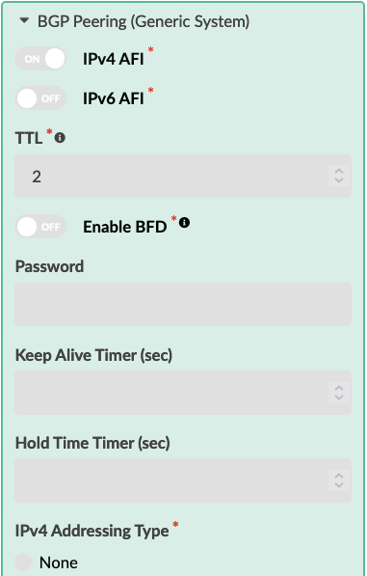
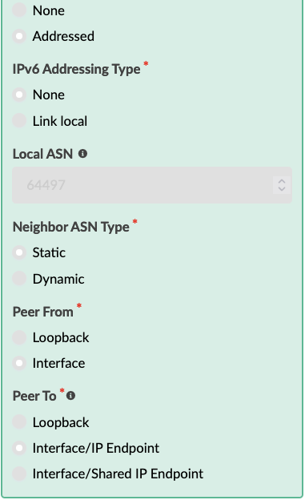
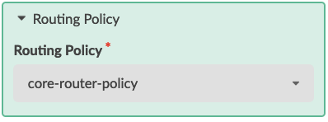
Configure the Core/WAN Connectivity Templates
Method 1 (DC-A): Discrete Connectivity Templates
see the “Data Center Interconnect #1 – Underlay” section for a step-by-step walkthrough
Go to Blueprints > DC-A > Staged > Connectivity Templates and click “Add Template”
Enter the Title ext-rtr_Border1_Core, then add the IP Link, BGP Peering (Generic System), and Routing Policy primitives with the following configurations:
IP Link
Routing Zone: Tenant-1
Interface Type: Tagged
VLAN ID: 5
BGP Peering (Generic System)
Peer From: Interface
Peer To: Interface/IP Endpoint
Routing Policy
Routing Policy: core-router-policy
Assign the ext-rtr_Border1_Core template to border_rack_dc_a_001_Leaf1, ge-0/0/3

Slide 25
Configure the Core/WAN Connectivity Templates
Method 1 (DC-A): Discrete Connectivity Templates
see the “Data Center Interconnect #1 – Underlay” section for a step-by-step walkthrough
Go to Blueprints > DC-A > Staged > Connectivity Templates and click “Add Template”
Enter the Title ext-rtr_Border1_Core, then add the IP Link, BGP Peering (Generic System), and Routing Policy primitives with the following configurations:
IP Link
Routing Zone: Tenant-1
Interface Type: Tagged
VLAN ID: 5
BGP Peering (Generic System)
Peer From: Interface
Peer To: Interface/IP Endpoint
Routing Policy
Routing Policy: core-router-policy
Assign the ext-rtr_Border1_Core template to border_rack_dc_a_001_Leaf1, ge-0/0/3

Slide 26
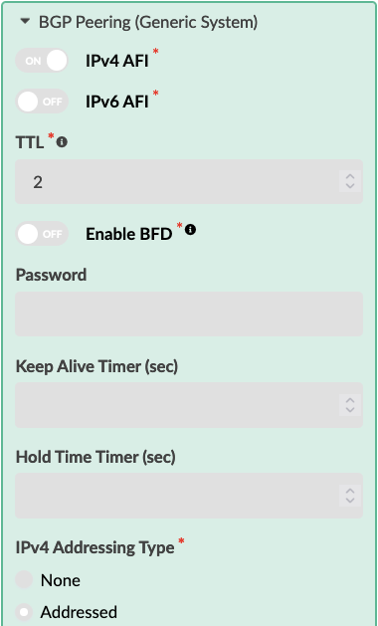
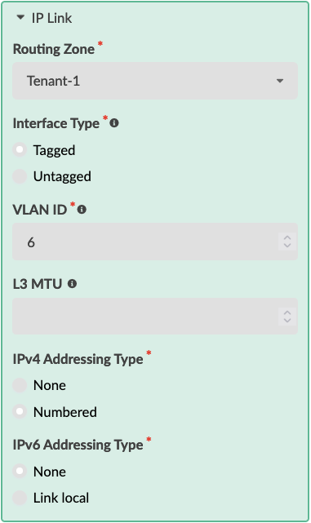
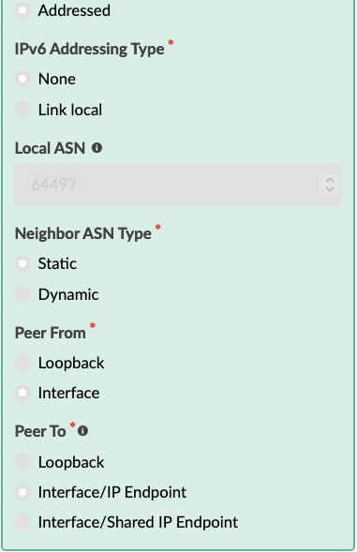
Configure the Core/WAN Connectivity Templates
Method 1 (DC-A): Discrete Connectivity Templates
see the “Data Center Interconnect #1 – Underlay” section for a step-by-step walkthrough
Click “Add Template”
Enter the Title ext-rtr_Border2_Core, then add the IP Link, BGP Peering (Generic System), and Routing Policy primitives with the following configurations:
IP Link
Routing Zone: Tenant-1
Interface Type: Tagged
VLAN ID: 6
BGP Peering (Generic System)
Peer From: Interface
Peer To: Interface/IP Endpoint
Routing Policy
Routing Policy: core-router-policy
Assign the ext-rtr_Border1_Core template to border_rack_dc_a_001_Leaf2, ge-0/0/3
Go to Blueprints > DC-A > Staged > Virtual > Routing Zones, edit the “To Generic Link IP’s” Resource Allocation, and assign the External Links pool to Tenant-1
Commit the Blueprint

Slide 27
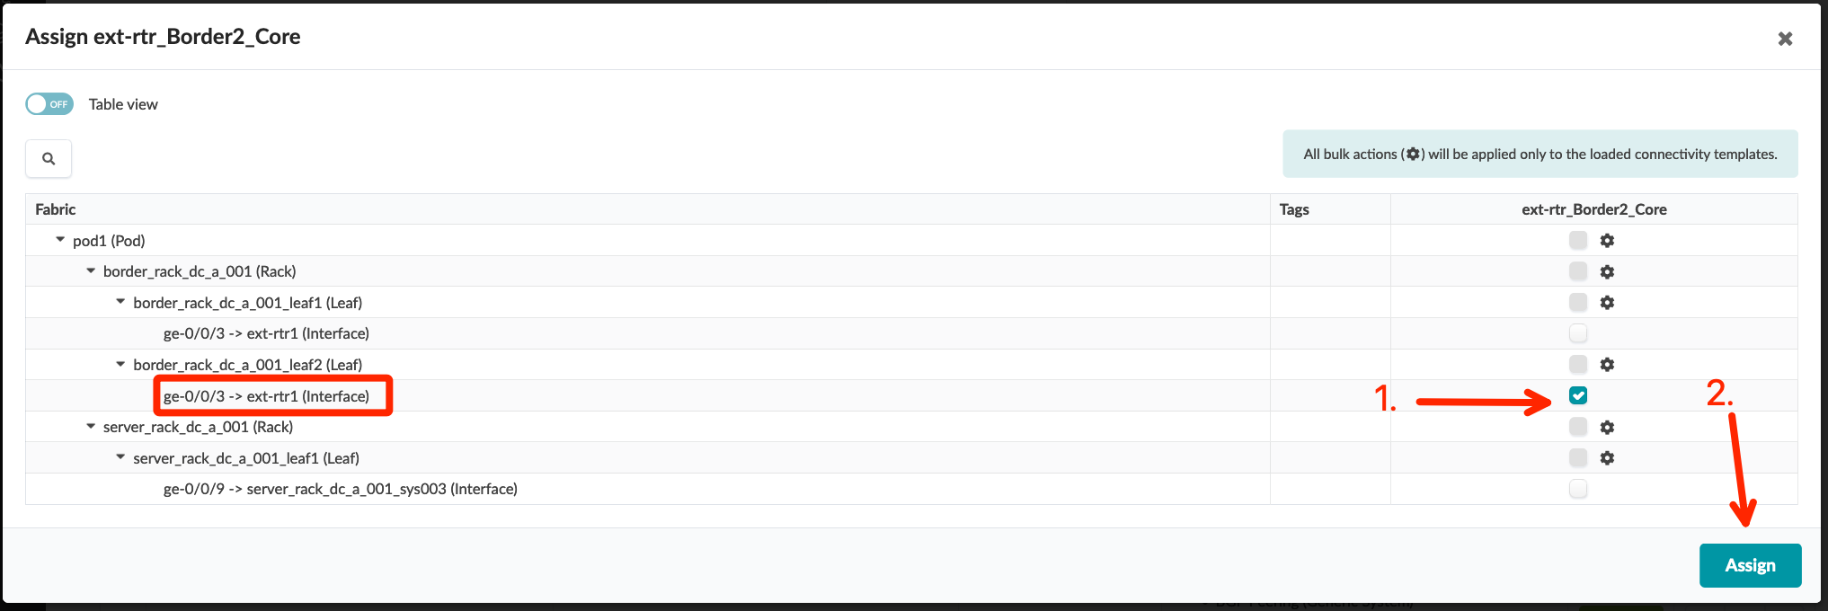
Configure the Core/WAN Connectivity Templates
Method 1 (DC-A): Discrete Connectivity Templates
see the “Data Center Interconnect #1 – Underlay” section for a step-by-step walkthrough
Click “Add Template”
Enter the Title ext-rtr_Border2_Core, then add the IP Link, BGP Peering (Generic System), and Routing Policy primitives with the following configurations:
IP Link
Routing Zone: Tenant-1
Interface Type: Tagged
VLAN ID: 6
BGP Peering (Generic System)
Peer From: Interface
Peer To: Interface/IP Endpoint
Routing Policy
Routing Policy: core-router-policy
Assign the ext-rtr_Border1_Core template to border_rack_dc_a_001_Leaf2, ge-0/0/3
Go to Blueprints > DC-A > Staged > Virtual > Routing Zones, edit the “To Generic Link IP’s” Resource Allocation, and assign the External Links pool to Tenant-1
Commit the Blueprint

Slide 28
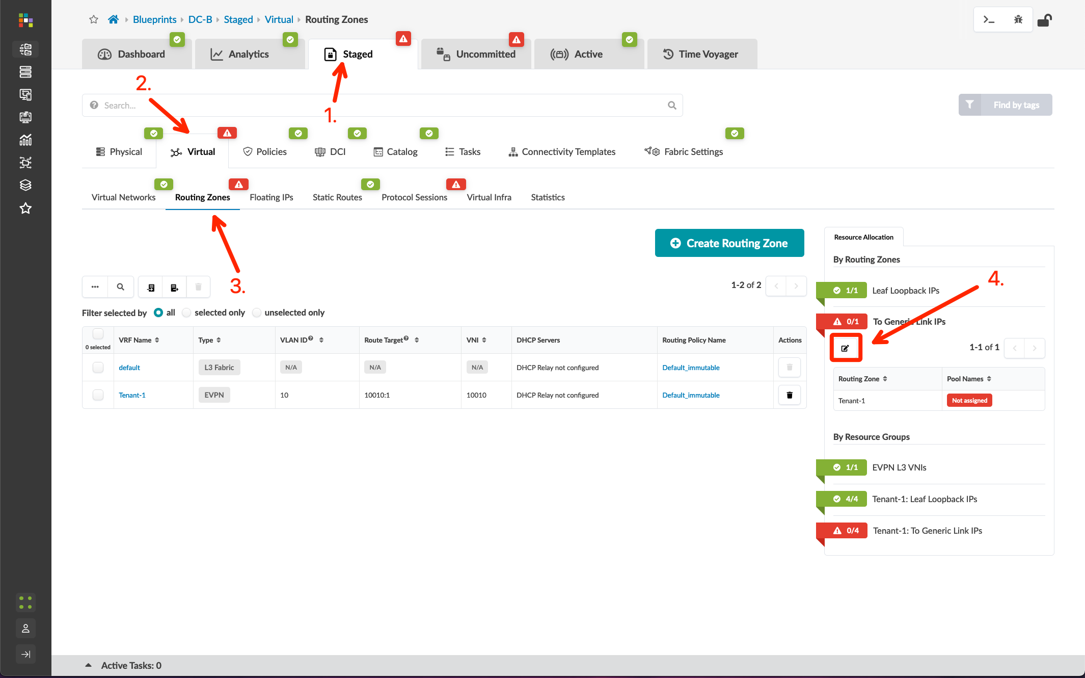
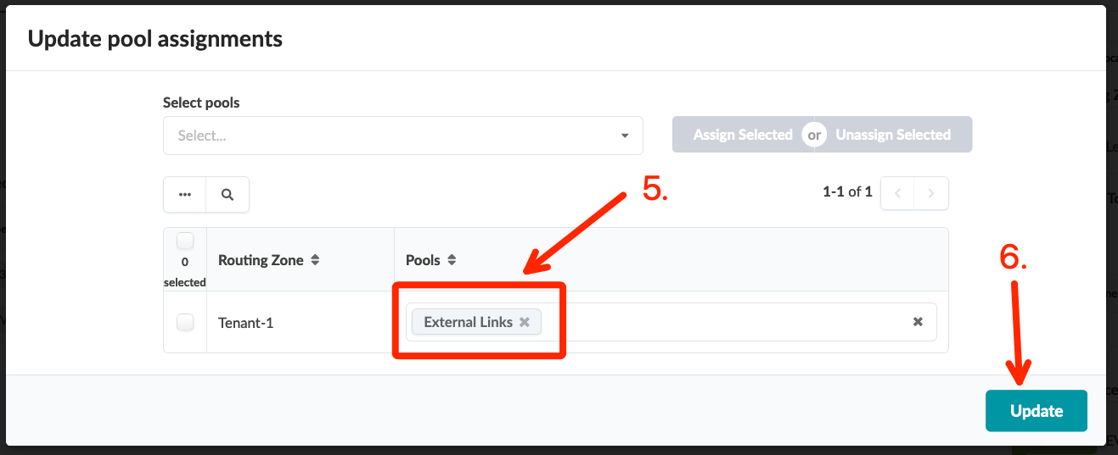
Configure the Core/WAN Connectivity Templates
Method 1 (DC-A): Discrete Connectivity Templates
see the “Data Center Interconnect #1 – Underlay” section for a step-by-step walkthrough
Click “Add Template”
Enter the Title ext-rtr_Border2_Core, then add the IP Link, BGP Peering (Generic System), and Routing Policy primitives with the following configurations:
IP Link
Routing Zone: Tenant-1
Interface Type: Tagged
VLAN ID: 6
BGP Peering (Generic System)
Peer From: Interface
Peer To: Interface/IP Endpoint
Routing Policy
Routing Policy: core-router-policy
Assign the ext-rtr_Border1_Core template to border_rack_dc_a_001_Leaf2, ge-0/0/3
Go to Blueprints > DC-A > Staged > Virtual > Routing Zones, edit the “To Generic Link IP’s” Resource Allocation, and assign the External Links pool to Tenant-1
Commit the Blueprint

Slide 29
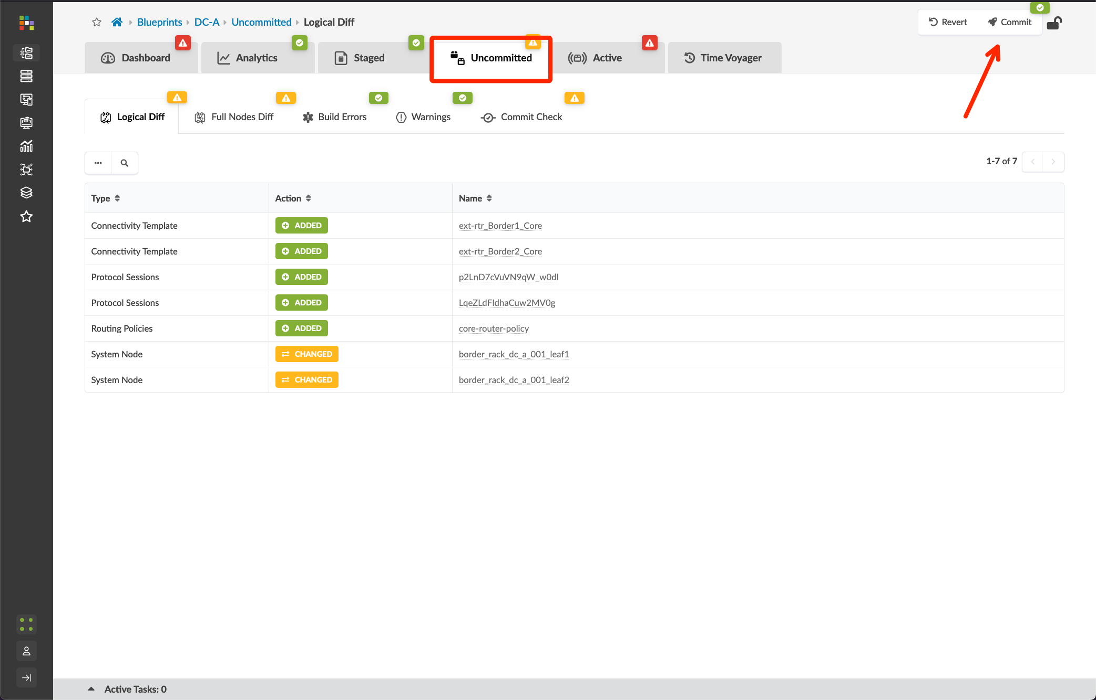
Configure the Core/WAN Connectivity Templates
Method 1 (DC-A): Discrete Connectivity Templates
see the “Data Center Interconnect #1 – Underlay” section for a step-by-step walkthrough
Click “Add Template”
Enter the Title ext-rtr_Border2_Core, then add the IP Link, BGP Peering (Generic System), and Routing Policy primitives with the following configurations:
IP Link
Routing Zone: Tenant-1
Interface Type: Tagged
VLAN ID: 6
BGP Peering (Generic System)
Peer From: Interface
Peer To: Interface/IP Endpoint
Routing Policy
Routing Policy: core-router-policy
Assign the ext-rtr_Border1_Core template to border_rack_dc_a_001_Leaf2, ge-0/0/3
Go to Blueprints > DC-A > Staged > Virtual > Routing Zones, edit the “To Generic Link IP’s” Resource Allocation, and assign the External Links pool to Tenant-1
Commit the Blueprint

Slide 30
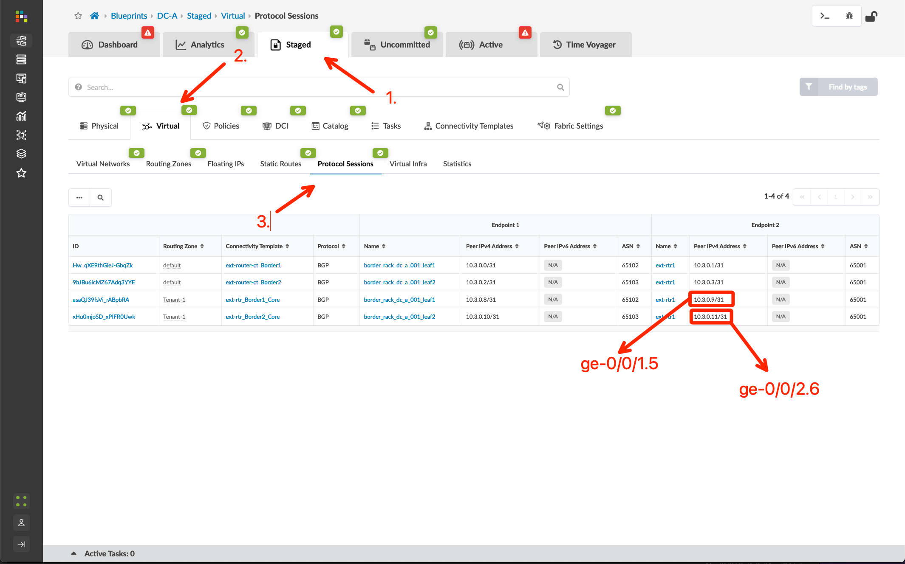
Configure the External Router for Core/WAN Connectivity
Method 1 (DC-A): Discrete Connectivity Templates
Go to Blueprints > DC-A > Staged > Virtual > Protocol Sessions and note the peer addresses for your new links
We will configure the external router to peer with the border leafs on the assigned VLAN’s and transit nets. We should see host IP’s advertised to the external router, and we will only advertise a default route into the Tenant-1 VRF. For now, this default will be a static discard. We’ll update that later when we add our upstream WAN router.
Configure ext-rtr1:
set interfaces ge-0/0/1.5 vlan-id 5 family inet address 10.3.0.9/31
set interfaces ge-0/0/2.6 vlan-id 6 family inet address 10.3.0.11/31
set routing-options static route 0.0.0.0/0 discard
set policy-options policy-statement EXPORT_DEFAULT term default from protocol static
set policy-options policy-statement EXPORT_DEFAULT term default then accept
set policy-options policy-statement EXPORT_DEFAULT term reject then reject
set protocols bgp group Core export EXPORT_DEFAULT
set protocols bgp group Core neighbor 10.3.0.8 peer-as 65102
set protocols bgp group Core neighbor 10.3.0.10 peer-as 65103
commit and-quit
(interfaces on ext-rtr1)

Slide 31
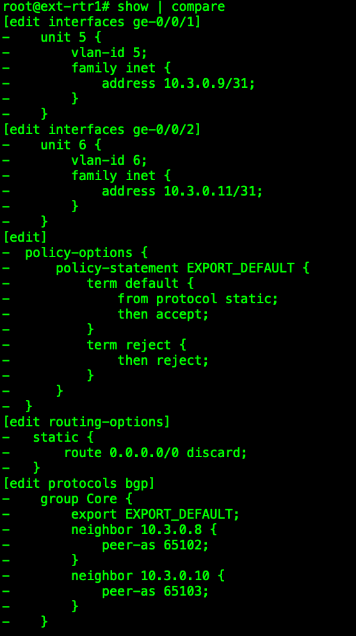
Configure the External Router for Core/WAN Connectivity
Method 1 (DC-A): Discrete Connectivity Templates
Go to Blueprints > DC-A > Staged > Virtual > Protocol Sessions and note the peer addresses for your new links
We will configure the external router to peer with the border leafs on the assigned VLAN’s and transit nets. We should see host IP’s advertised to the external router, and we will only advertise a default route into the Tenant-1 VRF. For now, this default will be a static discard. We’ll update that later when we add our upstream WAN router.
Configure ext-rtr1:
set interfaces ge-0/0/1.5 vlan-id 5 family inet address 10.3.0.9/31
set interfaces ge-0/0/2.6 vlan-id 6 family inet address 10.3.0.11/31
set routing-options static route 0.0.0.0/0 discard
set policy-options policy-statement EXPORT_DEFAULT term default from protocol static
set policy-options policy-statement EXPORT_DEFAULT term default then accept
set policy-options policy-statement EXPORT_DEFAULT term reject then reject
set protocols bgp group Core export EXPORT_DEFAULT
set protocols bgp group Core neighbor 10.3.0.8 peer-as 65102
set protocols bgp group Core neighbor 10.3.0.10 peer-as 65103
commit and-quit
NOTE: Verify your IP’s from the Protocol Sessions step from the previous slide! The transit nets I include in my router configurations may not match yours as they are being generated from a pool.
When I have problems with connecting external Generic Systems, it’s almost always because I’ve not double-checked my transit networks and I have the wrong IP’s configured!

Slide 32
Verify External Router for Core/WAN Connectivity
Method 1 (DC-A): Discrete Connectivity Templates
Verify peers are up
show bgp summary
Verify fabric host prefixes seen from the external router
show route receive-protocol bgp 10.3.0.8
show route receive-protocol bgp 10.3.0.10
Verify external router is only advertising a default route into Tenant-1
show route advertising protocol bgp 10.3.0.8
show route advertising protocol bgp 10.3.0.10
Test ping from router to a host
ping 192.168.101.11
Verify default route seen in Tenant-1 on a border leaf
(from border-leaf) show route table Tenant-1.inet.0

Slide 33
Configure the Core/WAN Routing Policies
Method 2 (DC-B): Combined Connectivity Templates
Go to Blueprints > DC-B > Staged > Policies > Routing Policies and click “Create Routing Policy”
Create the policy with the following information:
Name: core-router-policy
Import Policy: Default
Export Policy: L3 Edge Server Links and L2 Edge Subnets

Slide 34
Configure the Core/WAN Routing Policies
Method 2 (DC-B): Combined Connectivity Templates
Go to Blueprints > DC-B > Staged > Policies > Routing Policies and click “Create Routing Policy”
Create the policy with the following information:
Name: core-router-policy
Import Policy: Default
Export Policy: L3 Edge Server Links and L2 Edge Subnets

Slide 35
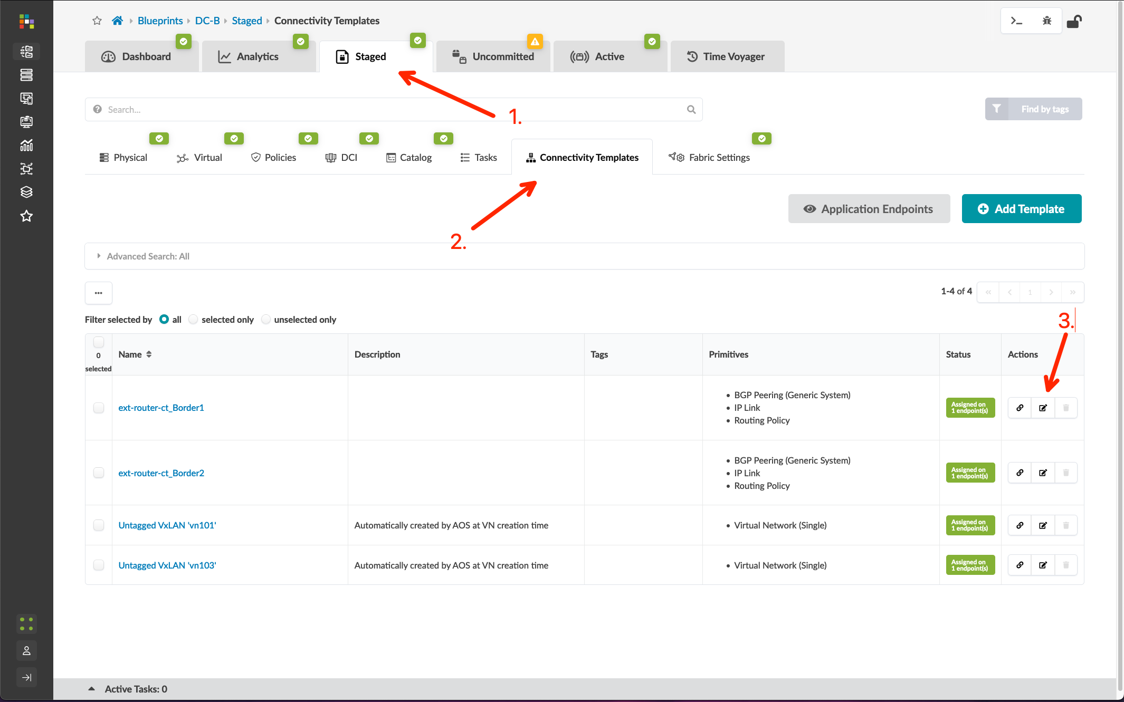
Configure the Core/WAN Connectivity Templates
Method 2 (DC-B): Combined Connectivity Templates
Go to Blueprints > DC-B > Staged > Connectivity Templates and edit the ext-router-ct_Border1 template
Click the “Primitives” tab, then add the IP Link, BGP Peering (Generic System), and Routing Policy primitives with the following configurations:
IP Link
Routing Zone: Tenant-1
Interface Type: Tagged
VLAN ID: 15
BGP Peering (Generic System)
Peer From: Interface
Peer To: Interface/IP Endpoint
Routing Policy
Routing Policy: core-router-policy

Slide 36
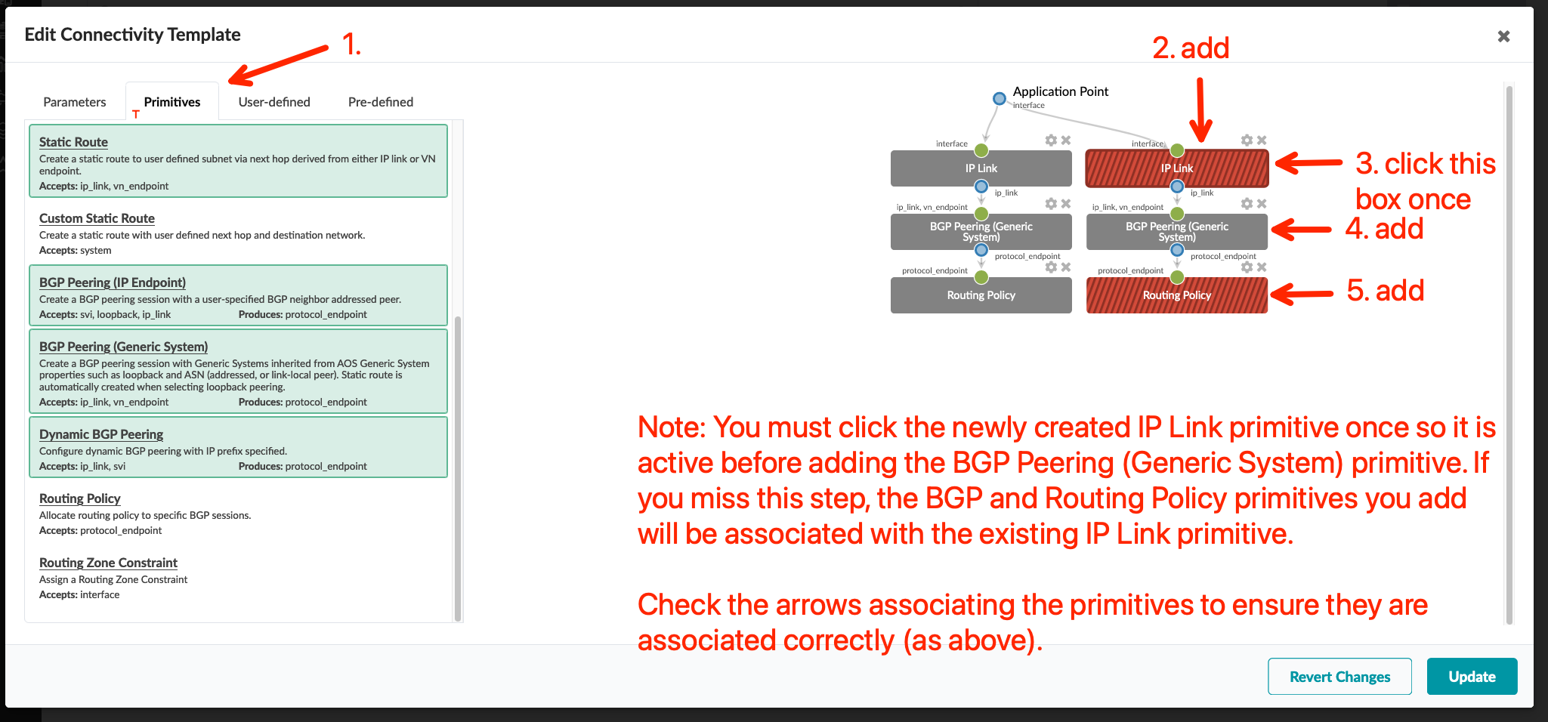
Configure the Core/WAN Connectivity Templates
Method 2 (DC-B): Combined Connectivity Templates
see the “Data Center Interconnect #1 – Underlay” section for a step-by-step walkthrough
Go to Blueprints > DC-B > Staged > Connectivity Templates and edit the ext-router-ct_Border1 template
Click the “Primitives” tab, then add the IP Link, BGP Peering (Generic System), and Routing Policy primitives with the following configurations:
IP Link
Routing Zone: Tenant-1
Interface Type: Tagged
VLAN ID: 15
BGP Peering (Generic System)
Peer From: Interface
Peer To: Interface/IP Endpoint
Routing Policy
Routing Policy: core-router-policy

Slide 37
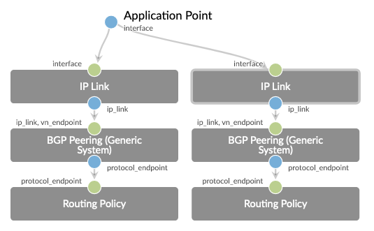
Configure the Core/WAN Connectivity Templates
Method 2 (DC-B): Combined Connectivity Templates
see the “Data Center Interconnect #1 – Underlay” section for a step-by-step walkthrough
Go to Blueprints > DC-B > Staged > Connectivity Templates and edit the ext-router-ct_Border1 template
Click the “Primitives” tab, then add the IP Link, BGP Peering (Generic System), and Routing Policy primitives with the following configurations:
IP Link
Routing Zone: Tenant-1
Interface Type: Tagged
VLAN ID: 15
BGP Peering (Generic System)
Peer From: Interface
Peer To: Interface/IP Endpoint
Routing Policy
Routing Policy: core-router-policy

Slide 38
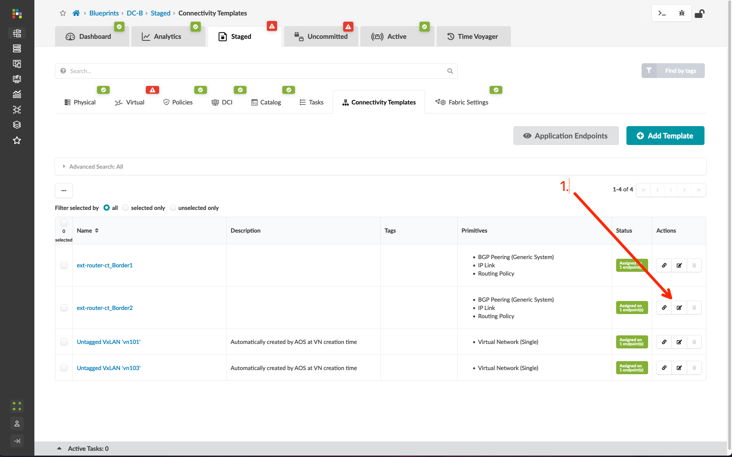
Configure the Core/WAN Connectivity Templates
Method 2 (DC-B): Combined Connectivity Templates
Edit the ext-router-ct_Border2 template
Click the “Primitives” tab, then add the IP Link, BGP Peering (Generic System), and Routing Policy primitives with the following configurations:
IP Link
Routing Zone: Tenant-1
Interface Type: Tagged
VLAN ID: 16
BGP Peering (Generic System)
Peer From: Interface
Peer To: Interface/IP Endpoint
Routing Policy
Routing Policy: core-router-policy
Go to Blueprints > DC-B > Staged > Virtual > Routing Zones, edit the To Generic Link IP’s Resource Allocation, and assign the External Links pool to Tenant-1
Commit the Blueprint

Slide 39
Configure the Core/WAN Connectivity Templates
Method 2 (DC-B): Combined Connectivity Templates
see the “Data Center Interconnect #1 – Underlay” section for a step-by-step walkthrough
Edit the ext-router-ct_Border2 template
Click the “Primitives” tab, then add the IP Link, BGP Peering (Generic System), and Routing Policy primitives with the following configurations:
IP Link
Routing Zone: Tenant-1
Interface Type: Tagged
VLAN ID: 16
BGP Peering (Generic System)
Peer From: Interface
Peer To: Interface/IP Endpoint
Routing Policy
Routing Policy: core-router-policy
Go to Blueprints > DC-B > Staged > Virtual > Routing Zones, edit the To Generic Link IP’s Resource Allocation, and assign the External Links pool to Tenant-1
Commit the Blueprint

Slide 40
Configure the Core/WAN Connectivity Templates
Method 2 (DC-B): Combined Connectivity Templates
see the “Data Center Interconnect #1 – Underlay” section for a step-by-step walkthrough
Edit the ext-router-ct_Border2 template
Click the “Primitives” tab, then add the IP Link, BGP Peering (Generic System), and Routing Policy primitives with the following configurations:
IP Link
Routing Zone: Tenant-1
Interface Type: Tagged
VLAN ID: 16
BGP Peering (Generic System)
Peer From: Interface
Peer To: Interface/IP Endpoint
Routing Policy
Routing Policy: core-router-policy
Go to Blueprints > DC-B > Staged > Virtual > Routing Zones, edit the To Generic Link IP’s Resource Allocation, and assign the External Links pool to Tenant-1
Commit the Blueprint

Slide 41
Configure the Core/WAN Connectivity Templates
Method 2 (DC-B): Combined Connectivity Templates
see the “Data Center Interconnect #1 – Underlay” section for a step-by-step walkthrough
Edit the ext-router-ct_Border2 template
Click the “Primitives” tab, then add the IP Link, BGP Peering (Generic System), and Routing Policy primitives with the following configurations:
IP Link
Routing Zone: Tenant-1
Interface Type: Tagged
VLAN ID: 16
BGP Peering (Generic System)
Peer From: Interface
Peer To: Interface/IP Endpoint
Routing Policy
Routing Policy: core-router-policy
Go to Blueprints > DC-B > Staged > Virtual > Routing Zones, edit the To Generic Link IP’s Resource Allocation, and assign the External Links pool to Tenant-1
Commit the Blueprint

Slide 42
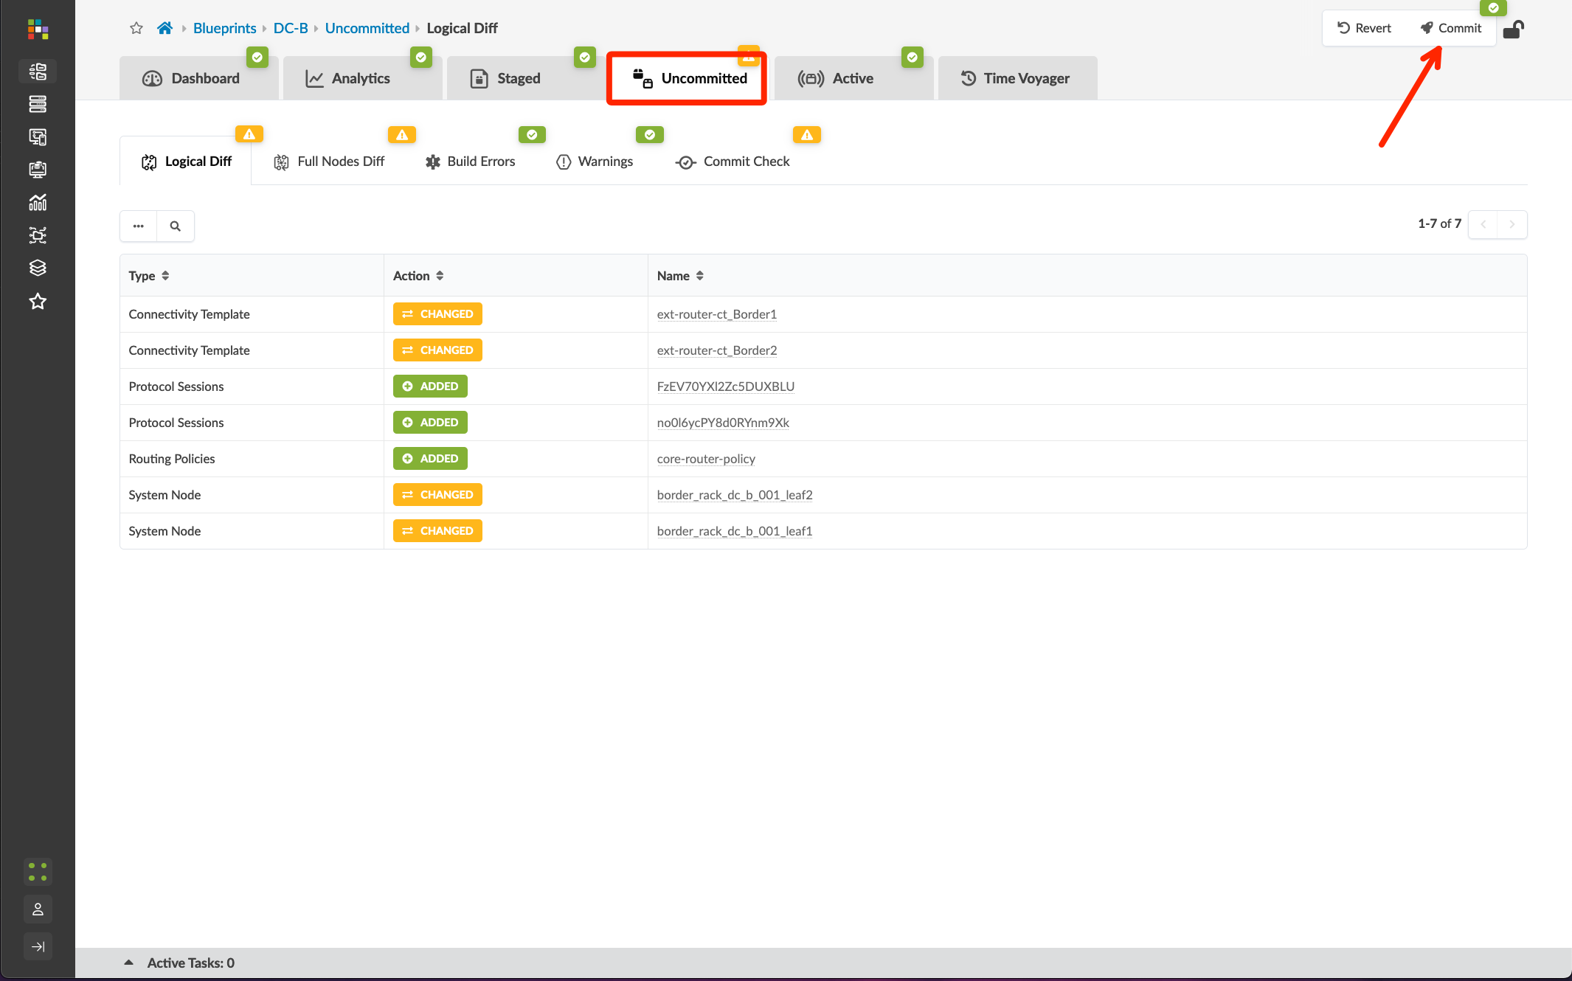
Configure the Core/WAN Connectivity Templates
Method 2 (DC-B): Combined Connectivity Templates
see the “Data Center Interconnect #1 – Underlay” section for a step-by-step walkthrough
Edit the ext-router-ct_Border2 template
Click the “Primitives” tab, then add the IP Link, BGP Peering (Generic System), and Routing Policy primitives with the following configurations:
IP Link
Routing Zone: Tenant-1
Interface Type: Tagged
VLAN ID: 16
BGP Peering (Generic System)
Peer From: Interface
Peer To: Interface/IP Endpoint
Routing Policy
Routing Policy: core-router-policy
Go to Blueprints > DC-B > Staged > Virtual > Routing Zones, edit the To Generic Link IP’s Resource Allocation, and assign the External Links pool to Tenant-1
Commit the Blueprint

Slide 43
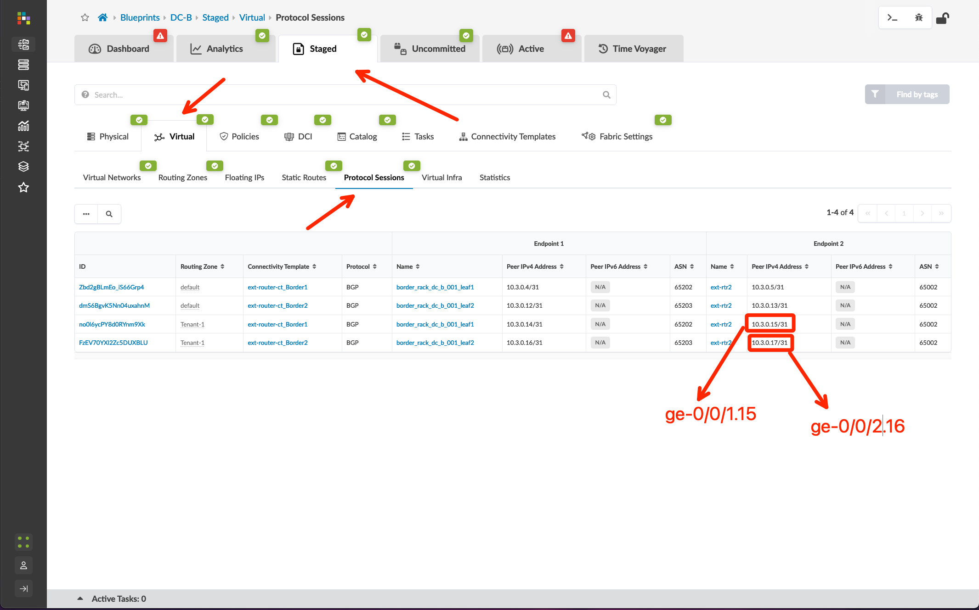
Configure the External Router for Core/WAN Connectivity
Method 2 (DC-B): Combined Connectivity Templates
Go to Blueprints > DC-B > Staged > Virtual > Protocol Sessions and note the peer addresses for your new links
We will configure the external router to peer with the border leafs on the assigned VLAN’s and transit nets. We should see host IP’s advertised to the external router, and we will only advertise a default route into the Tenant-1 VRF. For now, this default will be a static discard. We’ll update that later when we add our upstream WAN router.
Configure ext-rtr2
set interfaces ge-0/0/1.15 vlan-id 15 family inet address 10.3.0.15/31
set interfaces ge-0/0/2.16 vlan-id 16 family inet address 10.3.0.17/31
set routing-options static route 0.0.0.0/0 discard
set policy-options policy-statement EXPORT_DEFAULT term default from protocol static
set policy-options policy-statement EXPORT_DEFAULT term default then accept
set policy-options policy-statement EXPORT_DEFAULT term reject then reject
set protocols bgp group Core export EXPORT_DEFAULT
set protocols bgp group Core neighbor 10.3.0.14 peer-as 65202
set protocols bgp group Core neighbor 10.3.0.16 peer-as 65203
commit and-quit

Slide 44
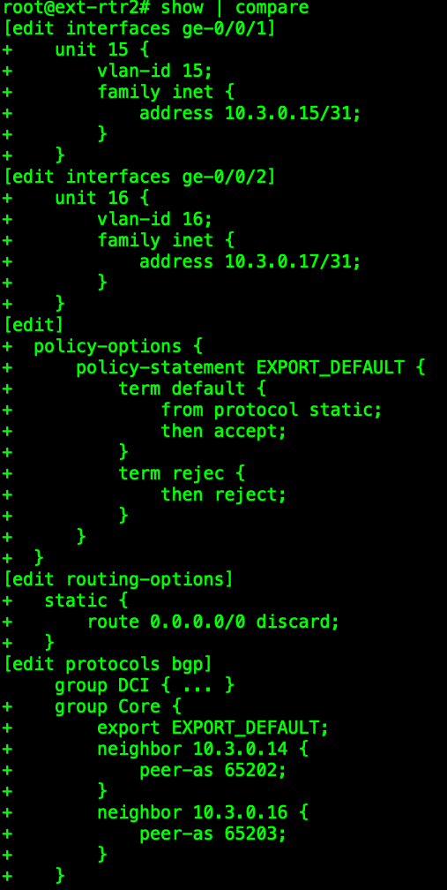
Configure the External Router for Core/WAN Connectivity
Method 2 (DC-B): Combined Connectivity Templates
Go to Blueprints > DC-A > Staged > Virtual > Protocol Sessions and note the peer addresses for your new links
We will configure the external router to peer with the border leafs on the assigned VLAN’s and transit nets. We should see host IP’s advertised to the external router, and we will only advertise a default route into the Tenant-1 VRF. For now, this default will be a static discard. We’ll update that later when we add our upstream WAN router.
Configure ext-rtr2
set interfaces ge-0/0/1.15 vlan-id 15 family inet address 10.3.0.15/31
set interfaces ge-0/0/2.16 vlan-id 16 family inet address 10.3.0.17/31
set routing-options static route 0.0.0.0/0 discard
set policy-options policy-statement EXPORT_DEFAULT term default from protocol static
set policy-options policy-statement EXPORT_DEFAULT term default then accept
set policy-options policy-statement EXPORT_DEFAULT term reject then reject
set protocols bgp group Core export EXPORT_DEFAULT
set protocols bgp group Core neighbor 10.3.0.14 peer-as 65202
set protocols bgp group Core neighbor 10.3.0.16 peer-as 65203
commit and-quit
NOTE: Verify your IP’s from the Protocol Sessions step from the previous slide! The transit nets I include in my router configurations may not match yours as they are being generated from a pool.
When I have problems with connecting external Generic Systems, it’s almost always because I’ve not double-checked my transit networks and I have the wrong IP’s configured!

Slide 45
Verify External Router for Core/WAN Connectivity
Method 2 (DC-B): Combined Connectivity Templates
Verify peers are up
show bgp summary
Verify fabric host prefixes seen from the external router
show route receive-protocol bgp 10.3.0.14
show route receive-protocol bgp 10.3.0.16
Verify external router is only advertising a default route into Tenant-1
show route advertising protocol bgp 10.3.0.14
show route advertising protocol bgp 10.3.0.16
Test ping from router to a host
ping 192.168.103.55
Verify default route seen in Tenant-1 on a border leaf
(from border-leaf) show route table Tenant-1.inet.0

Slide 46
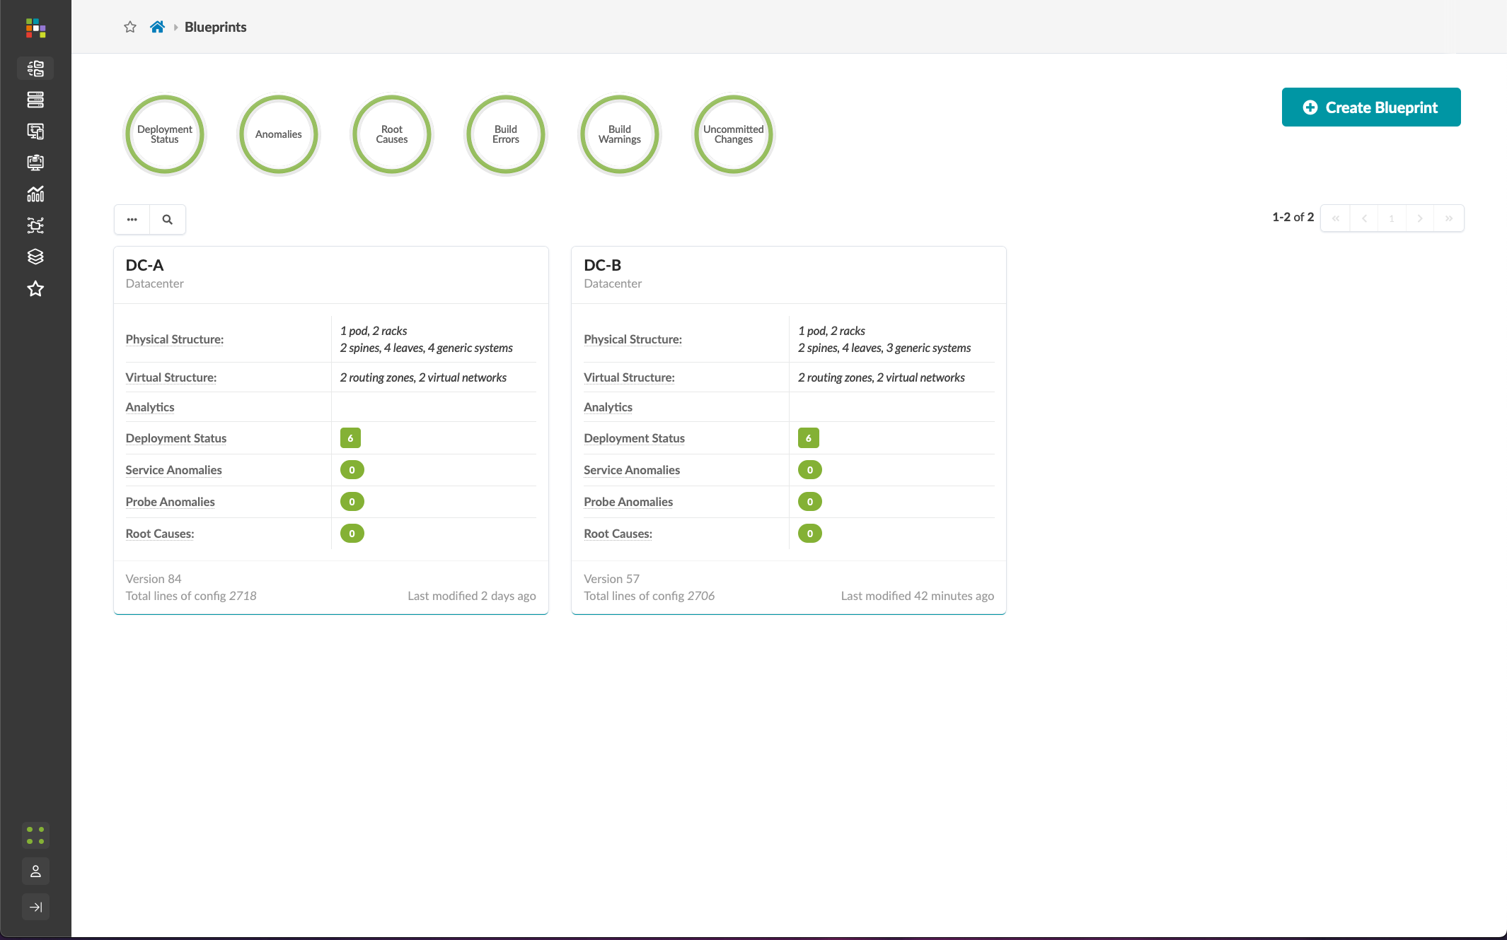
Everything Looking Good?

