Slide 1
Juniper Apstra 4.2.1 EVE-NG Virtual Lab Demo Video series companion guide Video 2: Prepping Your Lab
Colin Doyle, Sr. CE AMER
See the complete video walkthrough on YouTube at: https://www.youtube.com/@5minutejunos
Ask questions at the Juniper Elevate Community using the hashtag #5minutejunos
Adapted from v4.0.0 documentation originally compiled by: - Raymond Lam, SSE APAC - Tony Chan, SSE APAC

Slide 2
Agenda
Prepping your Lab
Day-0 Fabric Onboarding
Virtual Device Profile Verification
Virtual Device Profile Cloning
Onboarding Virtual Nodes
Create ASN Pool and IP Pools
Create Logical Devices and Interface Maps
Create Rack Types
Create Templates
Create Blueprints
Day-1 Service Provisioning
Create Routing Zones
Create Virtual Networks
Assign Virtual Network to Switchports
Add Server Links
Data Center Interconnect
DCI Addendum: Direct Peering
Core/WAN Connectivity
Internet Connectivity
Day-2 Operational Scenarios
Incorrect Cable Patch (RCA, LLDP Link Discovery, Time Voyager)
Config Deviation Checking
Apply custom config through Configlet
View Telemetry Data
Hardware Replacement
Future Documentation
Firewall Service Chaining
Cluster with Service Block
Type-5 Route (fabric integrated) with MNHA
VLAN Stitching
vEvo Fabric

Slide 3
Prepping your Lab
Software and vSwitch Versions
General Eve-NG Guidance
Topologies
Issues and Caveats
Zero Trust Provisioning and DHCP
Prepping your Switches

Slide 4
Software and vSwitch versions
Versions should not be considered recommendations for your lab. I’m building with the currently available vJunos, and vSRX images, and an older vMX image that I know to be stable.
I suggest using what ever the most current versions of virtual nodes are available and only using older versions should you encounter an issue.
Note: At the time of writing, Apstra 4.2.1 is in pre-release. The UI/UX updates in 4.2.1 are significant and represent the look and feel of the platform for the foreseeable future. As such, the decision to use this version represents a sort of future-proofing that will hopefully allow these instructions to be durable across future releases.
Type | Version
Eve-NG | 5.0.1-106-PRO
AOS Server | 4.2.1-beta (deploy w/ 64gig of memory!)
vJunos (aka. vEx) | 23.2R1
vSRX (service block, LACP, WAN) | 23.1r1.8
vMX (DCI) | 20.4R1
Linux Hosts (BMS) | ubuntu mate 20.04

Slide 5
General Eve-NG Guidance
Read-me stuff:
This guide is not an eve-ng tutorial. It is assumed that prior to starting your build, the following is true:
You are running a current(ish) version of eve-ng on bare metal*
You have already downloaded and deployed required images to your eve server
Apstra and vJunos downloads
Instructions for installing vEvo, vJunos, and Apstra server on eve
You have sufficient resources for the lab to function properly*
You have some way to reach your OoB network from a web-browser*
Building:
Use the topology screenshots on the following slides to stage your lab environment. Ensure the following steps are complete prior to starting the Day-0 section:
Apstra server online and initial configuration completed (should be reachable via browser)
Nodes are deployed:
Links match those in the topology
Management links are connected to an OoB vSwitch that also connects to the Apstra server
Static MAC addresses are configured for fabric nodes*
Nodes are powered and management IP’s are present (DHCP or static)
* see “Issues and Caveats” slide

Slide 6
Lab Topology - Summary
WAN_Sim
vSRX
A-fw cluster
B-fw cluster
A-fw1
A-fw2
ext-rtr1
ext-rtr2
B-fw1
B-fw2
vSRX
vSRX
vMX
vMX
vSRX
vSRX
A-border1
A-border2
B-border1
B-border2
vJunos
vJunos
vJunos
vJunos
apstra-server
A-spine1
A-spine2
B-spine1
B-spine2
vJunos
vJunos
vJunos
vJunos
A-leaf1
A-leaf2
B-leaf1
B-leaf2
vJunos
vJunos
vJunos
vJunos
Curious about these BMS bridge nodes?
See the “Issues and Caveats” slide for an explanation.
vSRX
vSRX
A-BMS-3
vSRX
vSRX
A-BMS-1_Bridge
A-BMS-2_Bridge
B-BMS-1_Bridge
B-BMS-2_Bridge
uMate
A-BMS-1
A-BMS-2
DC-A
DC-B
B-BMS-1
B-BMS-2
uMate
uMate
uMate
uMate

Slide 7
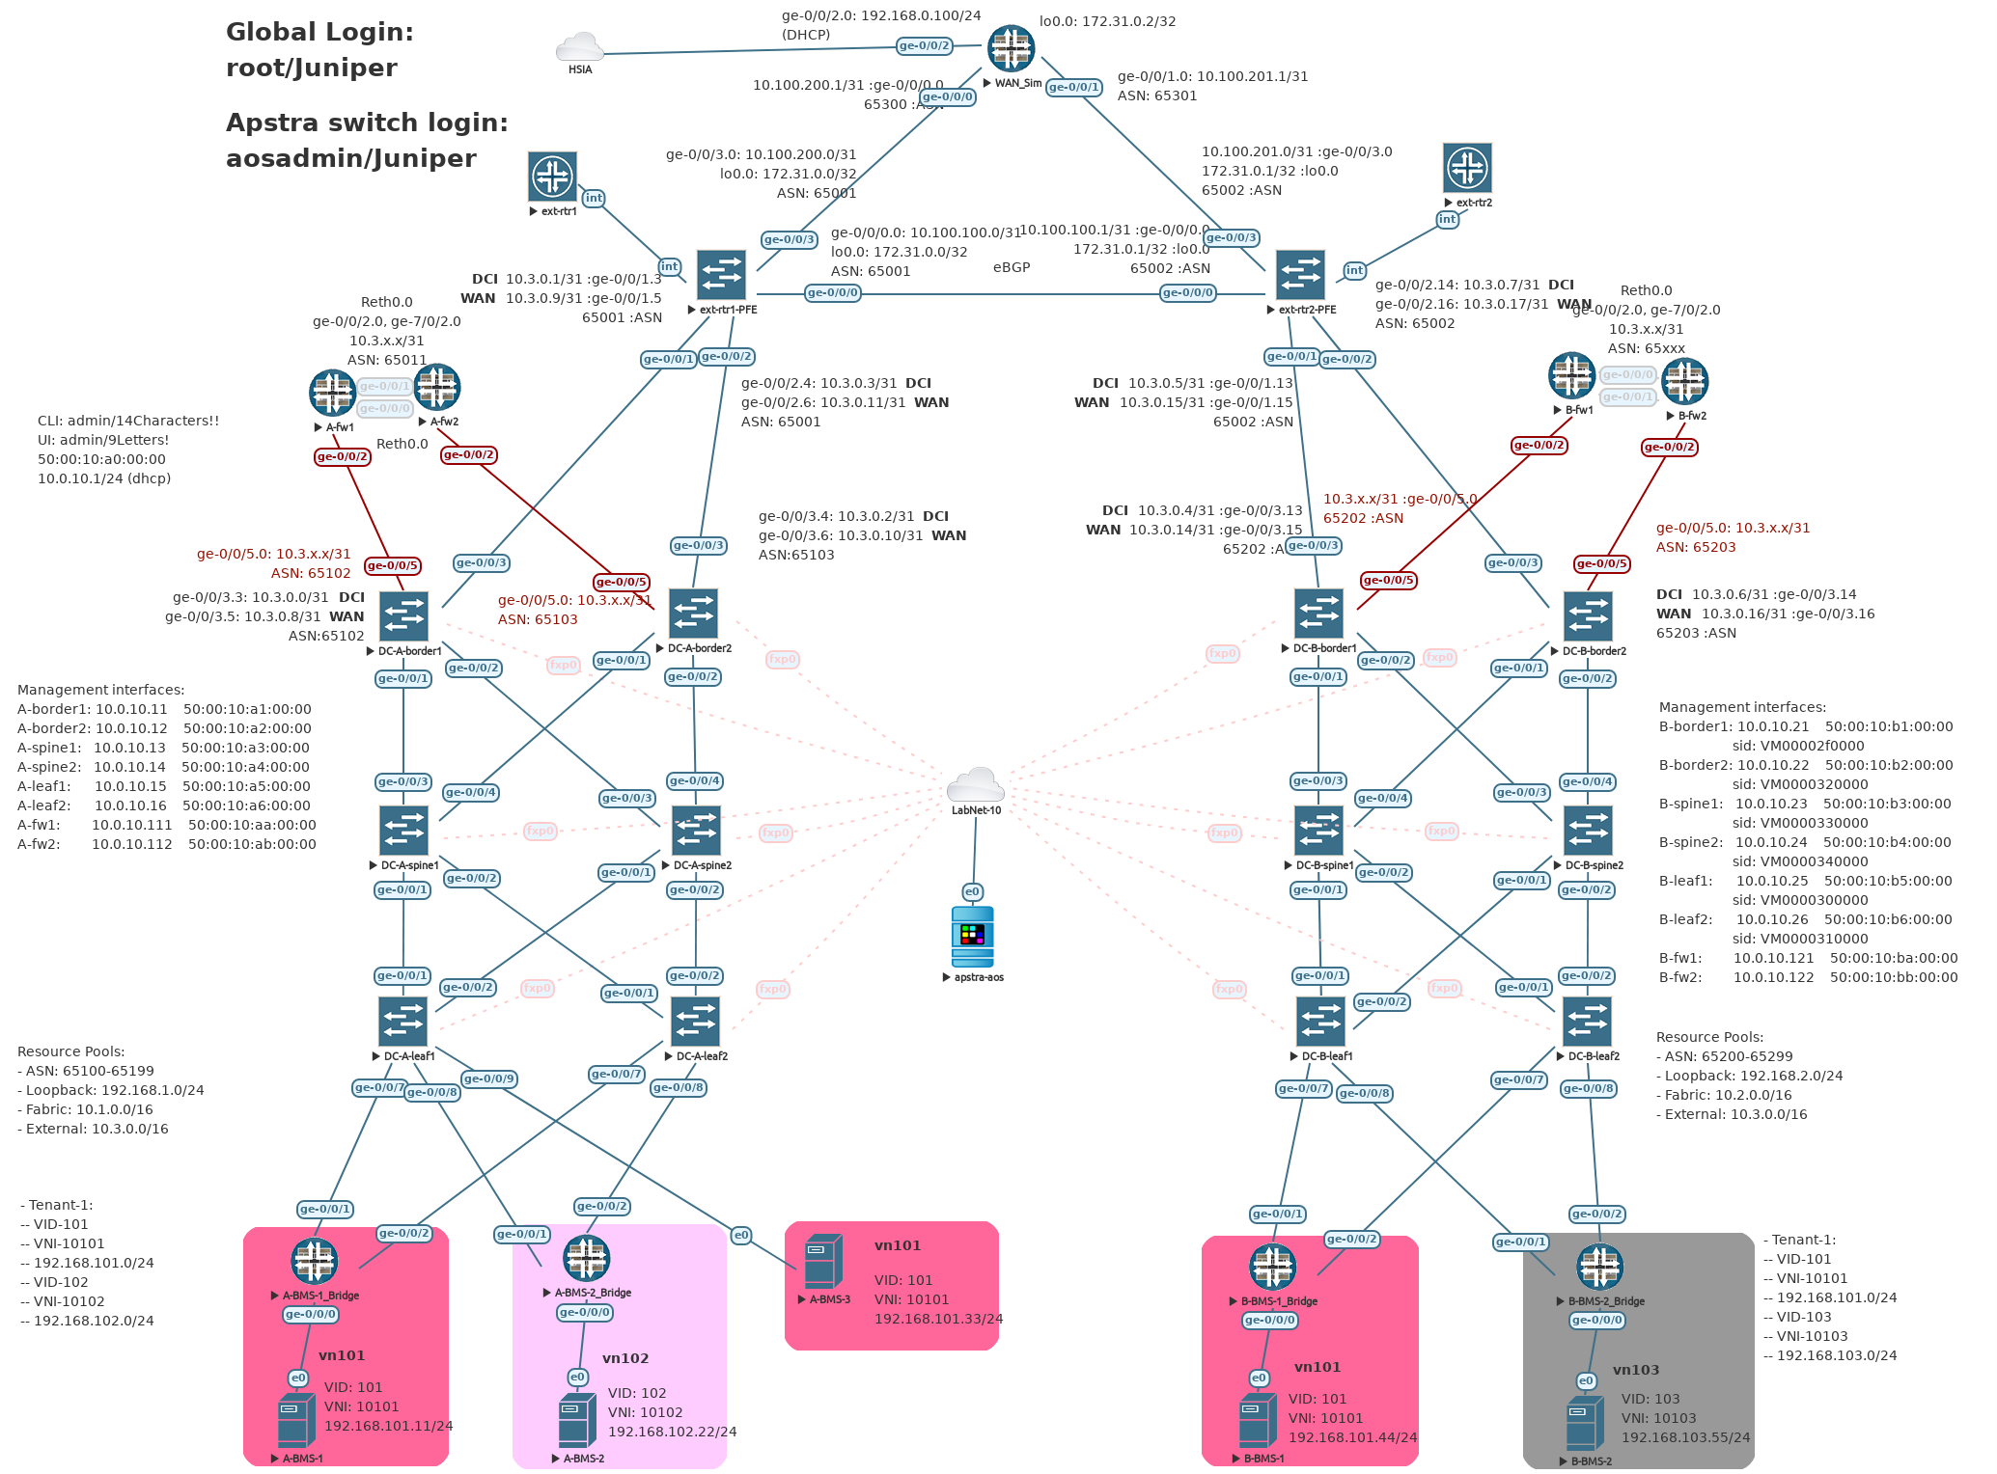
Lab Topology - Detail

Slide 8
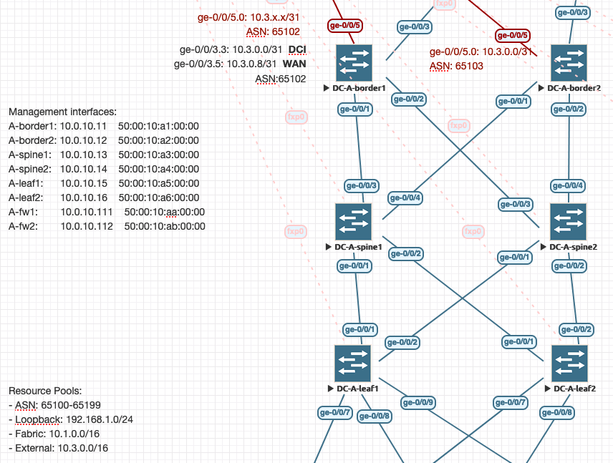
DC-A Fabric Detail
Data Center A Management Interfaces
Name | Mgmt MAC | Mgmt IP
A-border1 | 50:00:10:a1:00:00 | 10.0.10.11
A-border2 | 50:00:10:a2:00:00 | 10.0.10.12
A-spine1 | 50:00:10:a3:00:00 | 10.0.10.13
A-spine2 | 50:00:10:a4:00:00 | 10.0.10.14
A-leaf1 | 50:00:10:a5:00:00 | 10.0.10.15
A-leaf2 | 50:00:10:a6:00:00 | 10.0.10.16
A-fw1 (SRX node0) | 50:00:10:aa:00:00 | 10.0.10.111
A-fw2 (SRX node1) | 50:00:10:ab:00:00 | 10.0.10.112

Slide 9
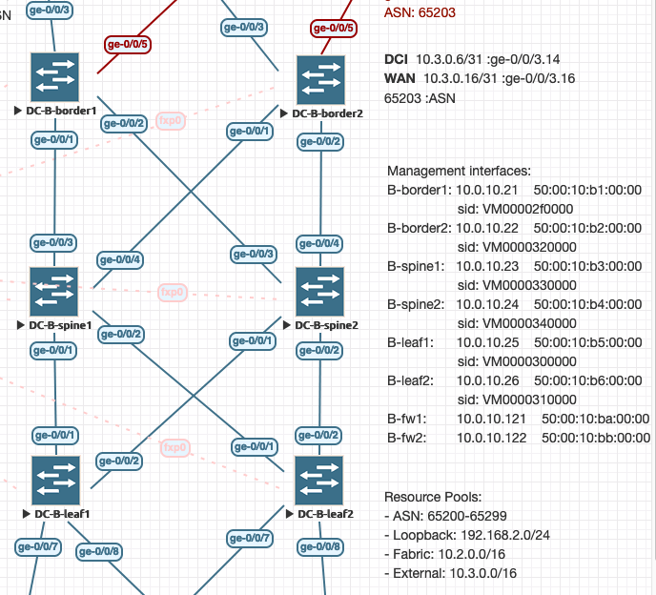
DC-B Fabric Detail
Data Center A Management Interfaces
Name | Mgmt MAC | Mgmt IP
B-border1 | 50:00:10:b1:00:00 | 10.0.10.21
B-border2 | 50:00:10:b2:00:00 | 10.0.10.22
B-spine1 | 50:00:10:b3:00:00 | 10.0.10.23
B-spine2 | 50:00:10:b4:00:00 | 10.0.10.24
B-leaf1 | 50:00:10:b5:00:00 | 10.0.10.25
B-leaf2 | 50:00:10:b6:00:00 | 10.0.10.26
B-fw1 (SRX node0) | 50:00:10:ba:00:00 | 10.0.10.121
B-fw2 (SRX node1) | 50:00:10:bb:00:00 | 10.0.10.122

Slide 10
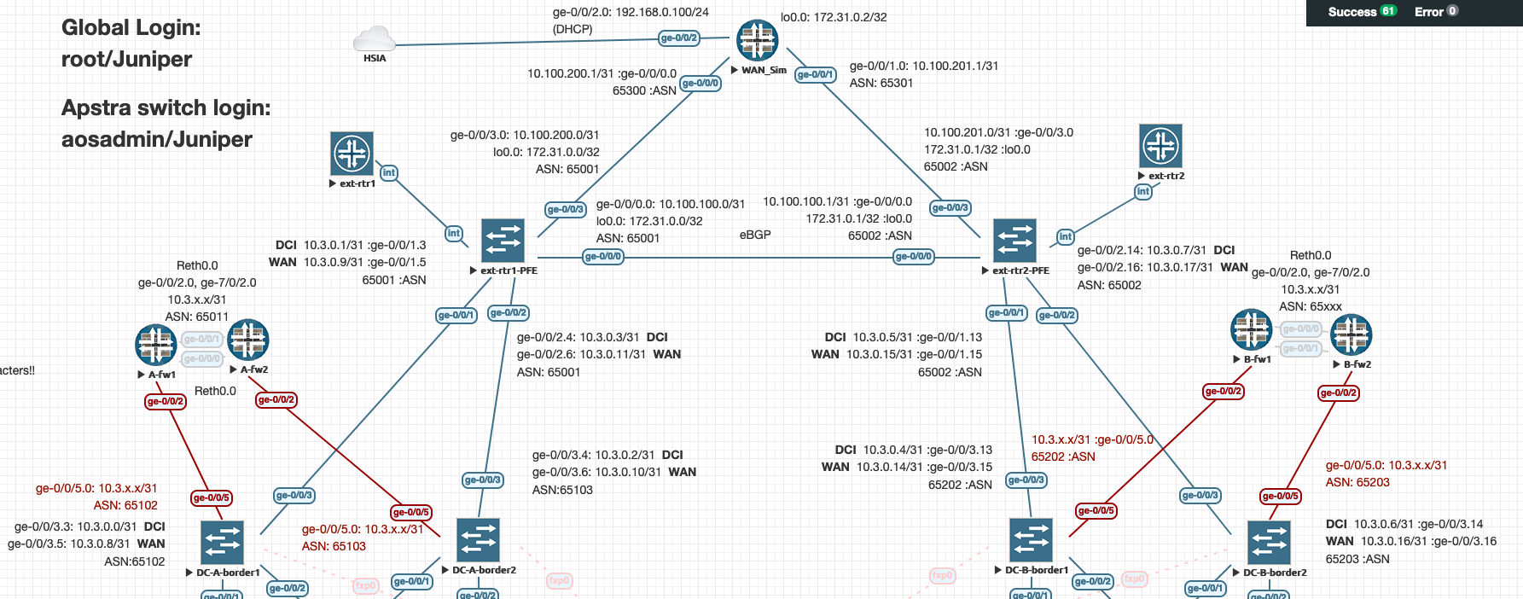
Hosts, DCI, and Service Blocks
Note: DCI/WAN networks shown represent the final state of the lab. The intermediate (pre-WAN) state is not shown in this diagram.

Slide 11
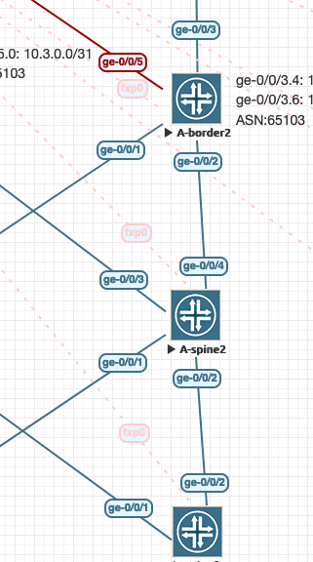
Color-Coding Links (if you want…)
You’ll note some of the links in my topology are a different color.
OoB Links – You cannot hide links in eve-ng, so I recommend changing the link “style” to make them blend into the background a bit.
Right-click the link (easiest to click the name on the link) and select “Edit Style”
Style: Dashed
Link color: FFCCCC
Link Style: StateMachine
Pos (fxp0): use slider to move link name so it’s in a good place
Service Block Links – I made these red because the density of links at the border leafs was making things pretty busy.
Ultimately, this is about making things visually easier to interpret. Adjust as-needed to your liking.

Slide 12
Issues and Caveats – 1 of 2
Issues:
If you want to use vEvo, it is a nested image and requires a bare metal install of eve to function
If you are running eve as a v/m, replace vEvo nodes with vJunos nodes
If you encounter links that are not passing traffic, it is always and “eve thing”, not the node image
Shutdown the nodes on either side of the link (or just the node that is grumpy if you know which one it is), run the eve “fix-permissions” command, and power-up/test
If that doesn’t work, turn off the node and use the “wipe” command (right-click menu), then power-up/test
If all else fails, delete the node and redeploy
NODE: once links are working, they won’t break again unless nodes are powered off without being shutdown from CLI (or a power event)
Caveats:
My eve-ng BMS build
HP DL380 Gen9
2x Xeon E5-2696 v4 @ 2.20GHz (44 cores/88 CPU’s)
256GB RDIMM DDR4 @ 2400MHz
2Tb Disk
Lab resource usage
~ 18% CPU
~35% Memory
32 nodes online
OoB in Eve
“LabNet-10” in my topology is a “Cloud” eve interface that acts as a vSwitch connected to one of the physical interfaces on my server – you can deploy however you like so long as Apstra can talk to nodes, and you can reach Apstra with a web browser

Slide 13
Issues and Caveats – 2 of 2
Issues:
Memory Issues
If you get close to running out of memory, weird things start to happen. Most notably management sessions (ssh/http) will start dropping
BMS “bridge” nodes
There are few things I hate more than trying to get LACP working in Linux. If you can get it working, great. To spare myself the pain, I have deployed vSRX nodes to act as a LACP bridge between the ESI-LAG links on the fabric leaf switches and the uMate nodes used to simulate connected servers
Yes, LACP in Linux counts as an Issue and not a Caveat!
Caveats:
Static node MAC’s
Since I’m using DHCP for fabric node management IP addressing, having deterministic MAC addresses is important
I have multiple labs and eve was assigning overlapping MAC’s, so I statically configured my MAC’s – you might be able to skip this step
What about the “sid” values from the 4.0.2 video series?
Thank goodness, this is an artifact of older versions of virtual switches and Apstra… These values needed to be unique and statically set when using vQFX

Slide 14
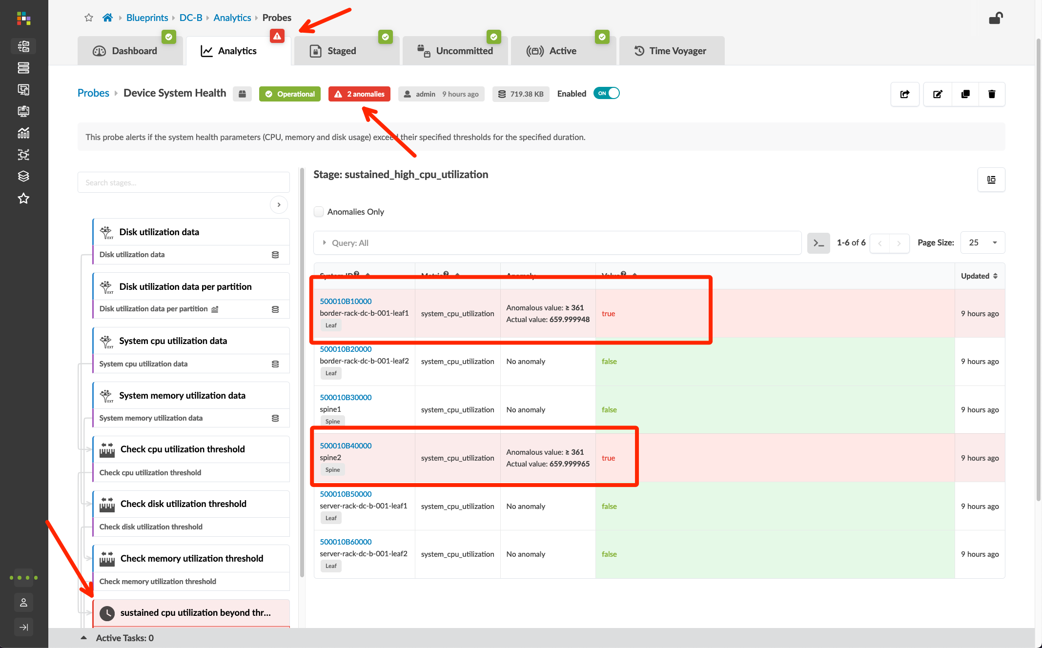
Issues and Caveats – 3 of 2 (things I discovered during the first build)
Issues:
Sustained CPU Anomaly
If you see this error, it is a memory leak with the on-switch dhcpd process
“show chassis routing-engine” is going to show load-averages well over 1.00
“show system processes extensive” will show jdhcpd process using quite a bit of CPU
Note the PID #
“request system process terminate <PID>”
This will bounce the service and clear the anomalies (they never came back, even after a month of uptime)

Slide 15
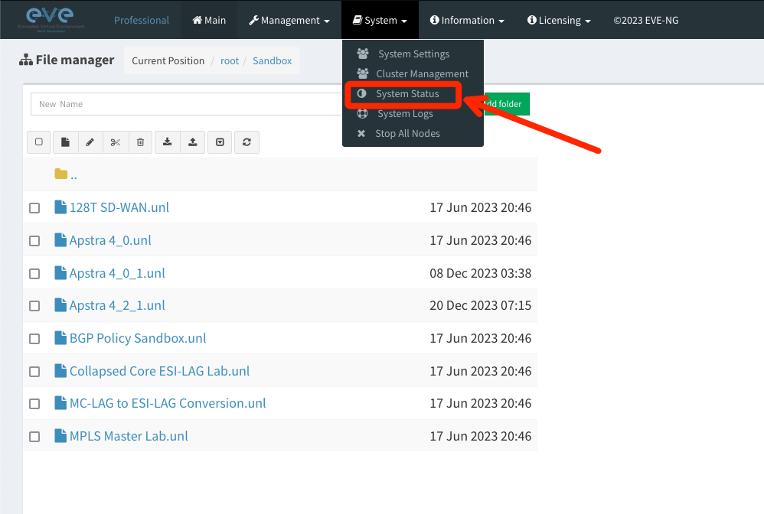
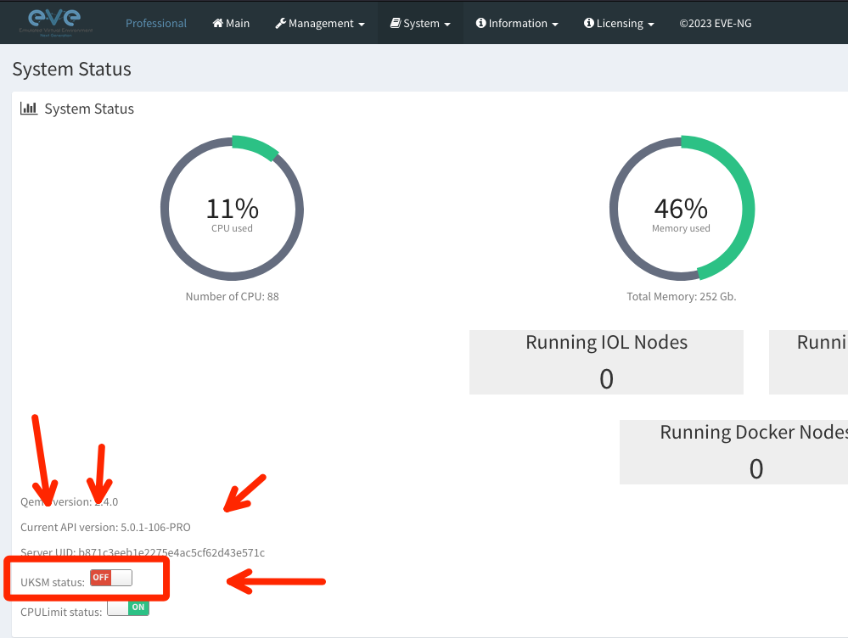
Issues and Caveats – 4 of 2 (things I discovered during the first build)
Issues:
TURN OFF UKSM!!!!
Once your lab starts to get big, UKSM will cause all sorts of weird problems
CLI hangs
CLI errors
Weird peering issues
Nodes not booting
All sorts of unpredictable behavior
Under the System menu, select System Status and turn off UKSM
If the button doesn’t let you toggle, turn off your labs – reboot if you have to – this needs to be OFF

Slide 16
Zero Touch Provisioning and DHCP
It’s possible to provision vJunos using the ZTP workflow, but it’s not zero touch. If you want to practice doing ZTP in a virtual lab, you can, but that is out of the scope of this walkthrough.
For my eve-ng lab, I am using a DHCP server running off a hardware firewall in my home network. For your lab, you can do something similar, use the DHCP service that deploys with the Apstra ZTP server node, or setup statics.
Remember, Apstra requires OoB connectivity, so ZTP/OTP is for addressing your management interfaces. This is “fxp0” in vJunos, and “re0:mgmt-0” on vEvo. I know, I know. They should be the same across platforms. We’re working on it…
The instructions will assume that the management interfaces on your virtual nodes are already configured with appropriate IP addresses and connected to a vSwitch that is also connected to your Apstra server.

Slide 17
Prepping your switches
NOTE: vEvo prep is included for reference. A vEvo fabric is out of scope of this documentation.
You only need to do this once, so I suggest being patient, booting one node at a time, doing the one-time configuration below, then testing reachability to the Apstra server (remember to source your ping from the mgmt_junos routing-instance). Once all nodes are up, you can install agents in batches.
There is no password for initial configuration – login as ”root”, then type “cli” to enter operational mode.
vJunos:
Enter “configuration exclusive”, type “delete”, and hit enter, and answer “yes” to delete the entire config
set system root-authentication plain-text-password
Juniper
set system login user aosadmin class super-user authentication plain-text-password
Juniper
set interfaces fxp0.0 family inet dhcp
set system management-instance
set routing-instances mgmt_junos description mgmt_junos
set system services netconf ssh
set system commit synchronize
commit and-quit
vEvo (let it boot completely – about 6m):
Enter “configuration exclusive”, type “delete”, and hit enter, and answer “yes” to delete the entire config
set system root-authentication plain-text-password
Juniper
set system login user aosadmin class super-user authentication plain-text-password
Juniper
set interfaces re0:mgmt-0.0 family inet dhcp
set system management-instance
set routing-instances mgmt_junos description mgmt_junos
set system services netconf ssh
set system services ssh
commit and-quit

