Slide 1
128 Technology Multi-Point SVR (Multicast)

Slide 2
Multi-POINT Introduction
The SENDERS send
Multicast Addressing - rfc1700
class D (224.0.0.0 - 239.255.255.255)‏
The RECEIVERS inform the routers what they want to receive
Internet Group Management Protocol (IGMP) - rfc2236 -> version 2
The routers make sure the STREAMS make it to the correct receiving nets.
Multicast Routing Protocols (PIM-SM/SSM)‏
RPF (reverse path forwarding) – against source address
2

Slide 3
Multi-POINT Introduction
http://www.iana.org/assignments/multicast-addresses
Examples of Reserved & Link-local Addresses
224.0.0.0 - 224.0.0.255 reserved & not forwarded
239.0.0.0 - 239.255.255.255 Administrative Scoping
232.0.0.0 - 232.255.255.255 Source-Specific Multicast
224.0.0.1 - All local hosts
224.0.0.2 - All local routers
224.0.0.4 - DVMRP
224.0.0.5 - OSPF
224.0.0.6 - Designated Router OSPF
224.0.0.9 - RIP2
224.0.0.13 - PIM
224.0.0.15 - CBT
224.0.0.18 - VRRP
3

Slide 4
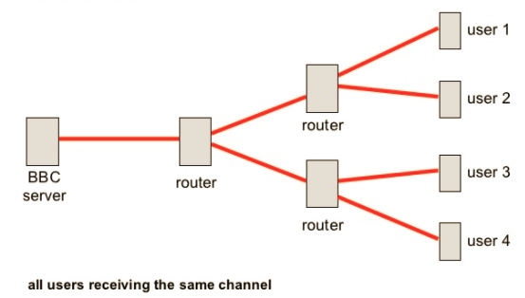
Multi-Point SVR

Slide 5
Multi-POINT SVR
Multipoint SVR
Overlapping IP Addresses
Session Migration
UFTP Multicast / Multipoint
VLC Video Multicast / Multipoint
Joins IGMP
Bandwidth Rate-Limiting
5

Slide 6
Multicast POC
Conductor (Minneapolis, MN)
Branch 1 Boston, MA
Conductor Mgmt.
192.168.1.70
Multicast Client1
192.168.64.2
LAN-interface
192.168.64.1/24
Datacenter (Cheyenne, WY, USA)
WAN1 10.0.128.0/31
Mgmt.
192.168.1.61/24
..
LAN x.x.x.x
Multicast Client2
WAN1 10.0.128.1/31
Internet
Branch 2 Atlanta, GA
Multicast Server
LAN-interface
172.16.128.1/24
SVR Secure Vector Routing
WAN2 10.0.129.1/31
Data Center Mgmt.
192.168.1.60/24
WAN2 10.0.129.0/31
LAN-interface
172.16.128.2/24
Multicast Client1
192.168.65.2
LAN-interface
192.168.65.1/24
Meta Data Constant Flow → → →
Mgmt.
192.168.1.62/24
..
Multicast Client2
6

Slide 7
Multicast POC Overlapping IP Addresses
Conductor (Minneapolis, MN)
Branch 1 Boston, MA
Conductor Mgmt.
192.168.1.70
Multicast Client1
192.168.64.2
LAN-interface
192.168.64.1/24
Datacenter (Cheyenne, WY, USA)
WAN1 10.0.128.0/31
Mgmt.
192.168.1.61/24
..
LAN x.x.x.x
Multicast Client2
WAN1 10.0.128.1/31
Internet
Branch 2 Atlanta, GA
Multicast Server
LAN-interface
172.16.128.1/24
SVR Secure Vector Routing
WAN2 10.0.129.1/31
Data Center Mgmt.
192.168.1.60/24
WAN2 10.0.129.0/31
LAN-interface
172.16.128.2/24
Multicast Client1
192.168.64.2
LAN-interface
192.168.64.1/24
Mgmt.
192.168.1.62/24
..
Multicast Client2
7

Slide 8
Multicast POC Session Migration
Conductor (Minneapolis, MN)
Branch 1 Boston, MA
Conductor Mgmt.
192.168.1.70
Multicast Client1
192.168.64.2
LAN-interface
192.168.64.1/24
Datacenter (Cheyenne, WY, USA)
WAN1 10.0.128.0/31
Mgmt.
192.168.1.61/24
..
LAN x.x.x.x
Multicast Client2
WAN3 10.0.127.0/31
SVR Secure Vector Routing
WAN1 10.0.128.1/31
Internet
Branch 2 Atlanta, GA
Multicast Server
LAN-interface
172.16.128.1/24
WAN 3 10.0.127.1/31
WAN2 10.0.129.1/31
WAN4 10.0.130.0/31
WAN4 10.0.130.1/31
Data Center Mgmt.
192.168.1.60/24
WAN2 10.0.129.0/31
LAN-interface
172.16.128.2/24
Multicast Client1
192.168.65.2
LAN-interface
192.168.64.1/24
Mgmt.
192.168.1.62/24
..
Multicast Client2
8

Slide 9
Multicast POC Session Migration
Conductor (Minneapolis, MN)
Branch 1 Boston, MA
Conductor Mgmt.
192.168.1.70
Multicast Client1
192.168.64.2
LAN-interface
192.168.64.1/24
Datacenter (Cheyenne, WY, USA)
WAN1 10.0.128.0/31
Mgmt.
192.168.1.61/24
..
LAN x.x.x.x
Multicast Client2
WAN3 10.0.127.0/31
SVR Secure Vector Routing
WAN1 10.0.128.1/31
Internet
Branch 2 Atlanta, GA
Multicast Server
LAN-interface
172.16.128.1/24
WAN 3 10.0.127.1/31
WAN2 10.0.129.1/31
WAN4 10.0.130.0/31
WAN4 10.0.130.1/31
Data Center Mgmt.
192.168.1.60/24
WAN2 10.0.129.0/31
LAN-interface
172.16.128.2/24
Multicast Client1
192.168.65.2
LAN-interface
192.168.64.1/24
Mgmt.
192.168.1.62/24
..
Multicast Client2
9

Slide 10
Multicast POC Failover
Conductor (Minneapolis, MN)
Conductor Mgmt.
192.168.1.70
Branch 1 Boston, MA
Datacenter (Cheyenne, WY, USA)
LAN x.x.x.x
Multicast Client1
192.168.64.2
LAN-interface
192.168.64.1/24
Multicast Server
Mgmt.
192.168.1.61/24
..
WAN1 10.0.128.0/31
Multicast Client2
SVR Secure Vector Routing
WAN3 10.0.127.0/31
LAN-interface
172.16.128.1/24
WAN1 10.0.128.1/31
WAN 2 10.0.129.1/31
LAN-interface
172.16.128.2/24
172.16.129.2/24
Data Center Mgmt.
192.168.1.60/24
Internet
Branch 2 Atlanta, GA
Datacenter2 (Santa Fe, NM, USA)
SVR Secure Vector Routing
WAN2 10.0.129.0/31
LAN x.x.x.x
WAN 3 10.0.127.1/31
WAN4 10.0.130.0/31
WAN 4 10.0.130.1/31
Multicast Client1
192.168.65.2
Multicast Server
LAN-interface
192.168.64.1/24
LAN-interface
172.16.129.1/24
Mgmt.
192.168.1.62/24
..
Multicast Client2
Data Center Mgmt.
192.168.1.59/24
10

Slide 11
Multicast POC Failover
Conductor (Minneapolis, MN)
Conductor Mgmt.
192.168.1.70
Branch 1 Boston, MA
Datacenter (Cheyenne, WY, USA)
LAN x.x.x.x
Multicast Client1
192.168.64.2
LAN-interface
192.168.64.1/24
Multicast Server
WAN1 10.0.128.0/31
Mgmt.
192.168.1.61/24
..
SVR Secure Vector Routing
WAN3 10.0.127.0/31
Multicast Client2
LAN-interface
172.16.128.1/24
WAN1 10.0.128.1/31
LAN-interface
172.16.128.2/24
WAN 2 10.0.129.1/31
Data Center Mgmt.
192.168.1.60/24
Internet
Branch 2 Atlanta, GA
Datacenter2 (Santa Fe, NM, USA)
SVR Secure Vector Routing
WAN2 10.0.129.0/31
WAN 3 10.0.127.1/31
WAN4 10.0.130.0/31
LAN x.x.x.x
WAN 4 10.0.130.1/31
Multicast Client1
192.168.65.2
Multicast Server
LAN-interface
192.168.64.1/24
LAN-interface
172.16.129.1/24
Mgmt.
192.168.1.62/24
..
Multicast Client2
LAN-interface
172.16.129.2/24
Data Center Mgmt.
192.168.1.59/24
11

Slide 12
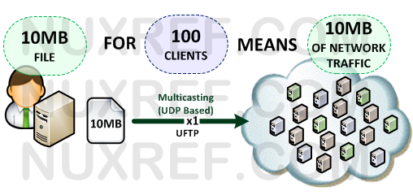
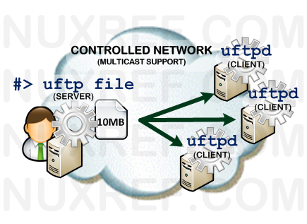
Testing UFTP Multicast
UFTP Multicast
Server side can also use –H to restrict who you pass multicast to.
Uftp filename –M 230.4.5.6 –i 172.16.128.2 –t 10 (Server Side)
Client using –X5 for debugging 1-5 logging
Uftpd –d –M 230.4.5.6 –x5

Slide 13
Testing VLC Server Multicast
Server side (VLC Receiver)
Open VLC and go to →Tools → Preferences-→
Then go to the bottom left corner and look for SHOW SETTINGS and click from “simple” to “All”
Then look for “Access OutPut” and change “hop limit (ttl)” from -1 to 10
In the Media menu, choose “Stream”
In the Open Media dialog file tab, click “add” and choose the file you want to stream and click “Open”
At the bottom, click the “Stream” button
This opens the “Stream Output” dialog showing the source file you have chosen. Click Next to set destination.
In “Destinations”, choose “RTP /MPEG Transport Stream” and click the “Add” button
In the “Address” box, enter the required multicast address (eg 239.255.0.1) and set the port (or leave default at 5004)
In transcoding options, choose the appropriate settings for your video and PC’s codecs. I chose “Video H.264 + MP3 (MP4)”. I had to set the options by clicking the options (screwdriver and spanner) button immediately to the right of the dropdown. In encapsulation, I chose MPEG-TS. In video codec, I set the bitrate to 4000kb/s
Once the options are set, click “Save”. Then click Next for “Option Setup” and select “Stream all elementary streams” then click stream.

Slide 14
Testing VLC Client Multicast
Client side (VLC Receiver)
To view the stream, open another instance of VLC media player (try it on the same PC before trying it over the network)
Choose Media/Open Network Stream
2. In address, enter rtp://@239.255.0.1:5004 – choose the correct address and port you entered when setting up the stream. Don’t forget to enter the “@” symbol after “rtp://” and before the multicast ip address!
3. Click “Play”

Slide 15
128 Technology Multi-Point SVR (Multicast) IGMP

Slide 16
Multi-POINT Introduction
The SENDERS send
Multicast Addressing - rfc1700
class D (224.0.0.0 - 239.255.255.255)‏
The RECEIVERS inform the routers what they want to receive
Internet Group Management Protocol (IGMP) - rfc2236 -> version 2
The routers make sure the STREAMS make it to the correct receiving nets.
Multicast Routing Protocols (PIM-SM/SSM)‏
RPF (reverse path forwarding) – against source address
16

Slide 17
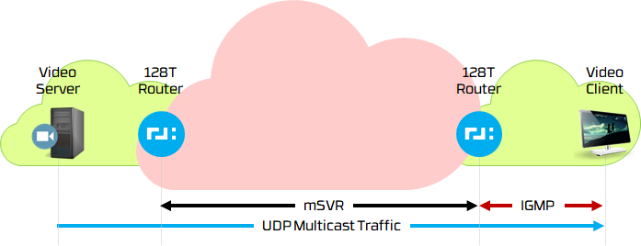
Joining a Multicast Group
The 128T router will implement IGMPv3. IGMPv3 is backward compatible so the 128T router will be able to support clients running IGMPv1, IGMPv2, and IGMPv3. No changes will be required on clients when relying on 128T routers in the network for multicast.
Note: MLDv2 provides analogous functionality to IGMPv3 for IPv6. It will be implemented (or enabled) when IPv6 functionality is available in the 128T networking platform. IPv6 multicast functionality is beyond scope of these requirements.
IGMP V2 / V3
The 128T router will implement IGMPv3. IGMPv3 is backward compatible so the 128T router will be able to support clients running IGMPv1, IGMPv2, and IGMPv3. No changes will be required on clients when relying on 128T routers in the network for multicast.
Note: MLDv2 provides analogous functionality to IGMPv3 for IPv6. It will be implemented (or enabled) when IPv6 functionality is available in the 128T networking platform. IPv6 multicast functionality is beyond scope of these requirements.

Slide 18
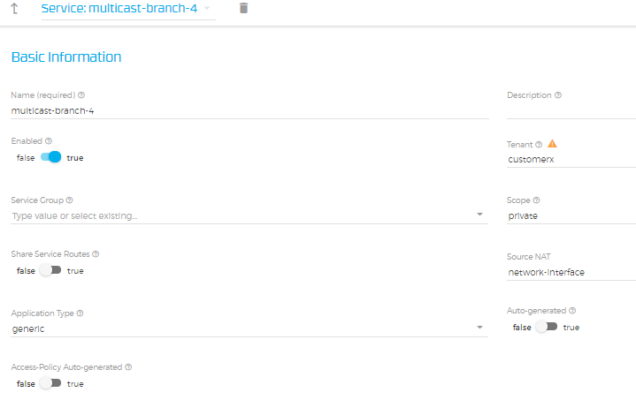
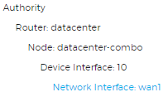
Datacenter Service Multicast Address
Unique Multicast
Specific /32 Address
No larger subnets
224.1.2.4/32
224.1.2.3/32

Slide 19
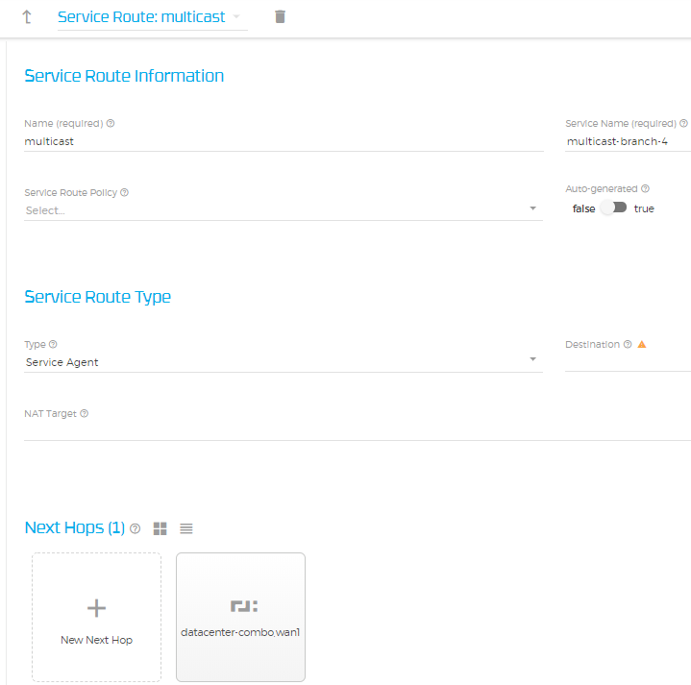
Datacenter Service Router Multicast

Slide 20
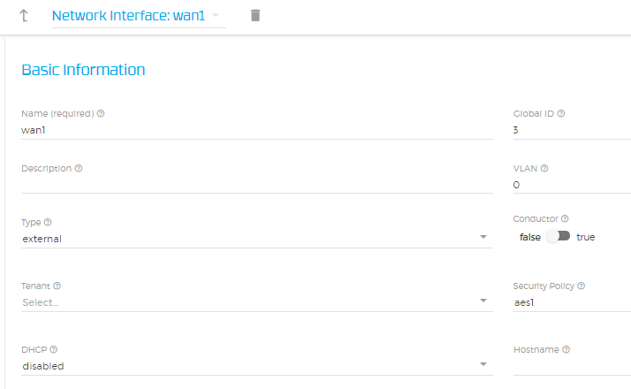
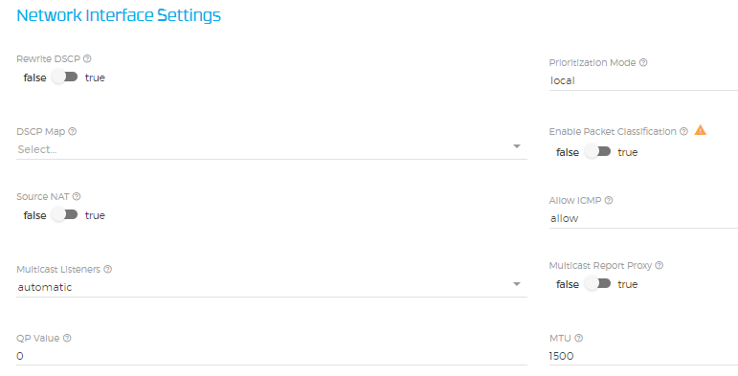
Datacenter Interface Multicast Configuration
Enables Sending of IGMP and MLD queries
(Multicast Listener Discovery)
Enabled (Activated)
Disabled (Deactivate)
Automatic (Activated)

Slide 21
Multicast POC PIM / IGMP Proxy
Conductor (Minneapolis, MN)
Branch 1 Boston, MA
Conductor Mgmt.
192.168.1.70
Mgmt.
192.168.1.61/24
..
PIM | IGMP Join
PIM
Multicast Client1
192.168.64.2
10.0.140.1/31
LAN-interface
192.168.64.1/24
Datacenter (Cheyenne, WY, USA)
LAN x.x.x.x
Multicast Client2
10.0.140.0/31
10.0.128.1/31
Branch 2 Atlanta, GA
Multicast Server
Multicast →
Internet
LAN-interface
172.16.128.1/24
10.0.128.0/31
10.0.141.0/31
Mgmt.
192.168.1.62/24
..
Data Center Mgmt.
192.168.1.60/24
LAN-interface
172.16.128.2/24
PIM Relay/Proxy
Multicast Client1
192.168.65.2
21
10.0.141.1/31
LAN-interface
192.168.65.1/24
PIM
PIM | IGMP Join
Multicast Client2
21

Slide 22
Testing VLC Client Multicast
Client side (VLC Receiver)
To view the stream, open another instance of VLC media player (try it on the same PC before trying it over the network)
Disable firewalld systemctl disable firewalld
Initiate the following command to run IGMP V2
Echo “2” | sudo tee /proc/sys/net/ipv4/conf/eth1/force_igmp_version
Choose Media/Open Network Stream
2. In address, enter rtp://@239.255.0.1:5004 – choose the correct address and port you entered when setting up the stream. Don’t forget to enter the “@” symbol after “rtp://” and before the multicast ip address!
3. Click “Play”

